Slide 1
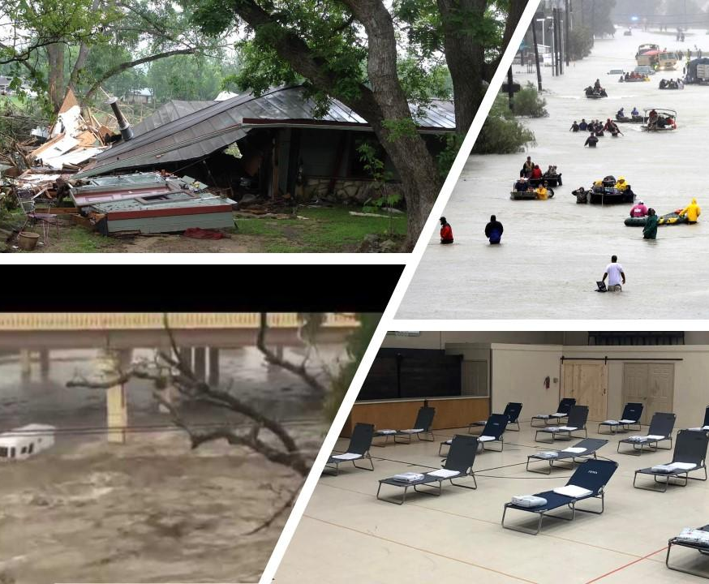
ARE YOU PREPARED ?
Community Preparedness and Awareness
Notes:
Presentation is designed to be presented to real estate agents for them to learn about community risks, preparedness and mitigation and organizations that can support them. There is a handout or email handout that can be emailed to all attendees after the presentation.

Slide 2


Introductions
Andy Cardiel – City of New Braunfels
Emergency Management Coordinator
Paul Ericksen – NBCERT
Search and Rescue Branch Director
Notes:
Introduce selves and your jobs

Slide 3
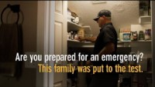
Video Link: https://www.youtube.com/watch?v=hhQqujnxmxk&t=2s
Notes:
Intro Video: How many feel their homes are prepared for a disaster? Don’t discuss to much leave the shock factor of the video can discuss more in next slide. NOTE Should be able to play video from slide it is embedded if it does not work the text below is a link that should play it in youtube

Slide 4
Types of Community Risks
Natural
Acts of Nature
Flash Flood - Flash Flood Alley
Technological
Accidents or Failure of System or Structure
Train Derailment – Community filled with train tracks
Human-Caused
Intentional Acts
Active Attack – Could happen anywhere
Tornado – Geronimo 2015
Winter Storm – Uri - Feb. 14-15, 2021
Dam Failure – Lake McQueeny - example
Shooter Attack - Uvalde
Cyber Attack - Everywhere
Explosive Attack – Boston Marathon
Utility Disruption – Rolling black-outs to longer outages
To understand community preparedness,
first explore the risks to communities
Notes:
The Video talked about a wildfire which is a possibility here what are the other types of risks to the community.

Slide 5
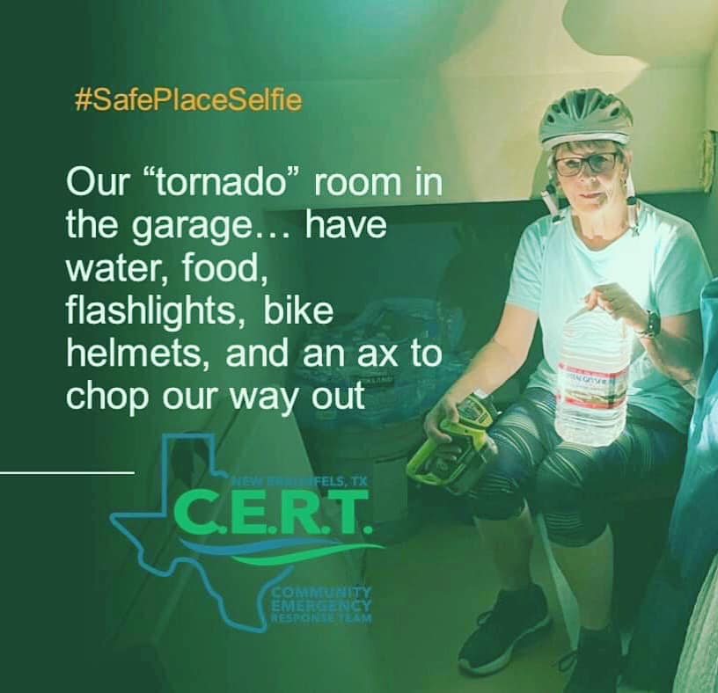
Community Preparedness
National Preparedness Goal*:
A secure and resilient Nation with the capabilities required across the whole community to prevent, protect against, mitigate, respond to, and recover from the threats and hazards that pose the greatest risk.
*https://www.fema.gov/sites/default/files/202006/national_preparedness_goal_2nd_edition.pdf
Notes:
Preparedness is the shared responsibility of our entire nation. The whole community contributes, beginning with individuals and communities, the private and nonprofit sectors, faith-based organizations, and all governments (local, regional/metropolitan, state, tribal1 , territorial, insular area2 , and Federal). ASK THEM WHAT DOES PREPAREDNESS MEAN TO THEM AND THEIR CLIENTS

Slide 6






Our Roles – Community Preparedness
Preparedness Partners
NBFD – NBPD
National Weather Service
FEMA – ready.gov
Community Members
NBCERT
Support Emergency Response
Support Community
Team Recruiting
Training & Education
Real Estate Agents
Provide for Clients
Community Experts benefits of area
Support resilient community
Training & Education
Emergency Management
Threat Assessments
EOC Operations
Policy & Procedure
Training & Education
Notes:
EXPLAIN: As A Whole Community Approach we all have roles and responsibilities to fill in preparing our community. We all share training and education as real estate agents they have a unique opportunity to discuss community preparedness and awareness with their clients and share where to get more information

Slide 7



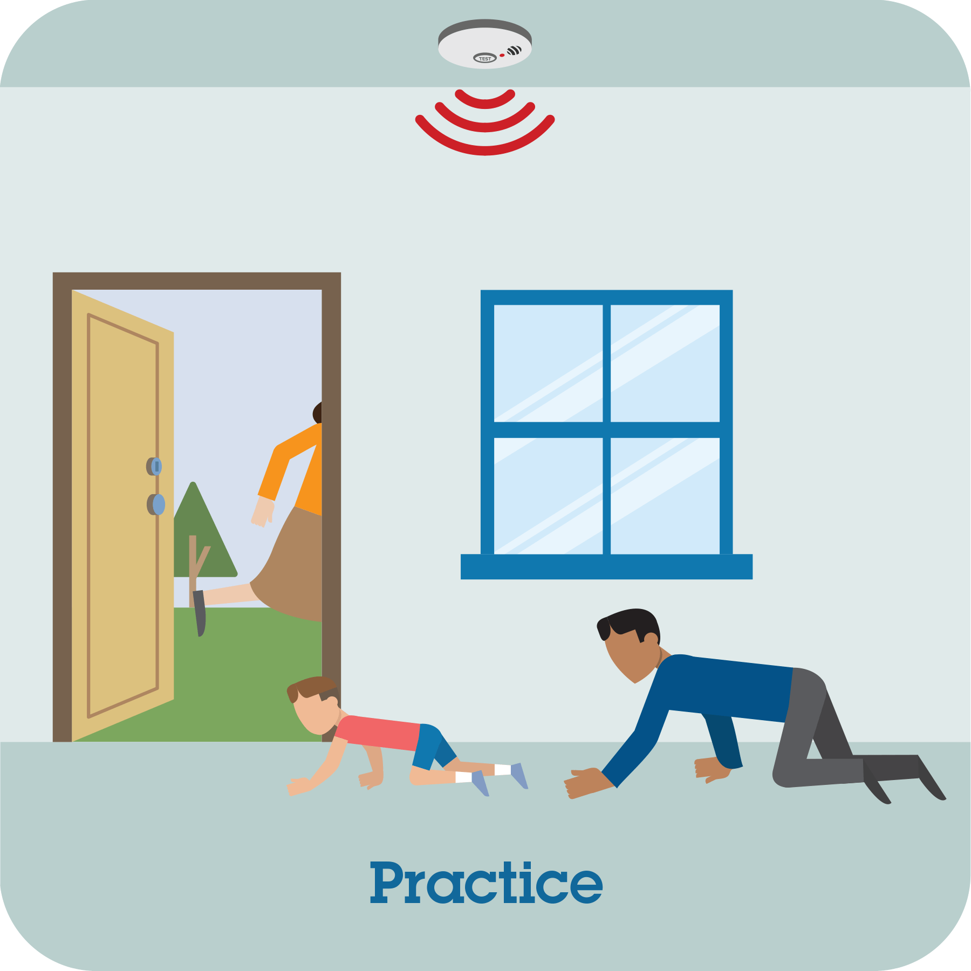
MAKE A PLAN FOR DISASTERS
Discuss with your Family
Consider Family Specific Needs
Create the Family Plan in Writing
Practice the Plan
Communications Plan
Evacuation Plan
Shelter Go or in Place Plan
Emergency Alerts and Warnings Plan
Ages of Household
Disability Needs
Language Spoken
Other locations – work/school
Work
Family Information
Meeting Places
Medical Information
Out of State Contacts
Run Home Fire Drills
Practice meetings at places
Run out of state contact drill
Do an Evacuation Drill
Notes:
Talk about first starts with discussing preparedness planning and making plans don’t forget to practice

Slide 8
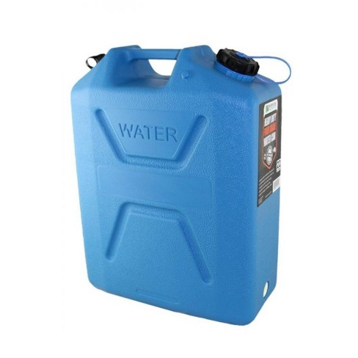
Home Emergency Supply Kit Basics – 72 hours at least
WATER
Min. 1 gallon per / person per day
For drinking, cooking and simple sanitation.
FOOD
Things that can be cooked on open flame or not cooked
Have a cooking source i.e. charcoal grill, smoker, open flame pit, solar cooker
Infant food needs
Pet Food
MEDICATIONS
Extra – just for emergency use
Work with your pharmacy
DOCUMENTS
Copies or USB drive with scanned
OTHER
Glasses & other personal
Flashlights & Fire Starters
Batteries & Chargers – Solar Chargers
First Aid Supplies
STOP THE BLEED KIT
Hand crank weather radio
Ham Radio – get your license
Non-Spark Utility Shut Off Tool
N95 Masks
Local Maps
Bags – garbage, zip lock
Burnable plates utensils
Reference Books
Games
CASH - secured in a safe location
5-gallon container: 1 for each person in household recommended, 1 for Pets and 1 for spare.
Notes:
Home Emergency Kits so if you have to shelter at home or if you have to take it too

Slide 9
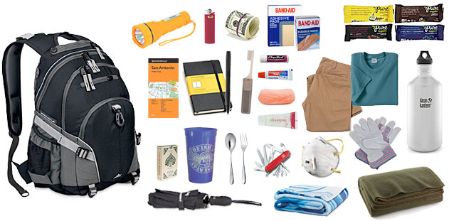
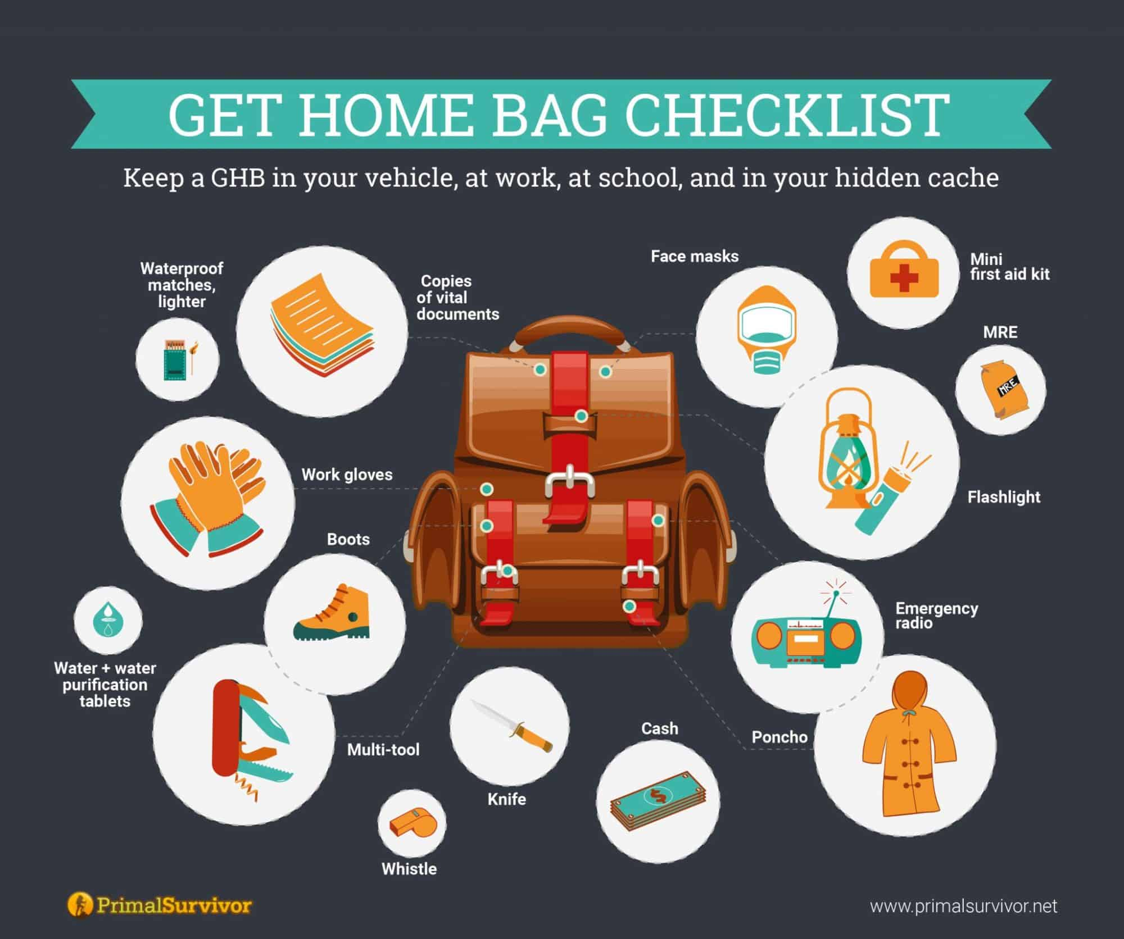
GO Bag/Kit Mini version of your home emergency supply kit - if you have to leave quickly. Still prepare for 72 hours.
Get Home Bag
For your car if you are stranded or have to walk home in a major disaster and roads are not available
Notes:
Go Bag verses Get home bag Mini emergency kits. One is to leave house on is to get home

Slide 10
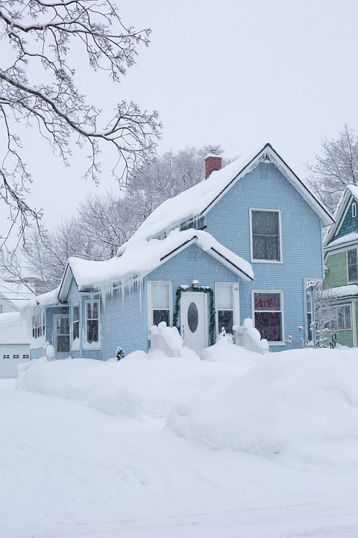


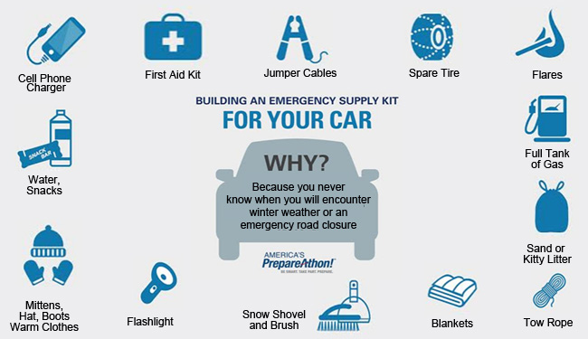
Winter Storm Preparedness
People & Pets
Home
Don’t Forget
During Storm
Have appropriate winter wear
Learn how to treat Frostbite & Hypothermia
Go over your plan & emergency supplies
Know Emergency Alerts
Check on neighbors
Insulation, caulking and weather stripping inside and out – Pipes
Trim tree branches so heavy snow/ice wont break
Fireplace safe & inspected
Outside vents & gutters clear of debris
Use generators & grills outdoor only
Reduce heart attack risk do not overexert shoveling
Install carbon monoxide detector
Have a winter car safety kit
Cover plants - bring inside
Fill a bathtub with water
Stay off the road
Stuff towels in door cracks
Close doors, & blinds in rooms, keep heat in
Emergency services may be delayed
Notes:
Chris asked specifically for a slide on winter storm preparedness Tis the season!

Slide 11
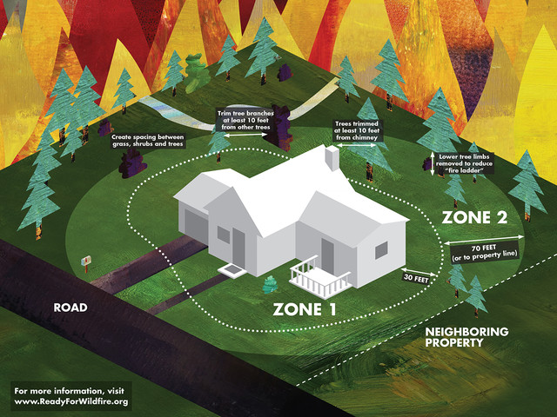

Other Home Safety Ideas
Home Mitigation
Safety by landscape design
Burn Break Zones around home
Fire Resistant plants landscaping
Secure tippy items
Inside and outside the home
Personal Cyber Security
All Weather Preparedness
People, Pets, Pipes & Plants
Target Hardening
Proper lighting - solar lighting – motion activated
Place low thorny plants near entryways and under 1st floor windows
Reduces hiding spots around home – trim bushes
Noisy ground cover – gravel under windows makes noise when stepped on more than grass
Add barriers – fences, gates and security cameras as part of landscaping
Notes:
Other ways to help make sure your home is safe and secure

Slide 12
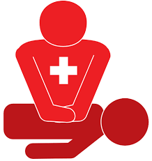


Additional Training for Families
Community Emergency Response Team
Stop the Bleed
CRASE
CPR/AED/Basic First Aid
Learn techniques to stop bleeding and possibly safe a life
Sponsor a local class
Learn possible ways to respond to an active attack
Run – Hide – Fight
Sponsor a local class
Learn more about preparedness
Emergency First Aid
Fire Safety
Light Search & Rescue
How to properly do CPR
When to use and AED
Basic First Aid
Attend a class
Notes:
Training is important in preparedness too. Tell the CERT could teach an until help arrives to their clients as well as STB with NBFD CRASE or CPR

Slide 13

Video Link: https://www.youtube.com/watch?v=6D_MmRz8gsU
Notes:
Intro Video: Summary video of what we have been discussing

Slide 14
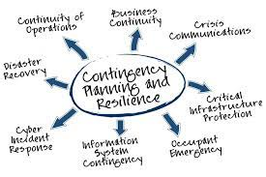
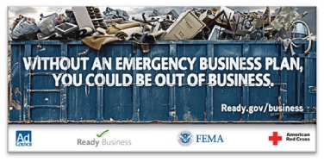
Business Disaster Preparedness Plan
How will your Business Operate in an Emergency or Disaster?
Business Emergency Communications Plan
Continuity of Business Plan
Data Plan
Alternate Location Plan
Notes:
Final Thought we talked a lot about your clients but do not forget your business You need a plan for that too.

Slide 15
Questions ?
Thank you for your time today.
You are Appreciated
Notes:
Questions

Slide 16
Contact Information
Andy Cardiel – City of New Braunfels
Emergency Management Coordinator
acardiel@newbraunfels.gov
820-221-4270
NBCERT Program Director
nbcertoffice@gmail.com
830-221-4223

