Slide 1

Welcome to new membership orientation

Slide 2
You will be participating in many zoom classes/meetings during your career so please take a moment to Review these Best Practices
Zoom Best Practices- If you can't do it in a classroom don’t do it on screen.
Camera On at all times
Mute yourself unless speaking
Be visible at all times, its important to show others your face not your ceiling.
No Working during this time, this is a required class with important information about your membership
NO DRIVING, this is a safely issue.
Breaks in the morning and afternoon with lunch from noon to 12:30.
Turn on the Chat feature – this is how we communicate with you.
Names on screen are a necessity
You must complete this class in its entirety to receive credit.

Slide 3
What is a Board of REALTORS® ?
3-tiered organization, each governed by a member elected Board of Directors:
NAR (founded in 1908)
TAR (chartered in1920)
Pre-merger existence (Chartered in the 1960’s) Local Association formed January 1, 2014

Slide 4
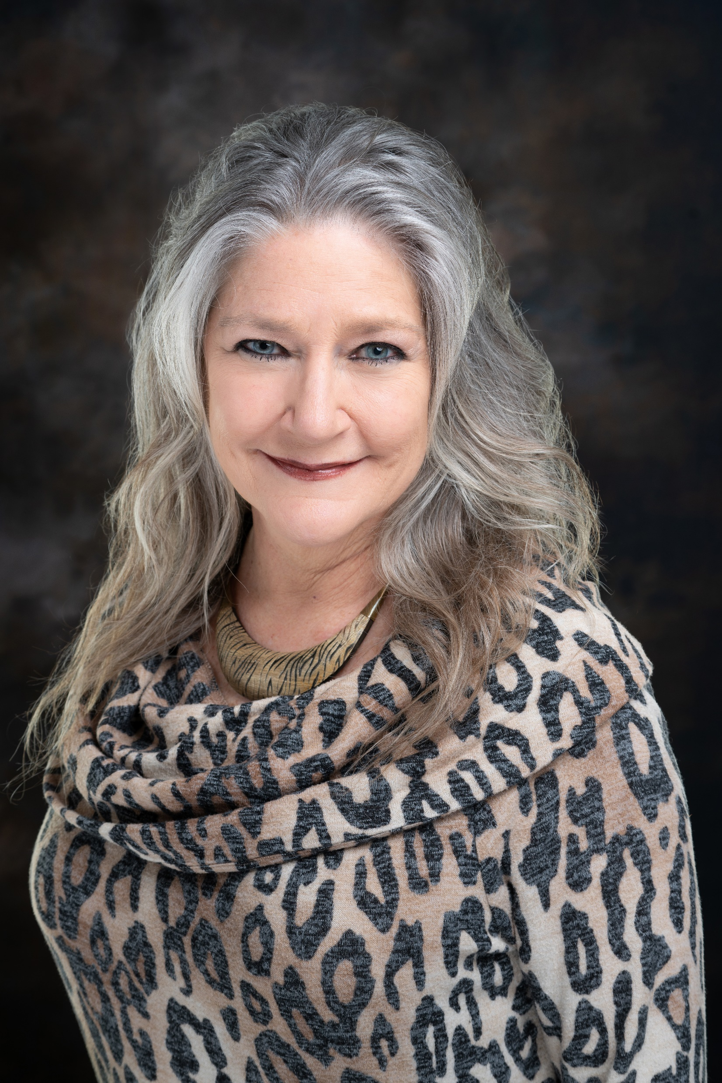
Introductions with Debbie homeier, 2022 President of four rivers association of realtors®
What is your name and what brokerage are you with?
How long have you been licensed and what is going to be your field of specialty? Residential, Commercial, Property Management or Farm and Ranch.
What was your profession or field of specialty before real estate?

Slide 5

FRAR Committee Descriptions:

Slide 6
Governmental Affairs: Passionate about politics? We are the Purple Party (The Real Estate Party) Members stay actively involved and monitor/take action on issues going on in our local areas and work in sub committees.
Scholarship: Support education and give back to the community by planning and hosting scholarship fundraisers, choose local student recipients for the program, and impact the lives of deserving families and students.
Professional Development: Coordinates/plans membership luncheons and important events (Market Forecast and REALTOR® Rally) to bring relevant content and knowledge to membership.
TREPAC: Awareness and PAC fundraising for the Texas Real Estate Political Action Committee) to support local and state REALTOR® Champions and communicate TREPAC success stories to Members and Property Owners.
FRAR MLS: Works to inform and education MLS Subscribers about how to use Matrix and CTXMLS Rules
& Regulations.
Professional Standards: Focus on education and training of professionalism, The Code of Ethics, and Standards of Practice with an emphasis on Broker Engagement.
NextGen: Built on aiding new member, 5 Years and Younger to the Real Estate Profession, through Lunch’n Learns, CE Classes, Panel discussions and community outreach projects. All REALTOR® Members welcome!

Slide 7
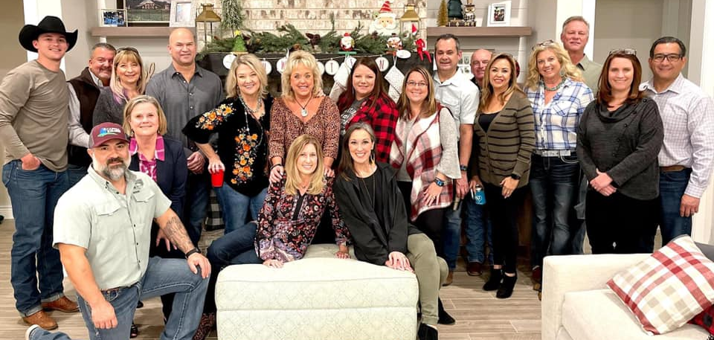
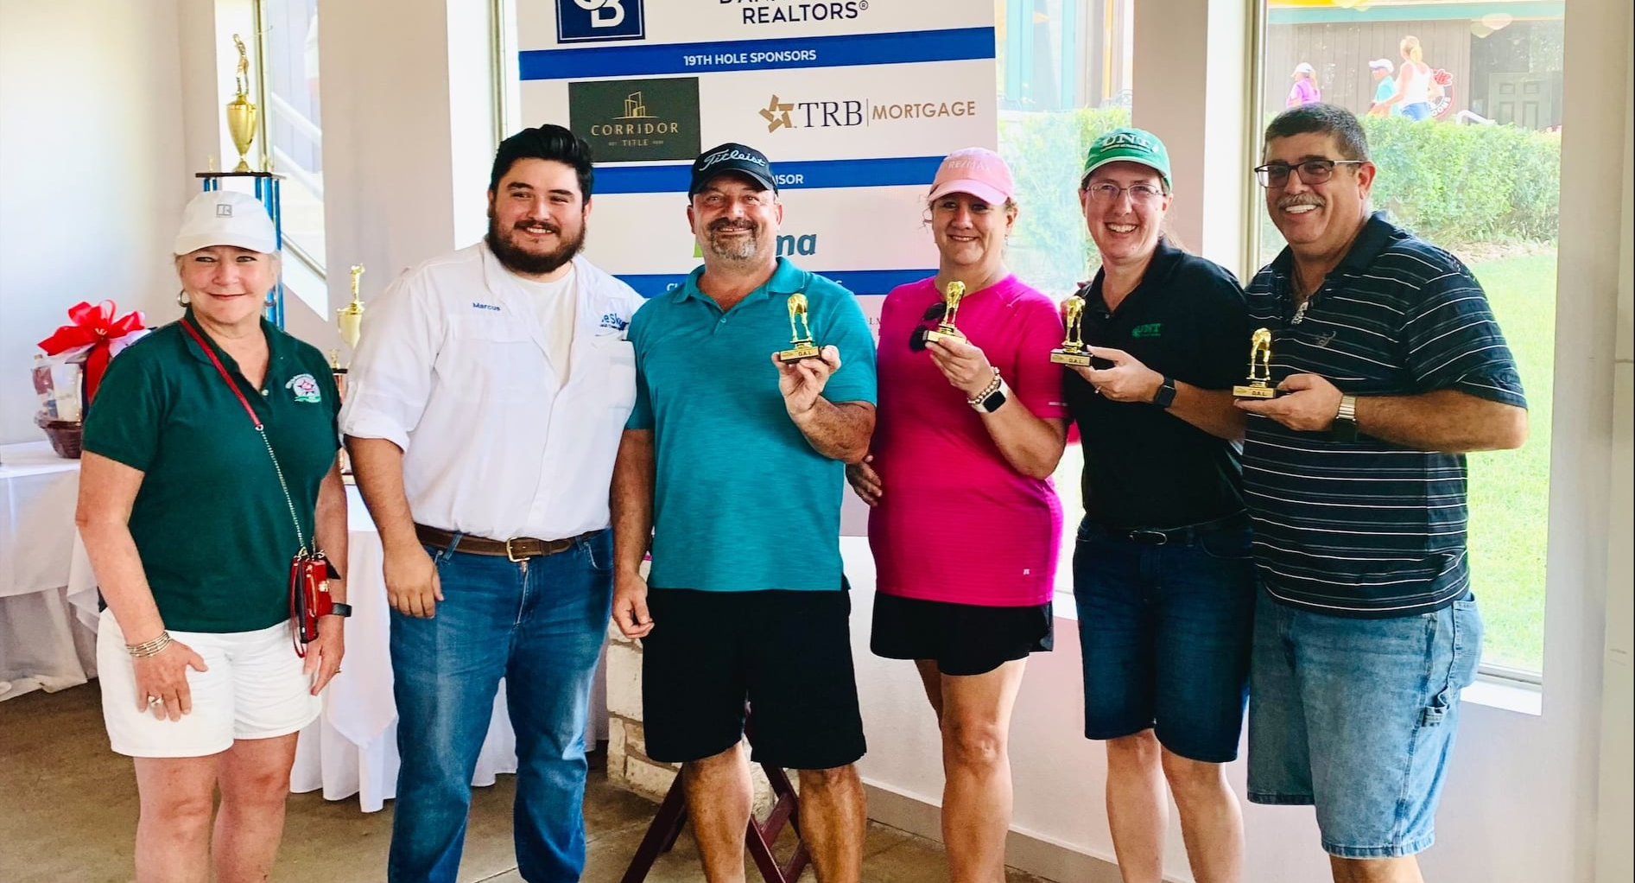

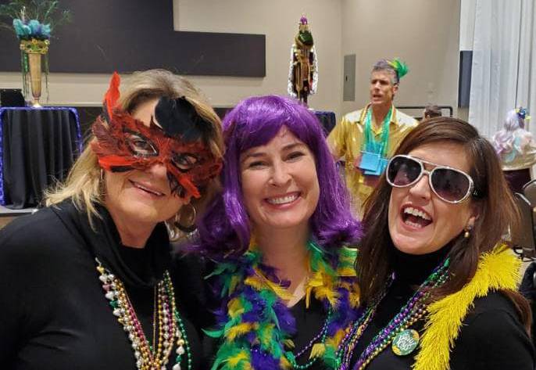
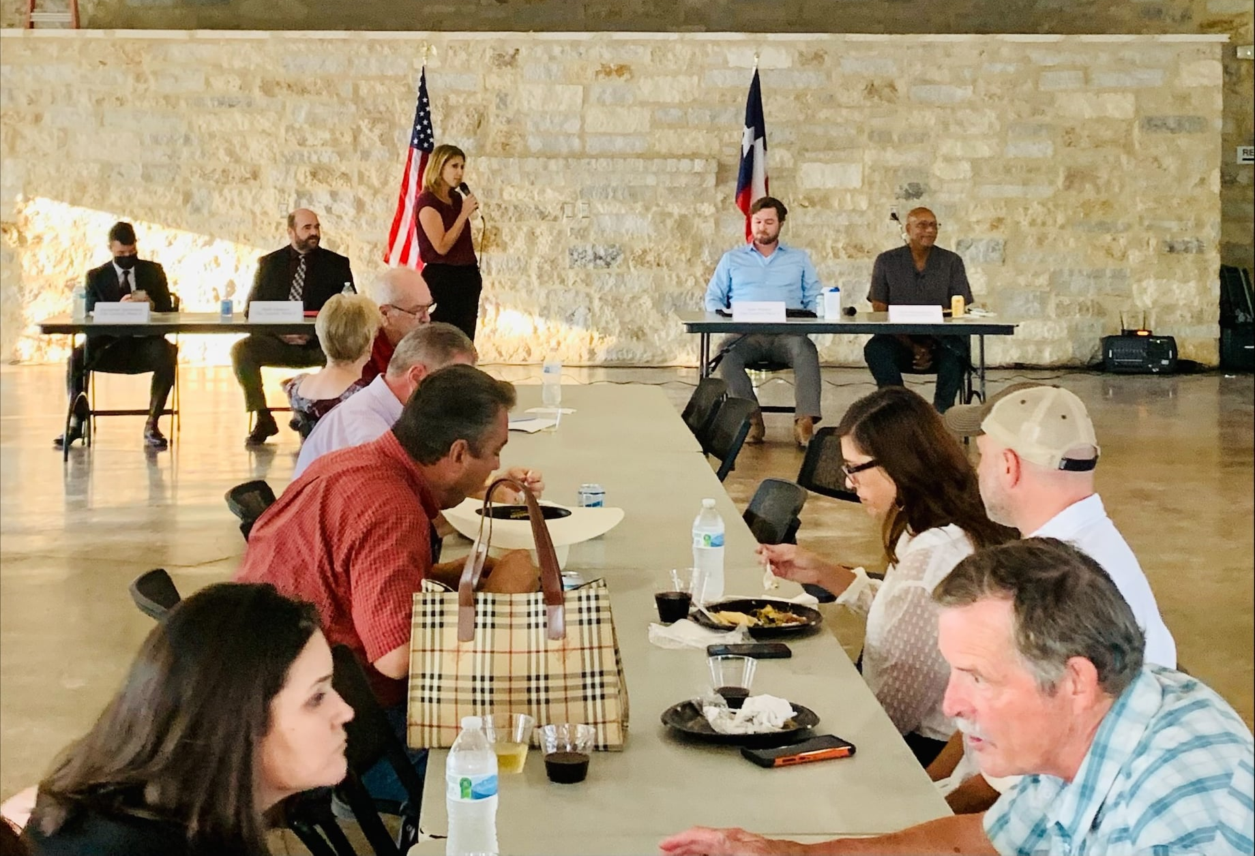
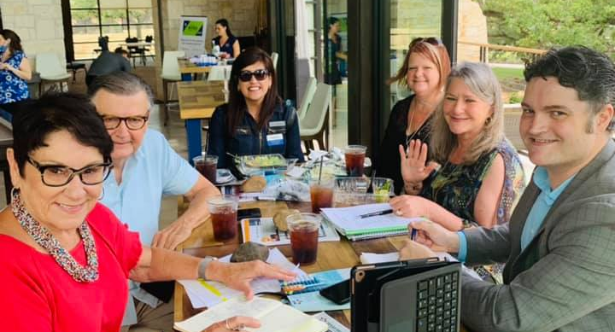
TREPAC Committee
Scholarship Committee
TREPAC Committee
Governmental Affairs Committee
NextGen Committee
TREPAC Committee

Slide 8


Slide 9
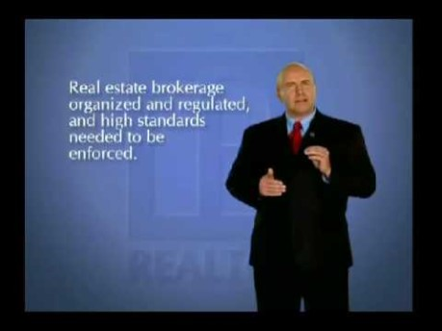
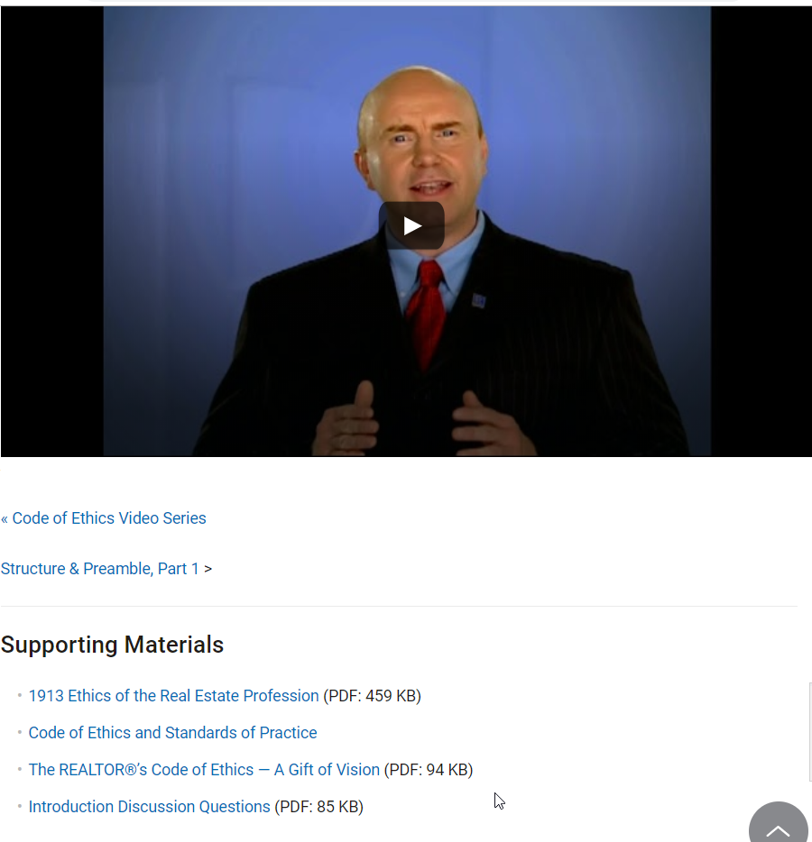

Slide 10
NAR Code of Ethics Training Requirement.
Failure to complete training during any cycle will lead to suspension of membership for the January and February immediately following the cycle deadline, with termination of membership starting March 1 after the cycle deadline.
Current Cycle
January 1, 2022, to December 31, 2024
Future Cycles
January 1, 2025, to December 31, 2027
January 1, 2028, to December 31, 2030

Slide 11
Contact the Broker
Contact the person's broker to inform him or her what happened. It could lead to a quick resolution.
Use the Ombudsman Program
A volunteer from the Texas REALTORS® Professional Standards Committee will listen to your concerns, explain possible resolutions, and answer questions.
File an Ethics Complaint
If contacting the broker and talking to an ombudsman don't resolve the problem, you can file a formal complaint.
File an Anonymous Complaint
For certain types of Code of Ethics violations, you can submit an anonymous complaint.
Arbitration
This process is used when you think you're owed money based on an agreement.

Slide 12

Pathways to Professionalism: Respect Starts Here

Slide 13

Fair Housing

Slide 14


Break time
10 Minutes

Slide 15
Casey Lee – Government Affairs Director
casey@fourriversrealtors.com
512-738-7053
LMT Chair
Ken Kiel
kkiel@cbharper.com
TREPAC Chair
Brenda Damron
brenda@thedamrongroup.com
Guadalupe County
Seguin
Ken Kiel
kkiel@cbharper.com
Hays County
San Marcos
Cody Lantelme
cody@carsonproperties.net
TREPAC Trustee
Peggy Jones
peggyjones@austinsa.com
Caldwell County
Jennifer Hellums
jhellums@cbharper.com
Political Involvement Comittee
Warren Hoskinson
hoskinsonrealestate@yahoo.com
Comal County
New Braunfels/Canyon Lake
Esther Boarnet
eboarnet@gmail.com
Gonzales County
Central Texas Field Rep
Nate Catey
ncatey@texasrealtors.com
737-262-6386

Slide 16
Advocacy is more than just political
Under all is the land. Upon its wise utilization and widely allocated ownership depend the survival and growth of free institutions and of our civilization. REALTORS® should recognize that the interests of the nation and its citizens require the highest and best use of the land and the widest distribution of land ownership. They require the creation of adequate housing, the building of functioning cities, the development of productive industries and farms, and the
preservation of a healthful environment.
Such interests impose obligations beyond those of ordinary commerce. They impose grave social responsibility and a patriotic duty to which REALTORS® should dedicate themselves, and for which they should be diligent in preparing themselves. REALTORS®, therefore, are zealous to maintain and improve the standards of their calling and share with their fellow REALTORS® a common responsibility for its integrity and honor.
In recognition and appreciation of their obligations to clients, customers, the public, and each other, REALTORS® continuously strive to become and remain informed on issues affecting real estate and, as knowledgeable professionals, they willingly share the fruit of their experience and study with others. They identify and take steps, through enforcement of this Code of Ethics and by assisting appropriate regulatory bodies, to eliminate practices which may damage the public or which might discredit or bring dishonor to the real estate profession.

Slide 17
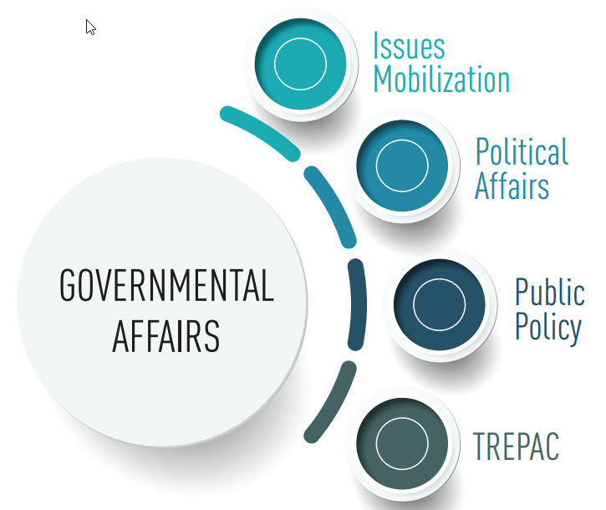
But it is political
Federal - NAR
State – Texas REALTORS®
Local – GA/TREPAC
Committees

Slide 18
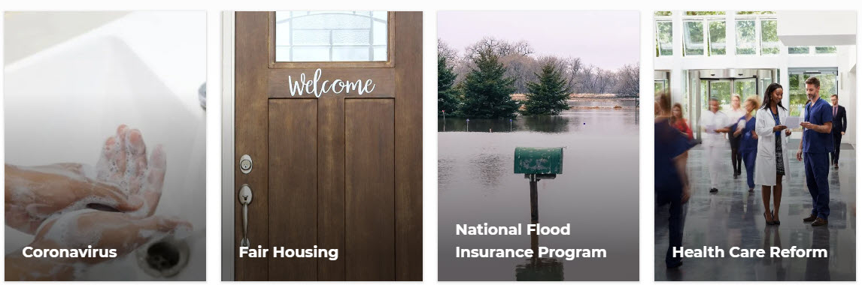

The National Association of REALTORS® advocates daily for 1.5 million REALTORS® and 75 million property owners.
NAR is one of the most effective advocacy organizations in the country.

Slide 19

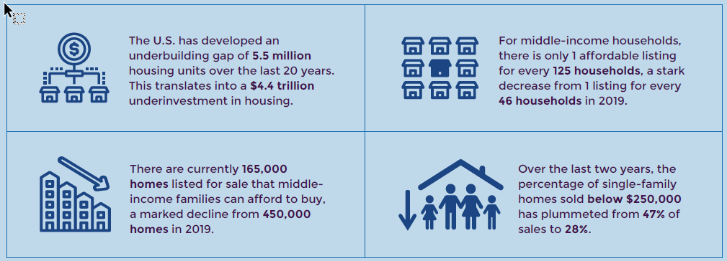

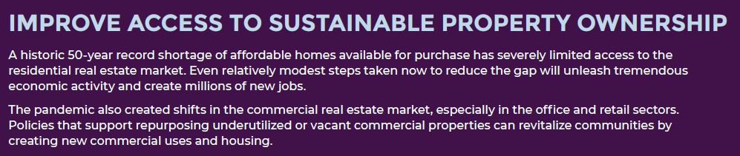

Slide 20


Slide 21
Every Session
Texas REALTORS® read every single bill …
Over 10,000 bills and resolutions filed during regular session
3000 tracked for potential impact on real estate

Slide 22

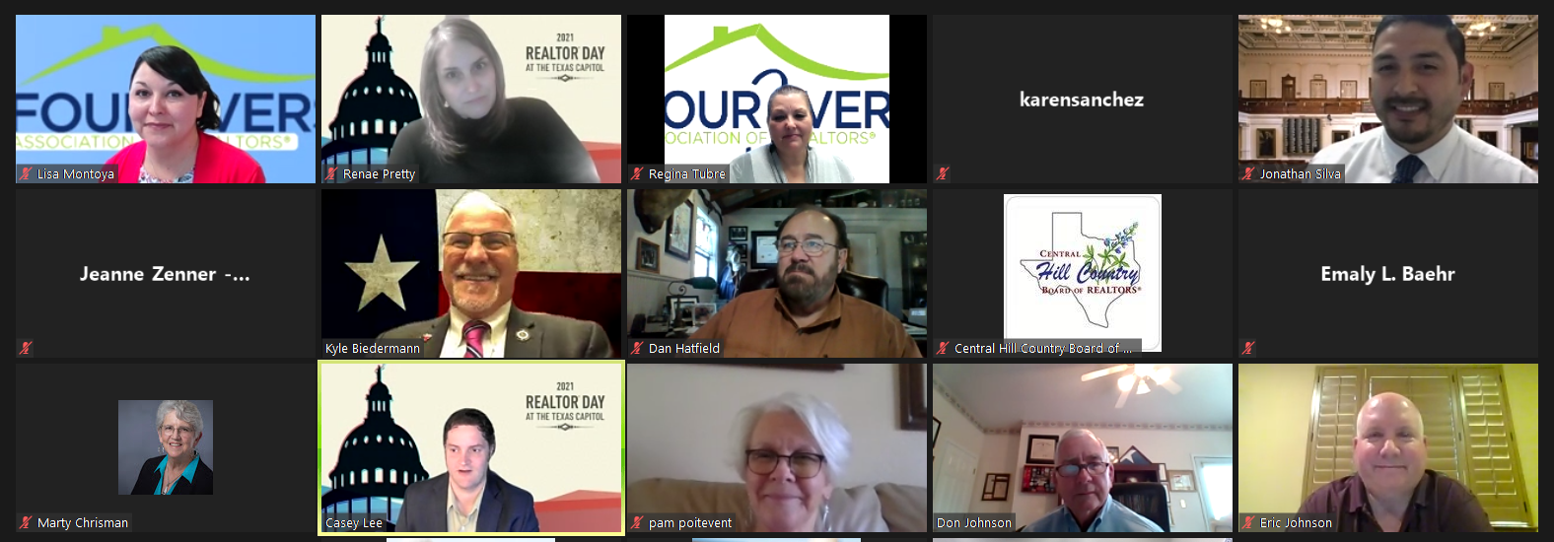
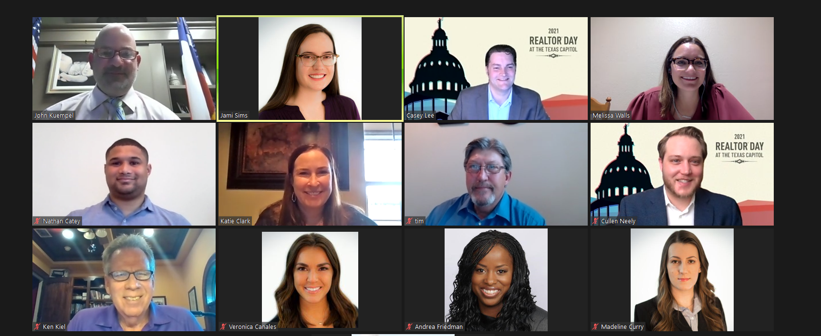
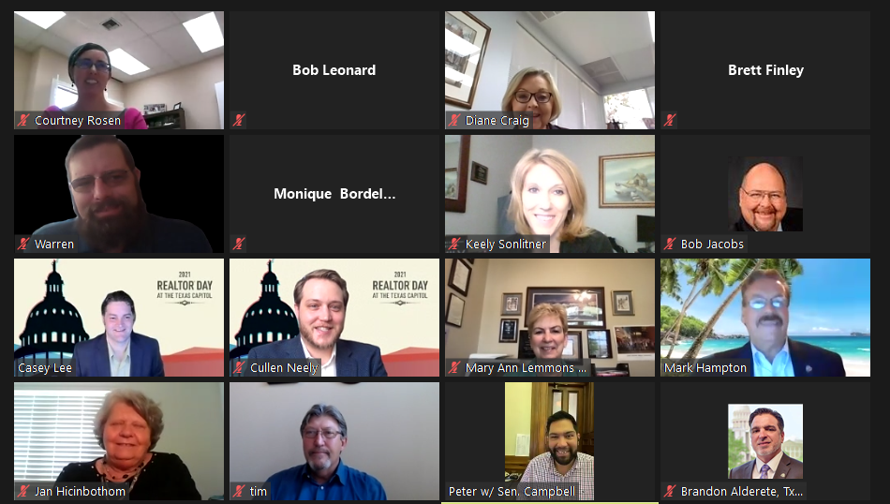
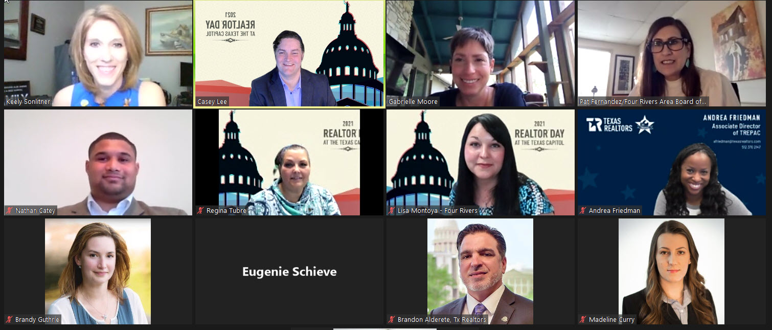
REALTOR® Engagement During Session
First-ever month-long virtual advocacy event (March 15-April 9)
Only org in the state (and probably the nation!) to take on an event of this scale
Worked to schedule meetings with all 181 legislators
Custom talking points updated timely to ensure REALTORS® had up-to-date information
Legislators joined from wherever they were—even stepping out of committee hearings or while traveling to/from the district!

Slide 23
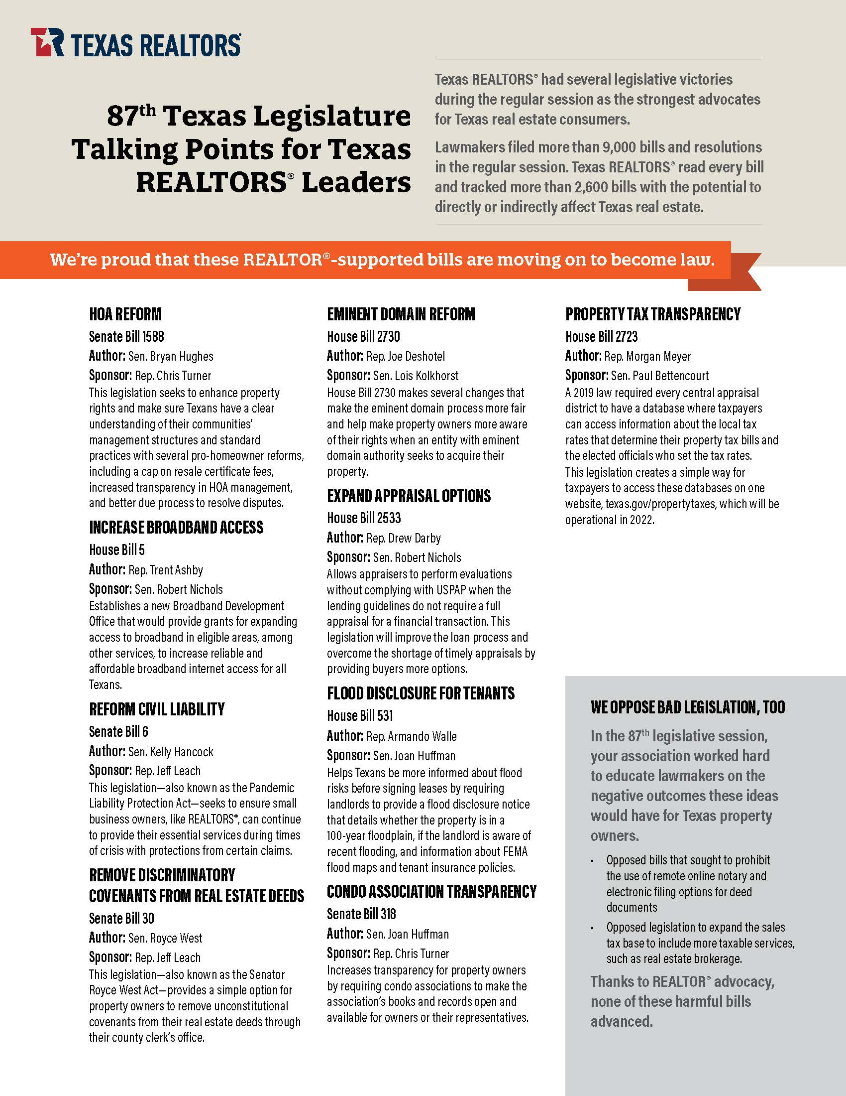


Slide 24
Everything starts and ends locally
The Four Rivers Assoc. covers five counties and is impacted by every municipality within those counties.
Public Policy: Member driven process to determine a policy idea’s impact on the real estate industry and our stance. Real estate is one of the most regulated industries. Strong public policy ensures consumers can buy, sell, and lease real property without undue burden from the government.
Issues Mobilization: Special fund to help local associations with local policy issues. REALTOR® engagement through Issues Mobilization has been proven to flip public, and elected official, perception on issues, resulting in victories which had seemed impossible. SMTX 4 All
Political Affairs: Core part of GA goals and strategy. Four main goals
1. Keep Texas REALTORS® informed and engaged
2. Build and strengthen relationships with elected officials and candidates
3. Elect REALTOR® Champions at all levels
4. Ensure everyone knows REALTORS® are engaged and paying attention

Slide 25
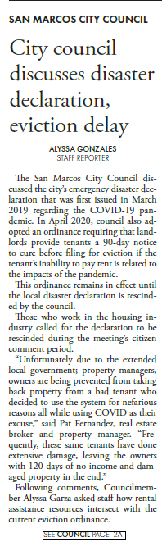
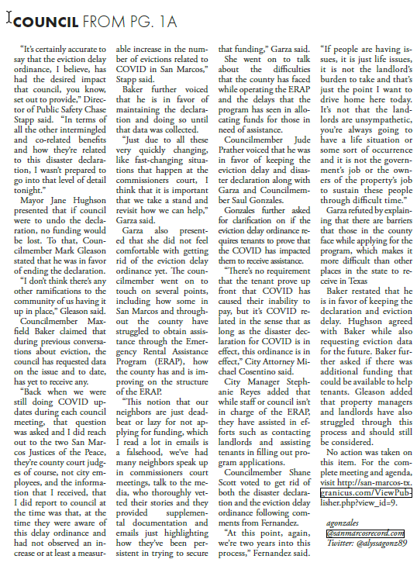








Slide 26
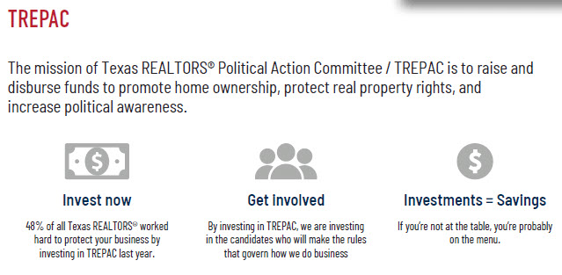

Slide 27
If real estate is your profession, politics is your business. And no one protects the real estate industry and your bottom line like TREPAC/Texas Association of REALTORS® Political Action Committee.
TREPAC backs local, state, and national candidates and elected officials who have a proven track record of protecting private-property rights, preserving the dream of homeownership, and supporting the vitality of the real estate industry.

Slide 28
TREPAC supported elected officials who supported:
2021:
HOA reform for fee caps, transparency, and homeowner protections
Increased broadband access
Property tax transparency
Eminent domain reform to increase property owner rights and education
Flood disclosure for tenants
2019:
Property tax reform for transparency measures and lowering voter approval rate to 3.5%
Comprehensive school finance reform
Ending forced annexation
TREC sunset review
2017:
Prohibiting linkage fees
Expansion of Seller’s Disclosure
Enhanced access to home equity
2015:
Bann on Transfer Tax
Repeal Broker’s Double Tax
Reduction of Franchise Tax
Equal and Uniform Property Valuation
Property Tax Transparency
Updated TWIA funding and structure
2013:
Infrastructure needs
Consumer-protection laws for Property Tax Loans

Slide 29


Slide 30
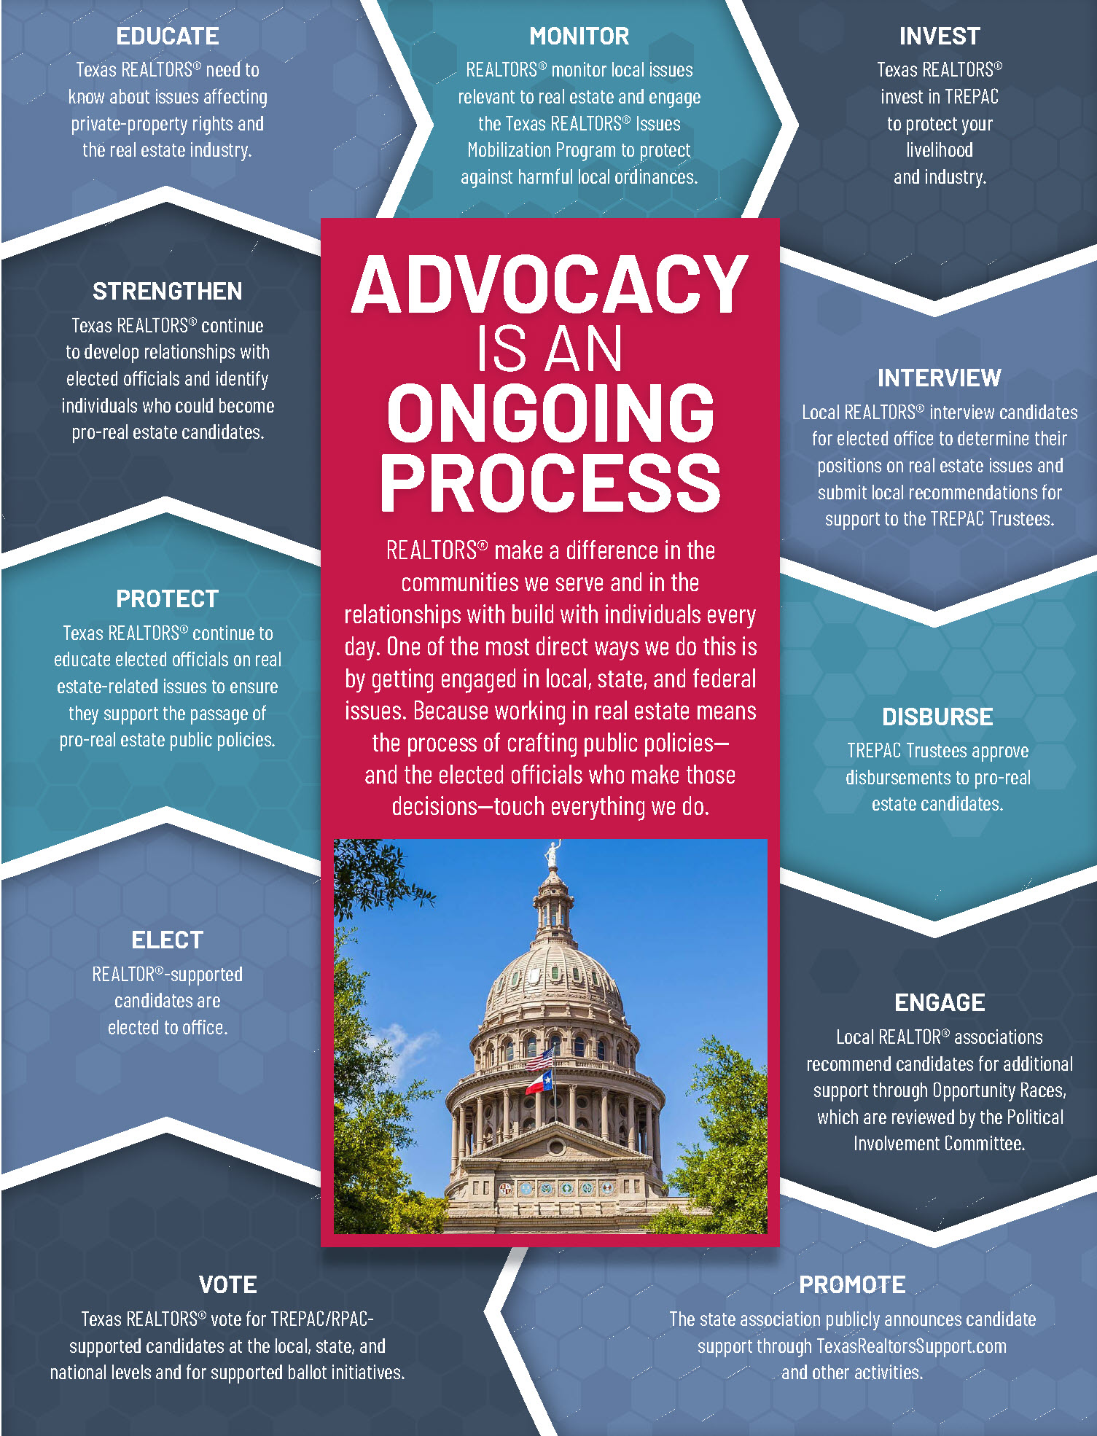


Slide 31

Stay informed
Text “txrealtors” 30644
TexasRealEstate.com/Liaison
TexasRealEstate.com/Issues
Receive periodic updates on issues
important to you and your profession from the experts!

Slide 32
Casey Lee – Government Affairs Director
casey@fourriversrealtors.com
512-738-7053
LMT Chair
Ken Kiel
kkiel@cbharper.com
TREPAC Chair
Brenda Damron
brenda@thedamrongroup.com
Guadalupe County
Seguin
Ken Kiel
kkiel@cbharper.com
Hays County
San Marcos
Cody Lantelme
cody@carsonproperties.net
TREPAC Trustee
Peggy Jones
peggyjones@austinsa.com
Caldwell County
Jennifer Hellums
jhellums@cbharper.com
Political Involvement Comittee
Warren Hoskinson
hoskinsonrealestate@yahoo.com
Comal County
New Braunfels/Canyon Lake
Esther Boarnet
eboarnet@gmail.com
Gonzales County
Central Texas Field Rep
Nate Catey
ncatey@texasrealtors.com
737-262-6386

Slide 33

Director of Education,
LaDawn Jackson

Slide 34

Antitrust

Slide 35
Lunch
30 Minutes

Slide 36

Marketing & Communications

Slide 37
local member benefits
Member Loyalty Cards (Get Punched)
-Quarterly $100.00 drawing
-Annual Dues Drawing
Education Opportunities-
-18 Hrs. of Free Classes Annually
-Up to a 25% Discount on paid classes/Board Store Items
FRAR REALTOR® Kid Scholarship
Exclusive Supra eKey Reciprocity
$10 Luncheons/Multiple FREE Events
SafeShowings Enterprise Safety App
Leadership and Community Outreach
Friendly, knowledgeable, and available staff.
What do you get for your $110/year?

Slide 38

State member benefits: texasrealestate.com/members/member-benefits

Slide 39
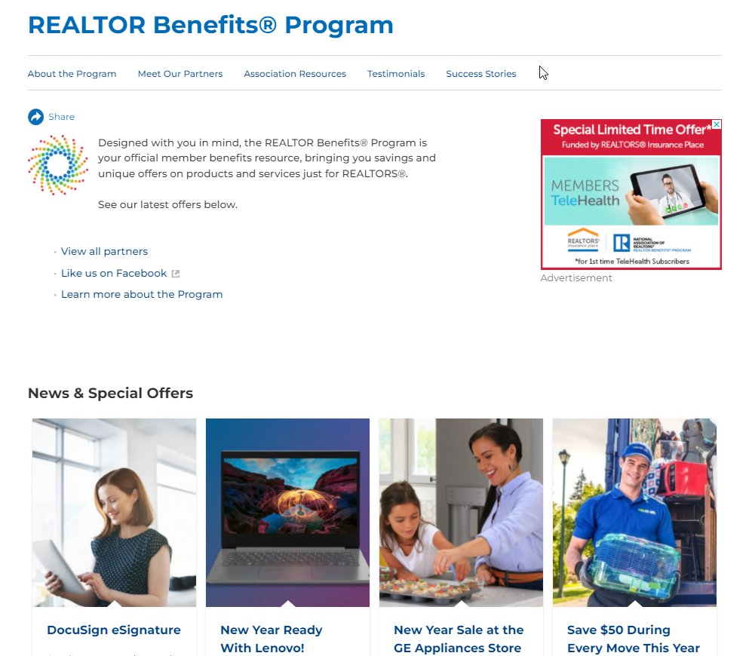
National Member benefits: nar.realtor/realtor-benefits/program

Slide 40

National Member benefits: .realtor® Domain/Top level domain

Slide 41
Three ways to make REALTOR® Trademark
REALTOR® should ALWAYS be CAPITALIZED, and trademark used when possible.
*Exception on some social media (Facebook Events and some publications)
Open parenthesis, letter R, closed parenthesis. (R)
ALT 0174
Special Characters in phone/mobile device

Slide 42

Why NAR Protects the REALTOR® Trademark

Slide 43
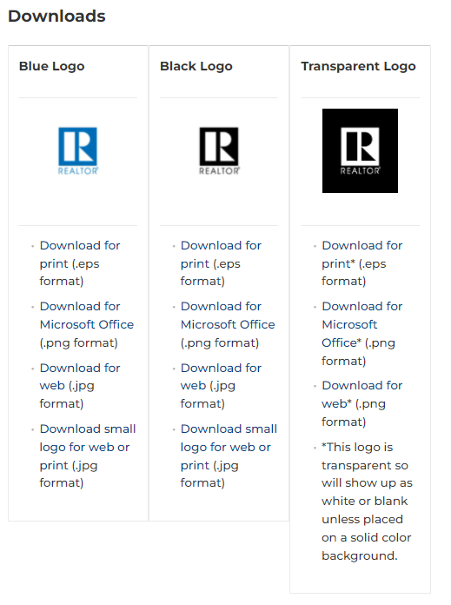
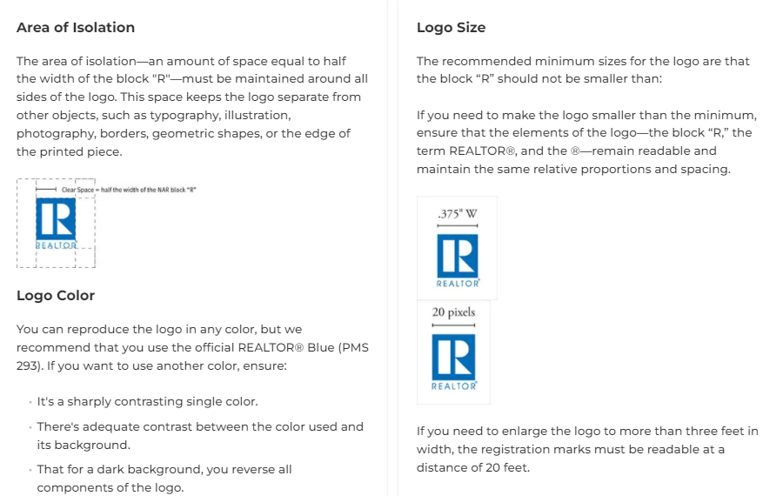
Nar.realtor/logos-and-trademark-rules/the-realtor-logo

Slide 44
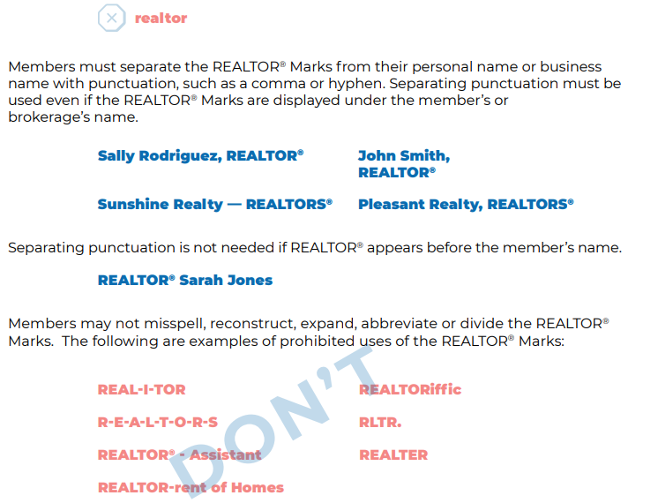
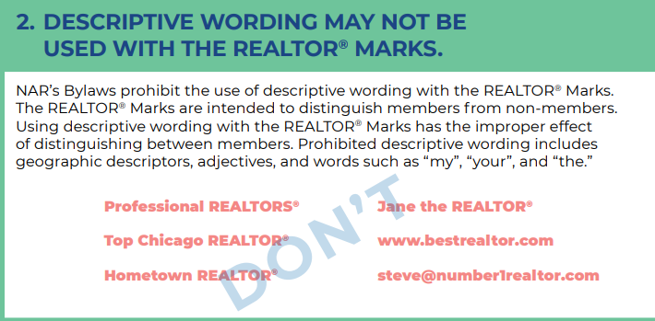

Slide 45
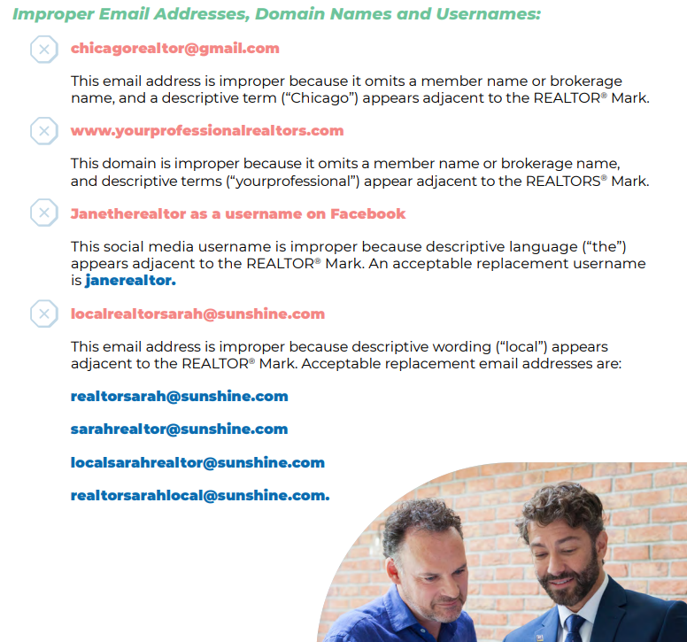

Slide 46
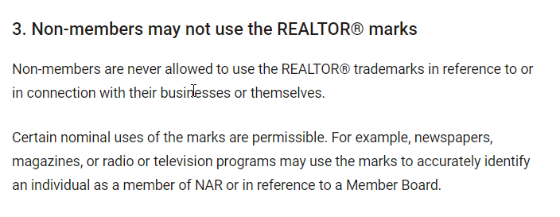

Slide 47
What is most important to remember as a NEW REALTOR®?
1. REALTOR® means = Member of NAR
2. REALTOR® only has 2 syllables (REAL-TOR)
3. REALTOR® should always be capitalized and followed by the trademark symbol when possible.
4. REALTOR® logo has design standards that should be followed when communicating to the public.
5. Punctuation is key! There should always be a comma or dash between your name and the term REALTOR®, and that information should be followed by your brokerage information for a complete contact, when possible.

Slide 48
Communicate with frar
StaY up to date with what is going on
in your association, And in your
real estate profession!

Slide 49

FRAR Weekly Newsletter Monday morning memo delivered by 6 am every Monday morning Organized by Local State & National AOR Information & Schedule of classes

Slide 50
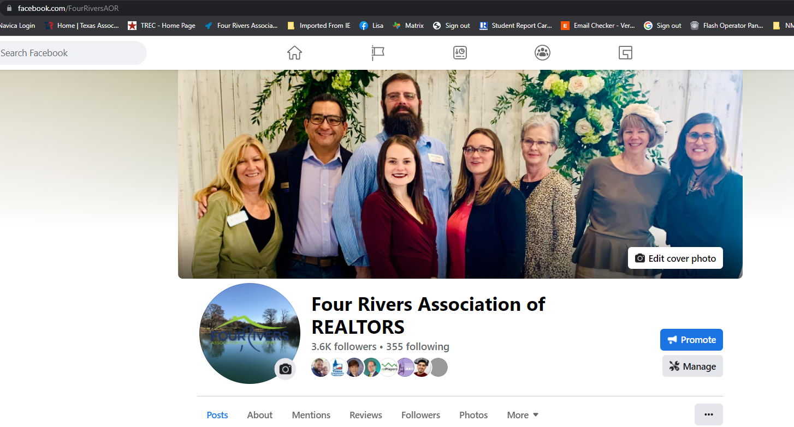
FRAR Facebook: @facebook.com/fourriversaor

Slide 51
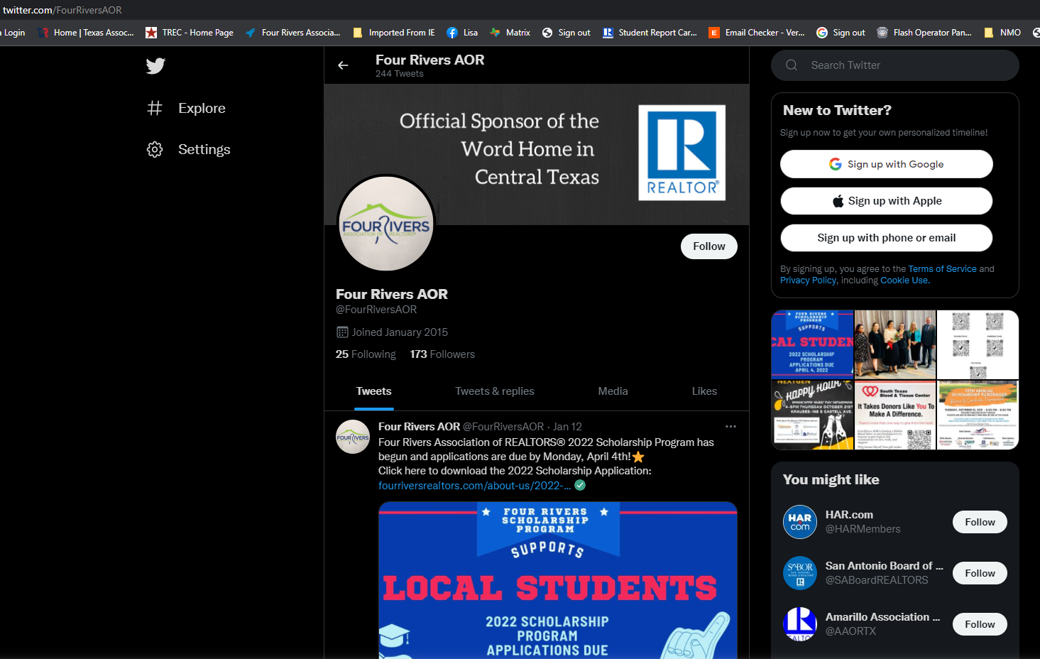
FRAR Twitter: twitter.com/fourriversaor
FRAR TWITTER PAGE: TWITTER.COM/FOURRIVERSAOR

Slide 52
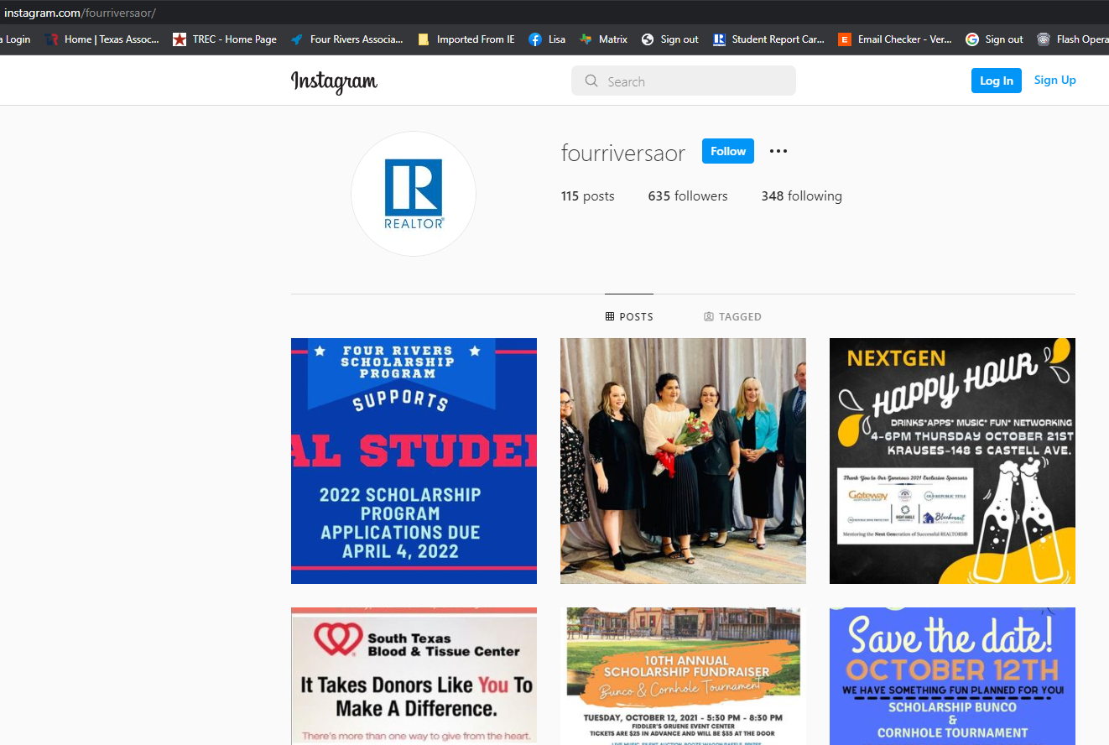
FRAR Instagram PAGE: Instagram.com/fourriversaor

Slide 53
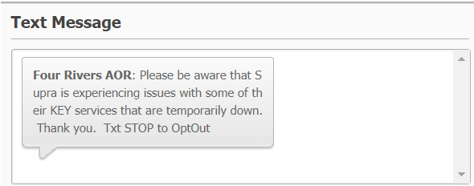
FRAR Texting Program Toll free #: 1-844-336-3727 *Save to contacts
Text “FRAR" to:
1-844-336-3727 to Opt-In/Message
Important Alerts/Reminders
2-Way Connection/Conversation

Slide 54

REALTOR® SAFTEY is so important

Slide 55

New Member benefit: safeshowings

Slide 56
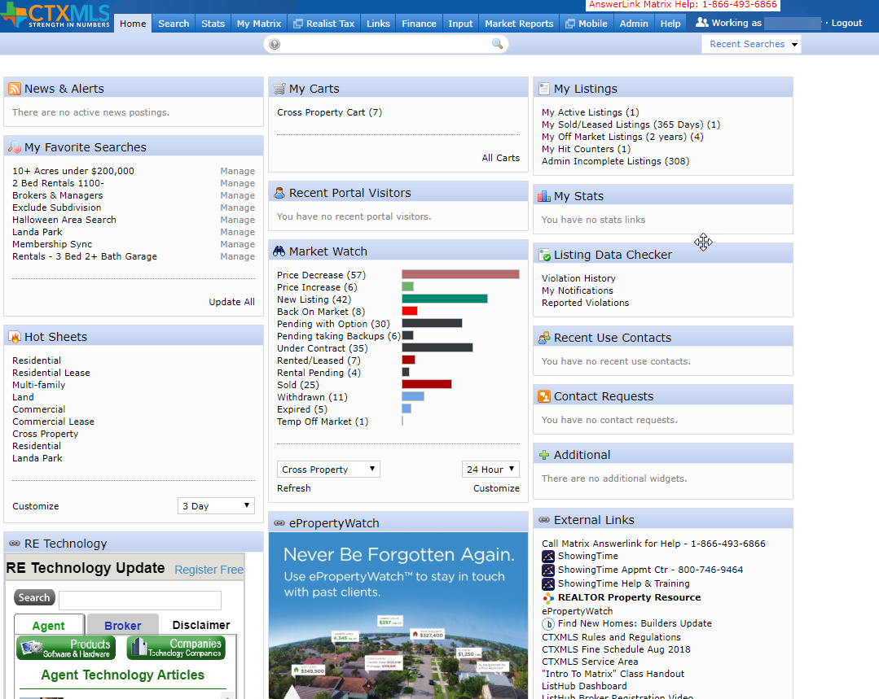

Intro to Matrix Selena Medina

Slide 57
Break time
5 Minutes

Slide 58

Central Texas Multiple Listing Service

Slide 59
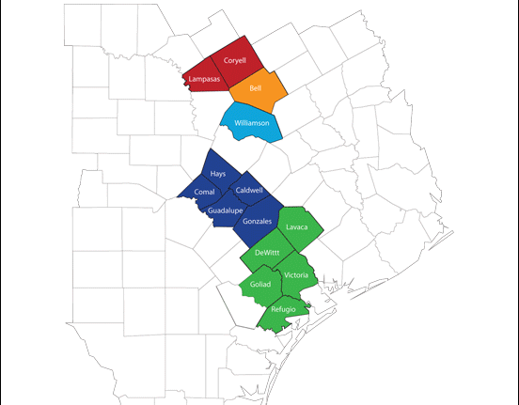
Coverage Area: -Four Rivers -Victoria -Williamson County -Temple Belton -Ft Hood
Notes:
Central Texas MLS consists of 5 shareholders.
Four Rivers, Victoria, Williamson County, Temple Belton, and Fort Hood
Together, we currently have 4800+ members and growing

Slide 60
Top Compliance Issues:
Branded or Copied Photos
Addresses not mapped accurately
Wrong Status – Listing says expired when it has sold
Incorrect Information in Remarks – No Gate Codes or contact info
Incorrect Acreage – Split Parcels
Notes:
Branded Photos – You cannot use photos that have logos or contact information in them. You MUST use original pictures and not copied form another agent or MLS.
Address Not Mapped- With many new subdivisions many properties are not found when entered into the MLS. Verify your listing is displayed accurately on the map. If not click “Get Lat/Long Manually” and manually place the map pin where the home or property is located.
Wrong Status – This happens when the listing is entered into multiple MLS and not updated in each. The property is Sold, agent is happy and neglects to update it in the MLS and so it expires.
Incorrect Remarks – Do not put gate codes. This is a security risk for the owners or tenants. Also never put any agent contact information into the remarks
Incorrect Acreage – Happens when owner wants to sell parcels of the total lot. Email Compliance@ctxmls.com and it will be waived.

Slide 61
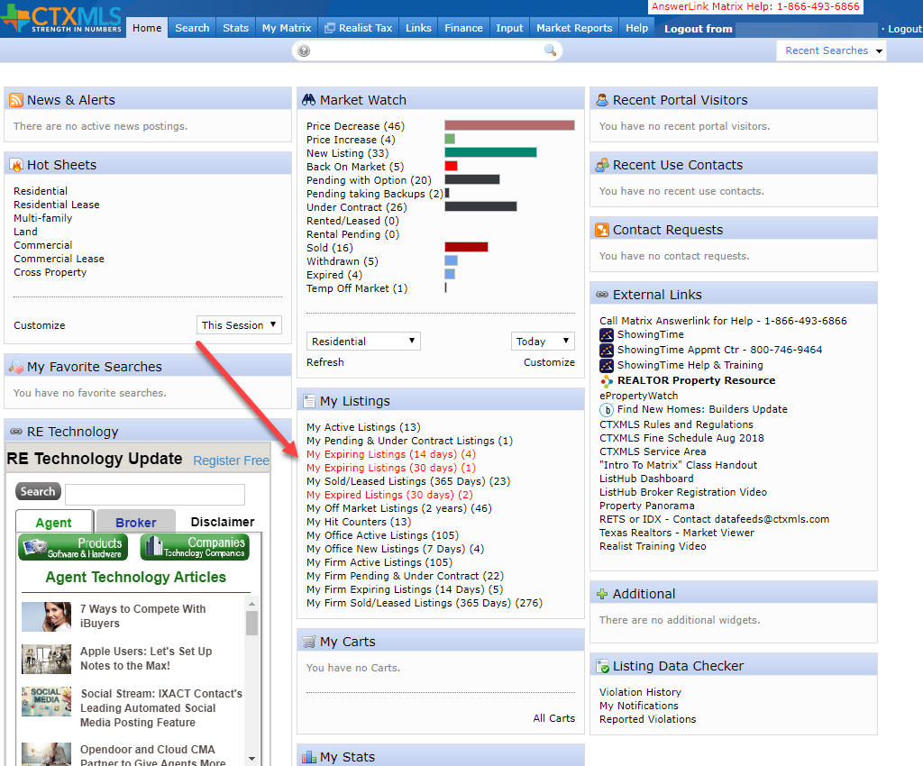
Incorrect Status: Matrix shows you before they expire

Slide 62

Report IT
Click the Yellow Caution icon to send a manual Report IT on a listing.
Leave a detailed explanation of the suspected compliance issue and LDC Specialist shall investigate and render a decision if it warrants any further action.

Slide 63
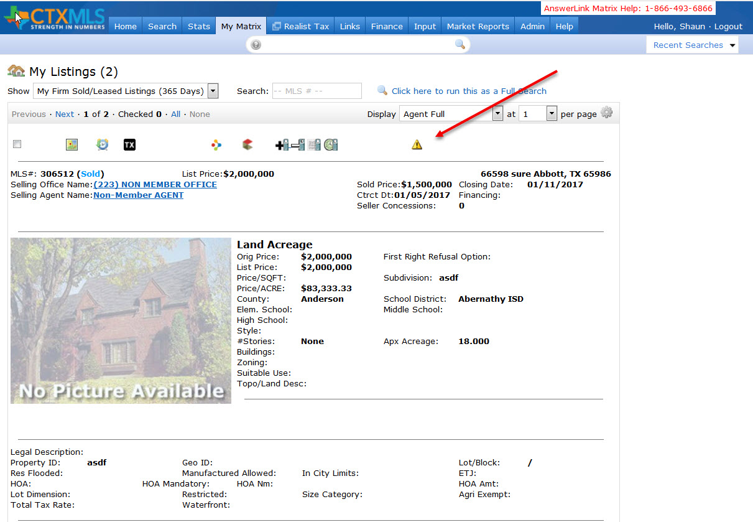
Report IT cont.

Slide 64
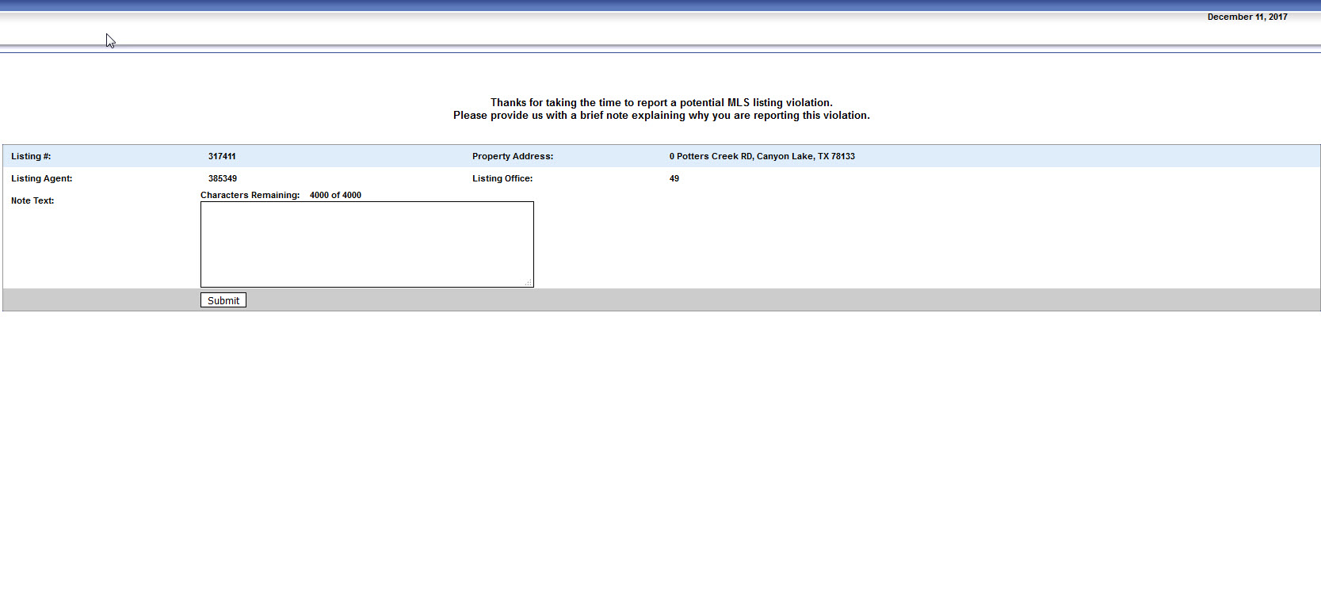
Report IT cont.
Notes:
Enter a short description of the compliance issue
All Report It’s are sent anonymously

Slide 65
Compliance Workflow
Minor Offence: New Workflow
Warning – If you correct the listing no further action.
$100 Fine – 72 Hours after the warning it’s an automatic fine if not corrected.

Slide 66

Compliance Workflow cont.
Serious Offence:
No warnings
Automatic $100 Fine
Allowing a listing to expire without changing the status to Sold
Branded Photos
Duplicating listings within the same property type

Slide 67
Compliance Workflow cont.
Egregious Offense:
No Warning
Automatic $1000 fine
Sharing Password or Login
Failure to provide Listing Agreement within 48 of request
Failure to correct any of the mentioned compliance issues

Slide 68
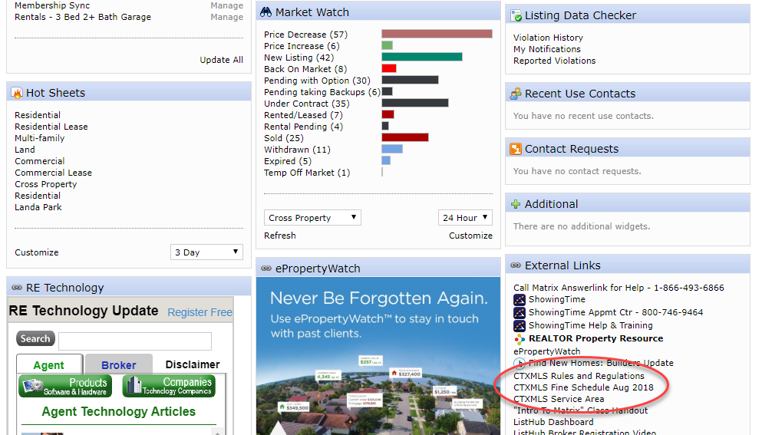
Notes:
Listings Rules, Fine Schedule, and coverage area can me found on the home page under External Links

Slide 70
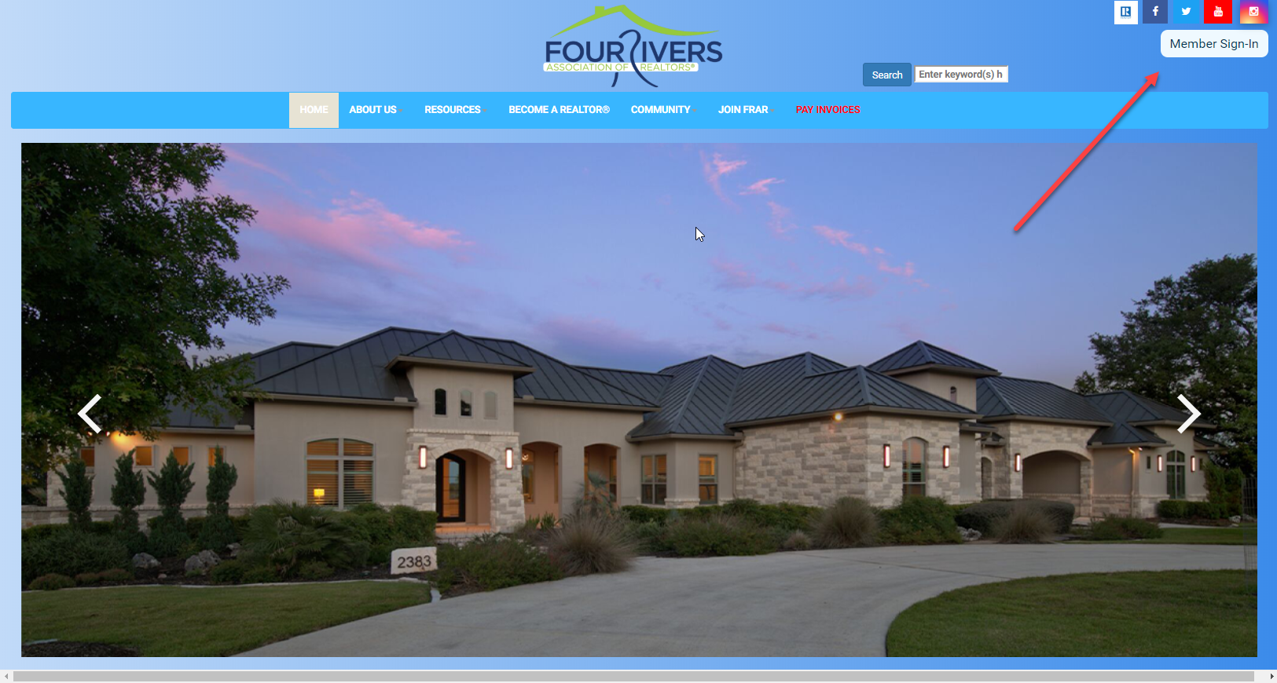
Matrix Cont.
Access via Fourriversrealtors.com from your Member Dashboard

Slide 71
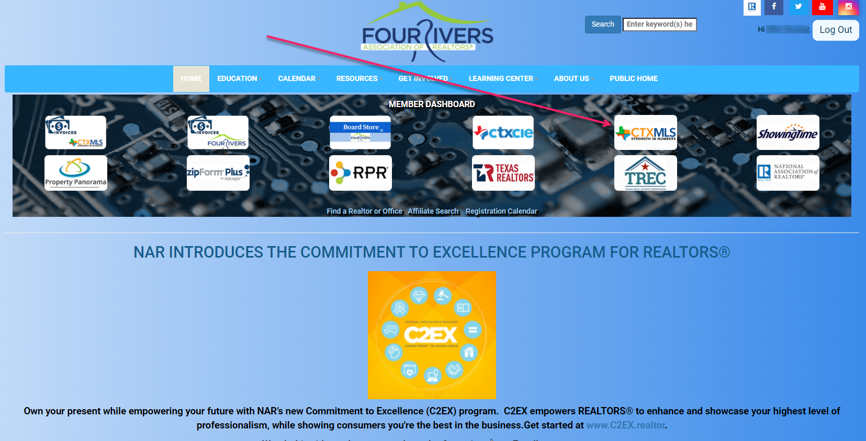
Click CTXMLS button on your member dashboard to access Matrix

Slide 72
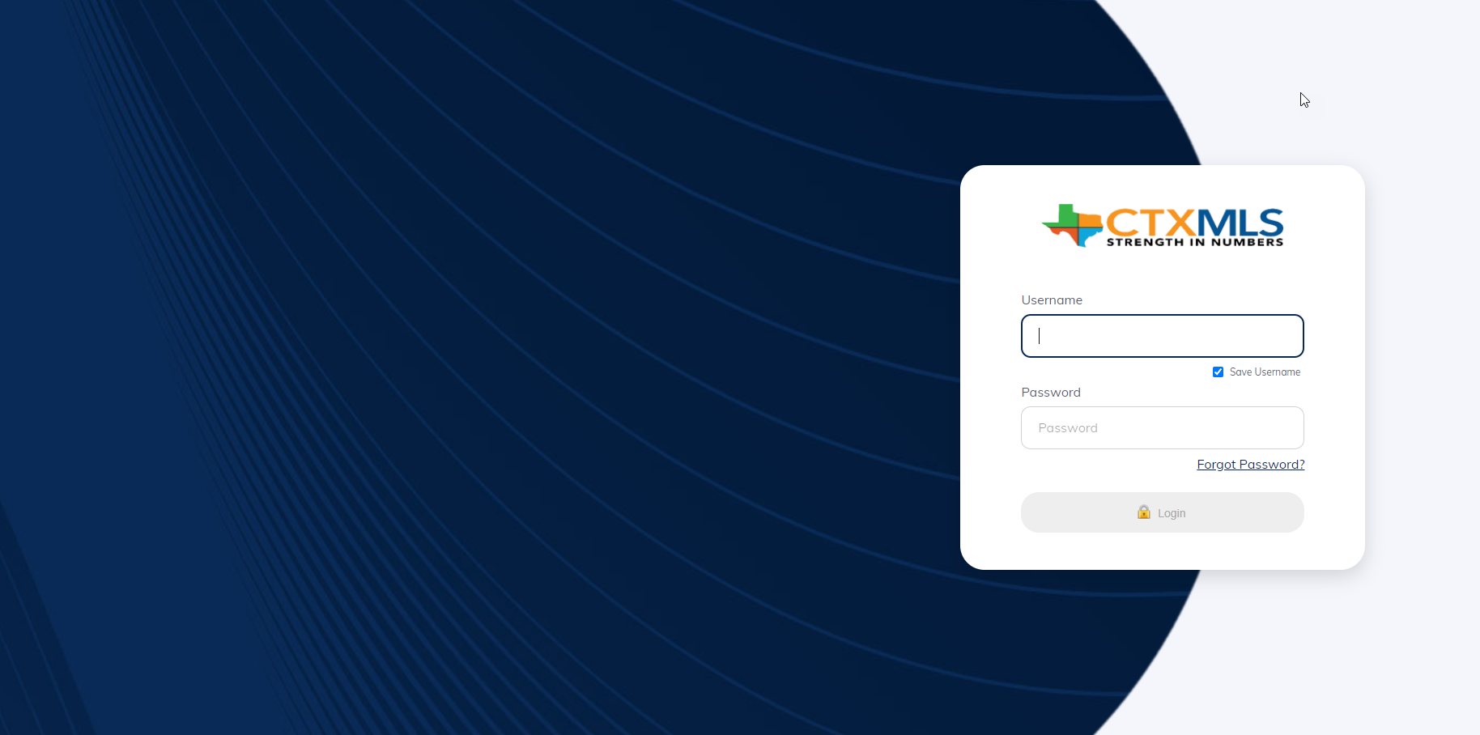
Click CTXMLS button on your member dashboard to access Matrix

Slide 73
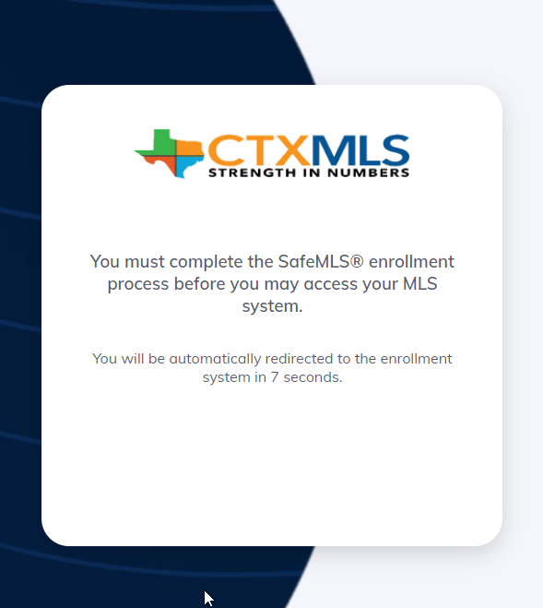
Click CTXMLS button on your member dashboard to access Matrix

Slide 74
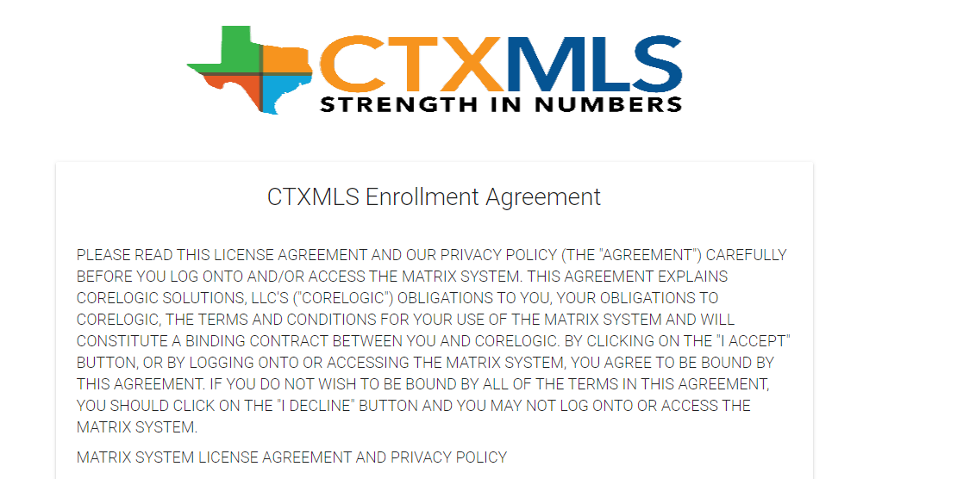
Click CTXMLS button on your member dashboard to access Matrix

Slide 75
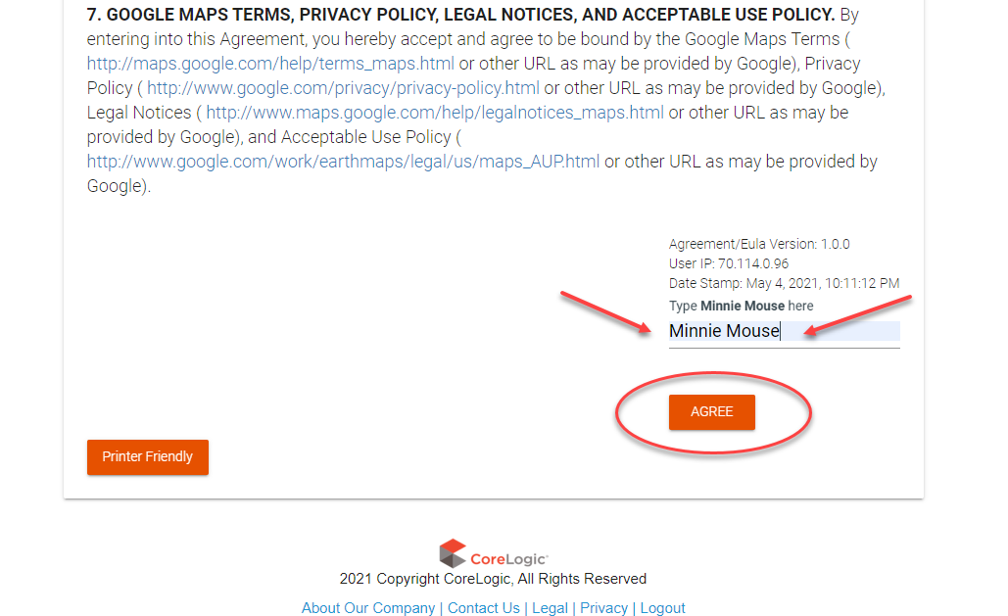
Click CTXMLS button on your member dashboard to access Matrix

Slide 76
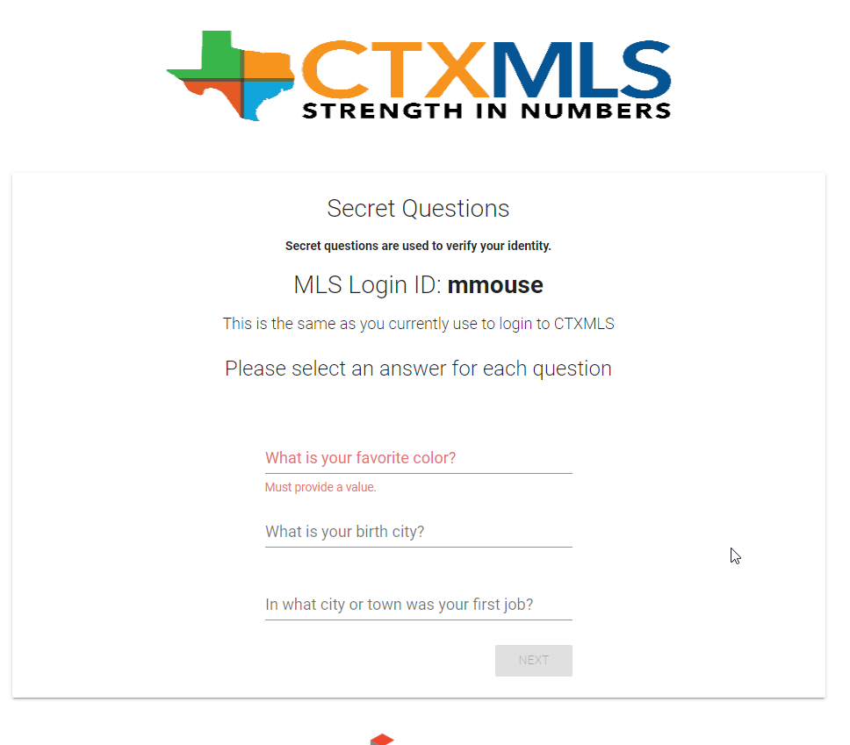
Click CTXMLS button on your member dashboard to access Matrix

Slide 77
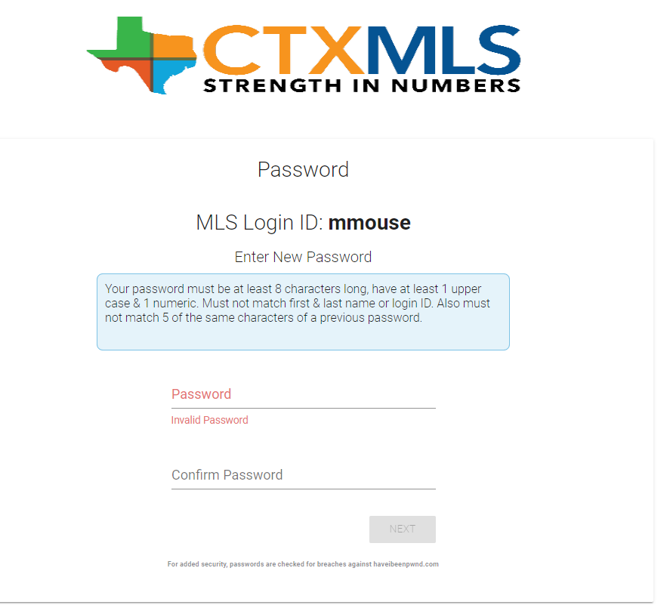
Click CTXMLS button on your member dashboard to access Matrix

Slide 78
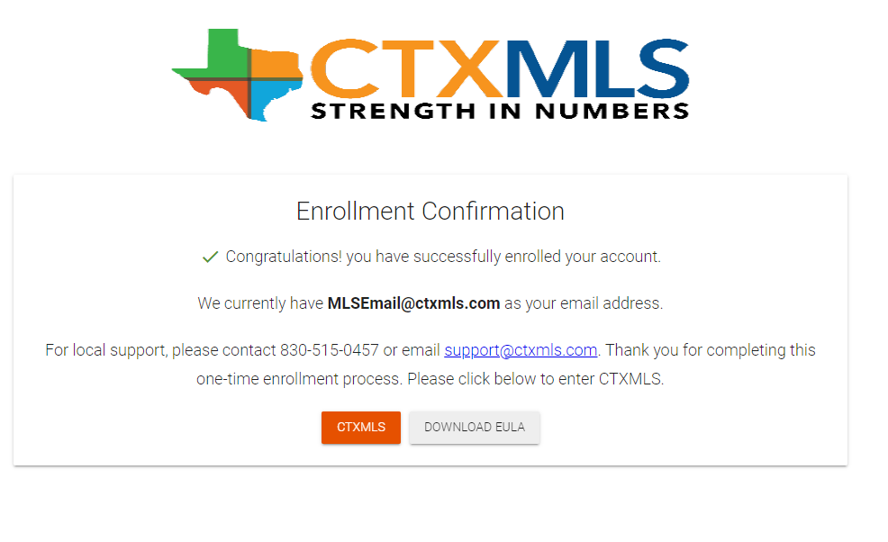
Click CTXMLS button on your member dashboard to access Matrix

Slide 79
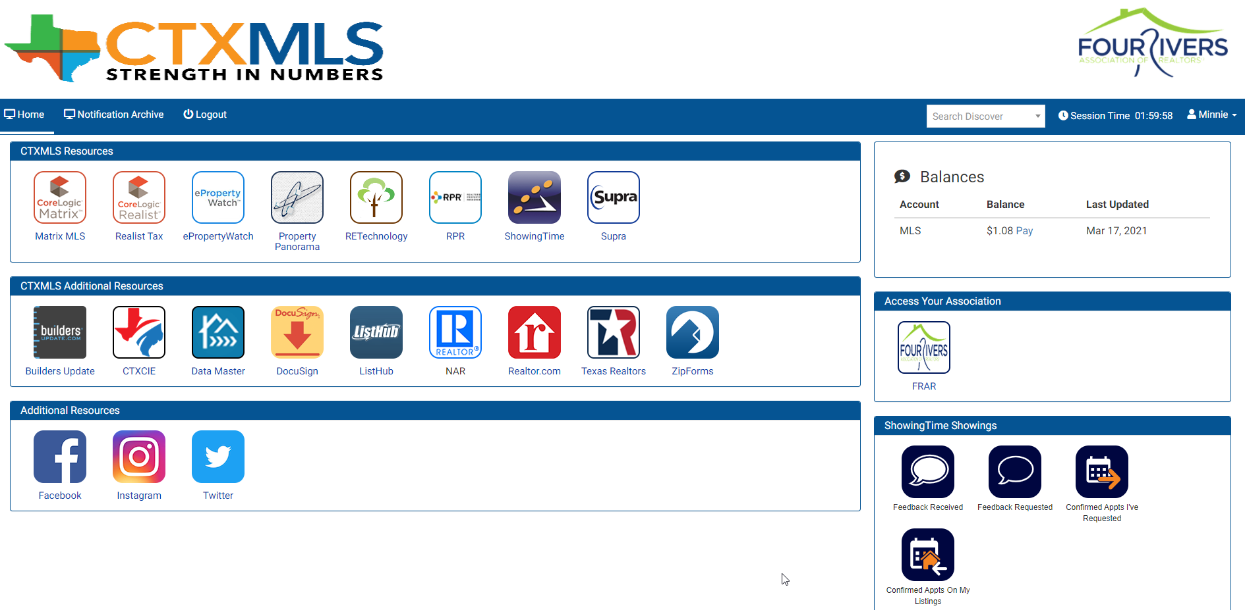
Click CTXMLS button on your member dashboard to access Matrix

Slide 80
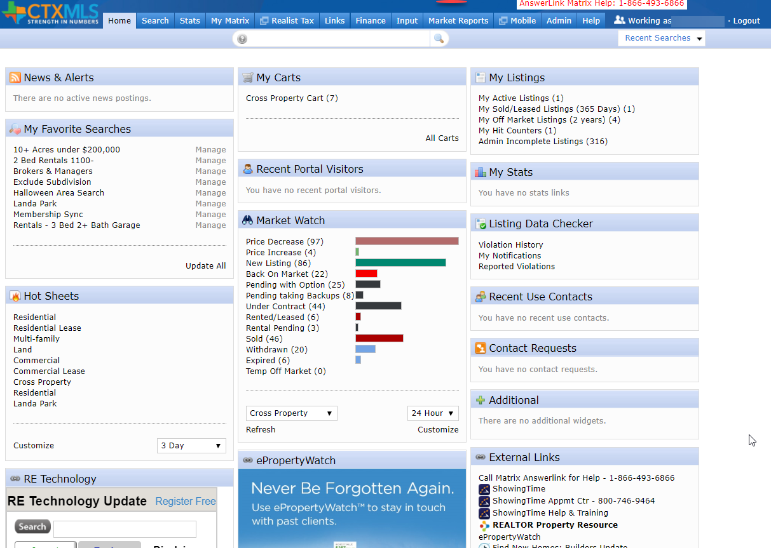
Matrix Home Page

Slide 81
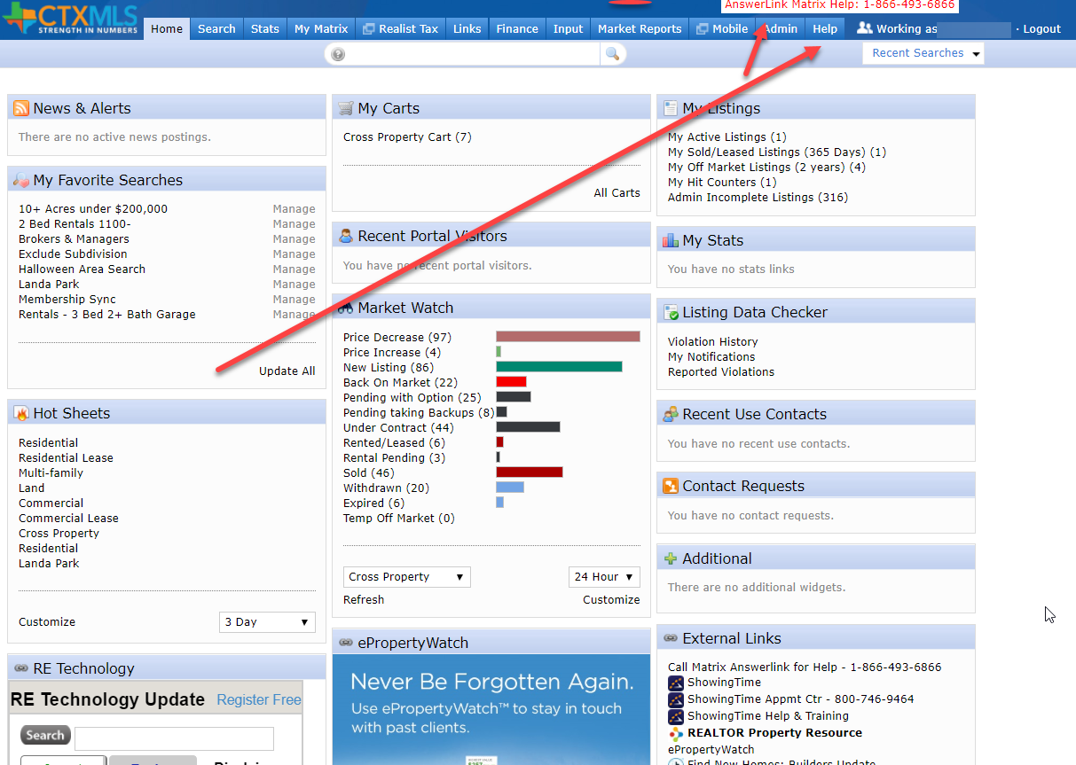
Help found under Help Tab or Answerlink
Notes:
Help can be found under the Help Tab or Four Rivers Staff or by calling Answerlink. NOTE: Answerlink is best as last resort or after hours.

Slide 82

Video Tutorials found under Help Tab

Slide 83


News & Alerts

Slide 84

Learning Center On Members Home Page

Slide 85

Homevisit Photos, Video, Drone, 3D

Slide 86

Homevisit Photos, Video, Drone, 3D

Slide 87


Slide 88

RE Technology Industry News & Updates

Slide 89

RE Technology cont.

Slide 90


E Property Watch

Slide 91
E Property Watch cont.
This is a web and email service that brands your contact info and sends market and neighborhood updates to your clients
Electronic version of branded notepads and calendars
Keeps clients informed on home sales in their neighborhood

Slide 92
Did you know You can Farm using Public Records Search in Matrix?
No need to search in a separate Realist platform
Farm Neighborhoods directly in Matrix
Print Mailing labels

Slide 93

Public Records Search in Matrix cont.
Notes:
Click Search > Public Record

Slide 94

Public Records Search in Matrix cont.
Notes:
Street Name – River Chase
County – Comal
Click Results

Slide 95

Public Records Search in Matrix cont.
Notes:
On the results, click Polygon icon to draw a polygon
Trace Neighborhood
Be sure to click on start point to close the polygon
Click Results

Slide 96

Public Records Search in Matrix cont.
Notes:
Click Results tab
Select the check box above results to select all results
Clcik the Print button on the bottom

Slide 97

Public Records Search in Matrix cont.
Notes:
Select one of the Mail Label options
Click Print to PDF
Then print your mailing labels

Slide 98

Public Records Search in Matrix cont.

Slide 99

Mobile Apps

Slide 100
Free Mobile Apps
CTXMLS – GoMLS (Matrix Mobile)
ShowingTime
RPR – NAR National searches
Supra – Lockbox
Zillow

Slide 101


App Store search ctxmls GoMLS: CTxMLS
Matrix Listings
Matrix Contacts
Branded with your info
Can be shared with clients
Agent sees active, sold, All
Clients only see Active List

Slide 102


ShowingTime
Schedule Showings
Receive notifications
Text or Email
Chat direct with List Agent
Running behind
Delay Appmts 15 minutes

Slide 103


RPR (REALTORS® Property Resource )
Nation Search All MLS’
Nice Reports
Nice Display
Easy to use
Agent Only App
Free with NAR Membership

Slide 104

Supra
Bluetooth to open lockbox
Chat
Flashlight
ALERT – Will call contact emergency alert.
FRAR CoOp with CTXMLS
San Antonio and Austin

Slide 105
Zillow
Easy Search
Household name clients use this
Nice UI
Adding Search by Brand or appliance, etc
Search Viking stove
Adding 360 video

Slide 106


Zillow Cont.

Slide 107
I AM A REALTOR®
I Pledge Myself To strive to be honorable and to abide by the Golden Rule; To strive to serve well my community, and through it, my country; To abide by the REALTORS'® Code of Ethics and to strive to conform my conduct to its aspirational ideals; To act honestly in all real estate dealings; To protect the individual right of real estate ownership and to widen the opportunity to enjoy it; To seek better to represent my clients by building my knowledge and competence

Slide 108


Slide 109

Thank you for joining us today!
You will receive an email with a brief survey to give
us feedback on this class and all the information
and links to this presentation.
Picture Time!

