Slide 1

Welcome to new membership orientation

Slide 2
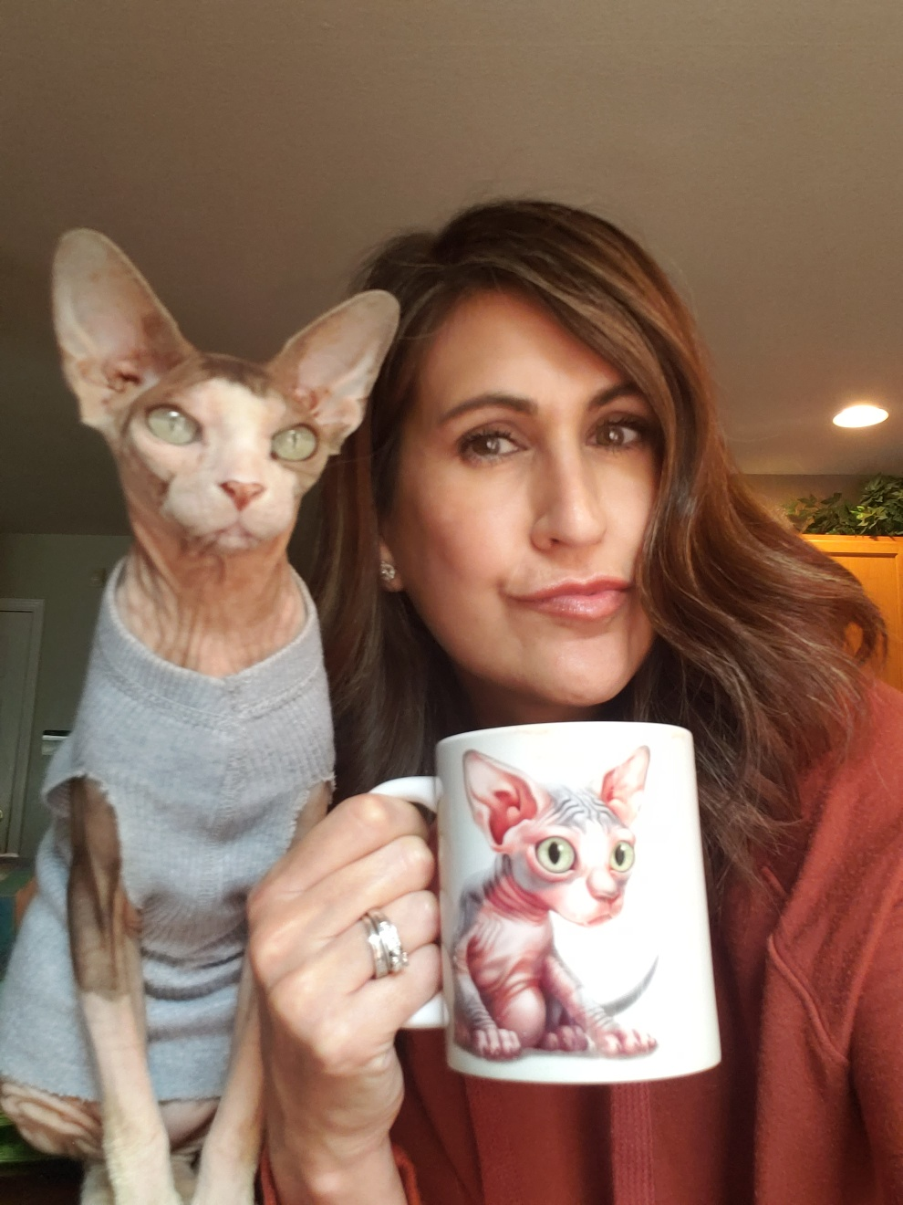
Introductions with Pat Fernandez, 2021 President of four rivers association of realtors®
What is your name and what brokerage are you with?
How long have you been licensed and what is going to be your field of specialty? Residential, Commercial, Property Management or Farm and Ranch.
What was your profession or field of specialty before real estate?

Slide 3

Education

Slide 4
Casey Lee – Government Affairs Director
casey@fourriversrealtors.com
512-738-7053
GA Oversight Chair
Melissa Walls
melissa@cornerpostrealestate.com
TREPAC Chair
Brenda Damron
brenda@thedamrongroup.com
Hays County
San Marcos:
Cody Lantelme
cody@carsonproperties.net
Kyle/Buda:
Peggy Jones
peggyjones@austinsa.com
Guadalupe County
Seguin
Ken Kiel
kkiel@cbharper.com
TREPAC Trustee
Debbie Homeier
debbie@vallonerealestate.net
Gonzales County
?
Political Involvement Comittee
Warren Hoskinson
hoskinsonrealestate@yahoo.com
Comal County
New Braunfels/Canyon Lake
Esther Boarnet
eboarnet@gmail.com
Caldwell County
?

Slide 5
Advocacy is more than just political
Under all is the land. Upon its wise utilization and widely allocated ownership depend the survival and growth of free institutions and of our civilization. REALTORS® should recognize that the interests of the nation and its citizens require the highest and best use of the land and the widest distribution of land ownership. They require the creation of adequate housing, the building of functioning cities, the development of productive industries and farms, and the
preservation of a healthful environment.
Such interests impose obligations beyond those of ordinary commerce. They impose grave social responsibility and a patriotic duty to which REALTORS® should dedicate themselves, and for which they should be diligent in preparing themselves. REALTORS®, therefore, are zealous to maintain and improve the standards of their calling and share with their fellow REALTORS® a common responsibility for its integrity and honor.
In recognition and appreciation of their obligations to clients, customers, the public, and each other, REALTORS® continuously strive to become and remain informed on issues affecting real estate and, as knowledgeable professionals, they willingly share the fruit of their experience and study with others. They identify and take steps, through enforcement of this Code of Ethics and by assisting appropriate regulatory bodies, to eliminate practices which may damage the public or which might discredit or bring dishonor to the real estate profession.

Slide 6
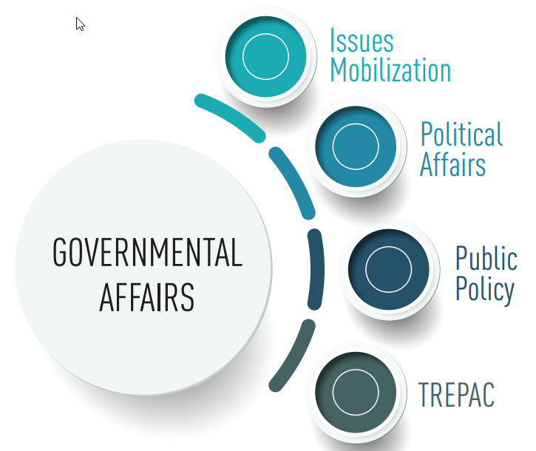
But it is political
Federal - NAR
State – Texas REALTORS®
Local – GA/TREPAC
Committees

Slide 7
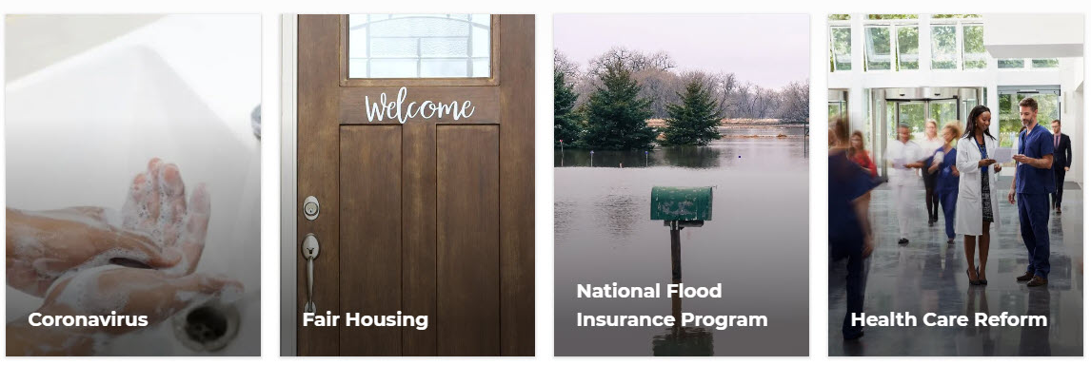

The National Association of REALTORS® advocates daily for 1.4 million REALTORS® and 75 million property owners.
NAR is one of the most effective advocacy organizations in the country.

Slide 8
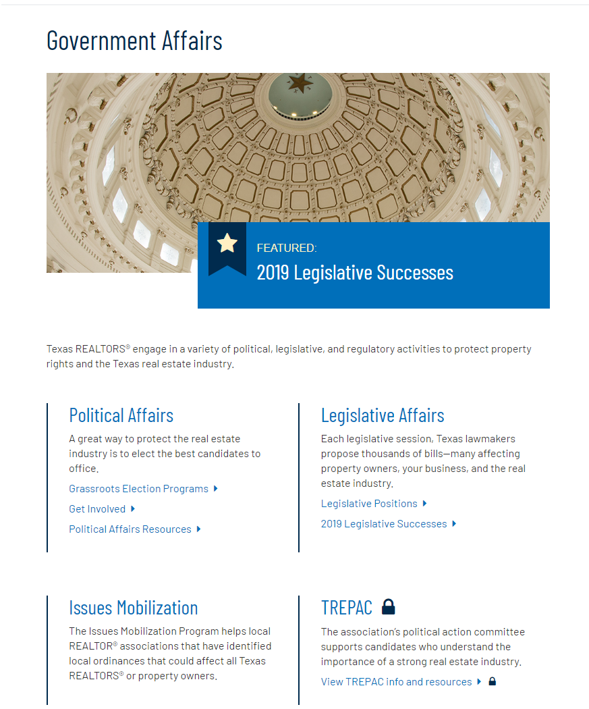


Slide 9
87th Texas Legislature
November 9, 2020: Bill prefiling
January 12, 2021: 87th Legislature convened at noon
March 12, 2021: 60-day bill filing deadline
May 31, 2021: Adjournment sine die (a.k.a. last day of session)
June 20, 2021: Post-session 20-day deadline for Governor to sign bills into law or veto bills
August 30, 2021: Effective date for new laws, unless specific date is given

Slide 10
By the Numbers
Texas REALTORS® read every single bill …
9,966 bills and resolutions filed
2,622 tracked for potential impact on real estate

Slide 11
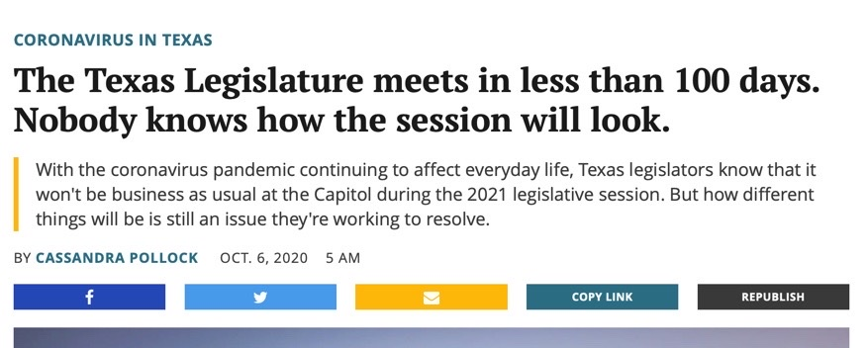
Same Legislature...but, Not the Same!
After all the money spent and drama of the campaign season, there was little to no change in the makeup of the House and Senate.
Key to REALTOR® success is existing relationships due to limited access.

Slide 12

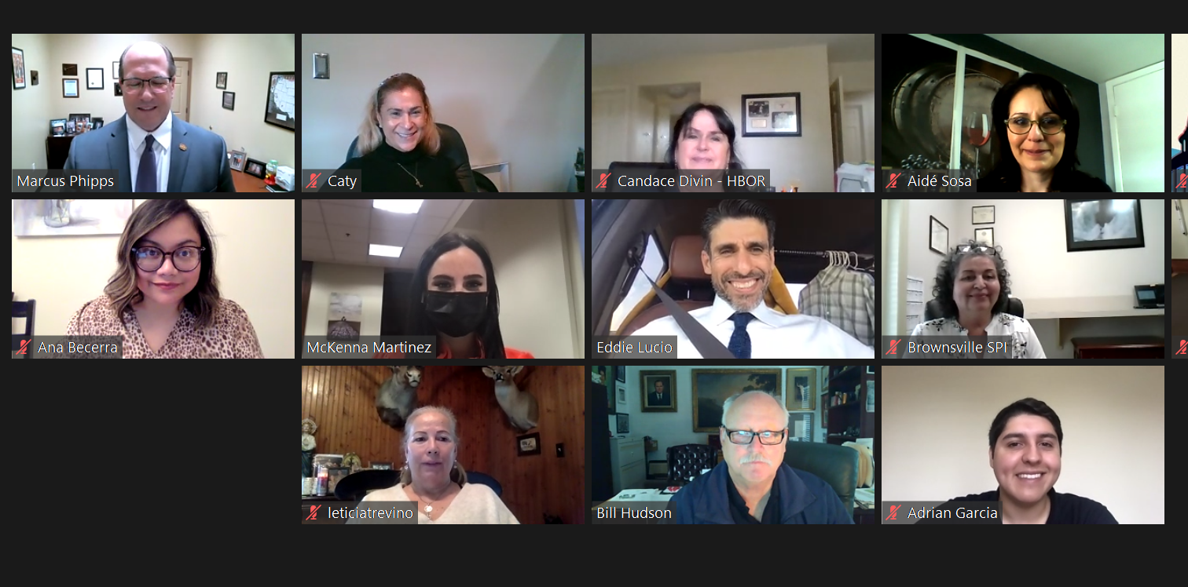
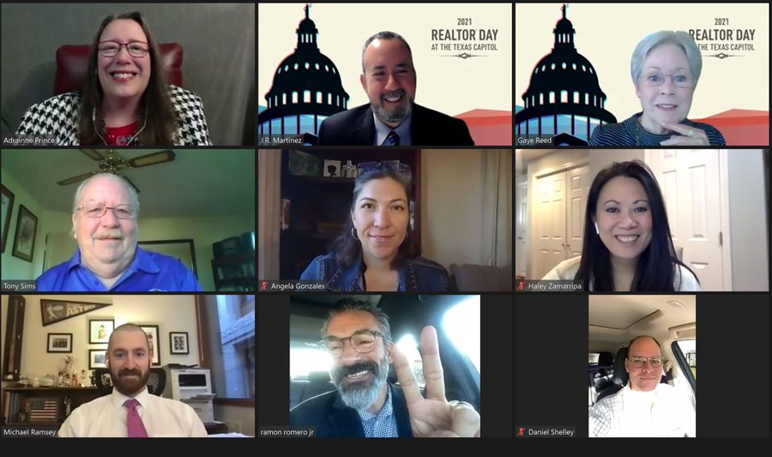
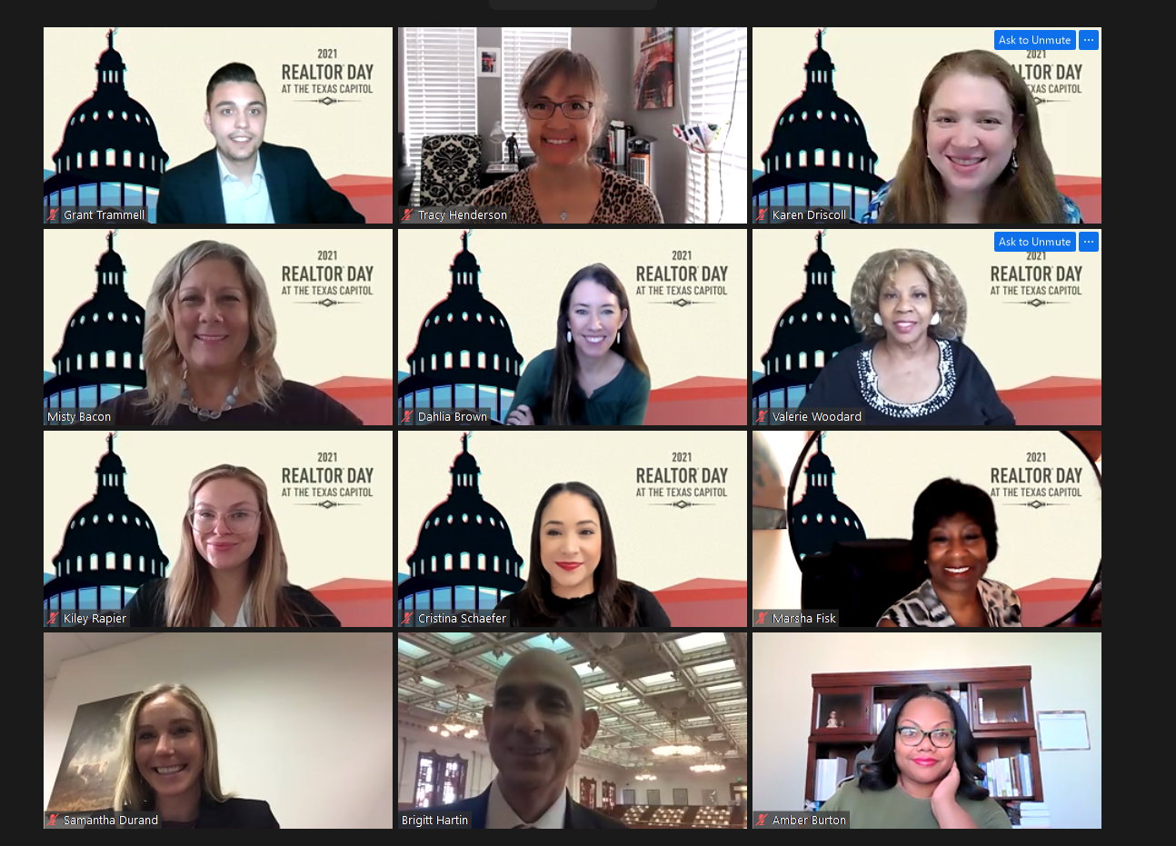
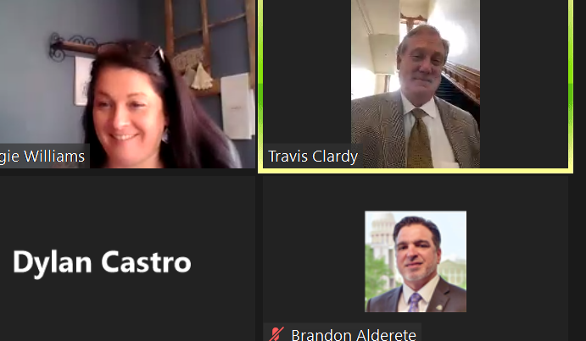
REALTOR® Engagement During Session
First-ever month-long virtual advocacy event (March 15-April 9)
Only org in the state (and probably the nation!) to take on an event of this scale
Worked to schedule meetings with all 181 legislators
Custom talking points updated timely to ensure REALTORS® had up-to-date information
Legislators joined from wherever they were—even stepping out of committee hearings or while traveling to/from the district! (See photos)

Slide 13
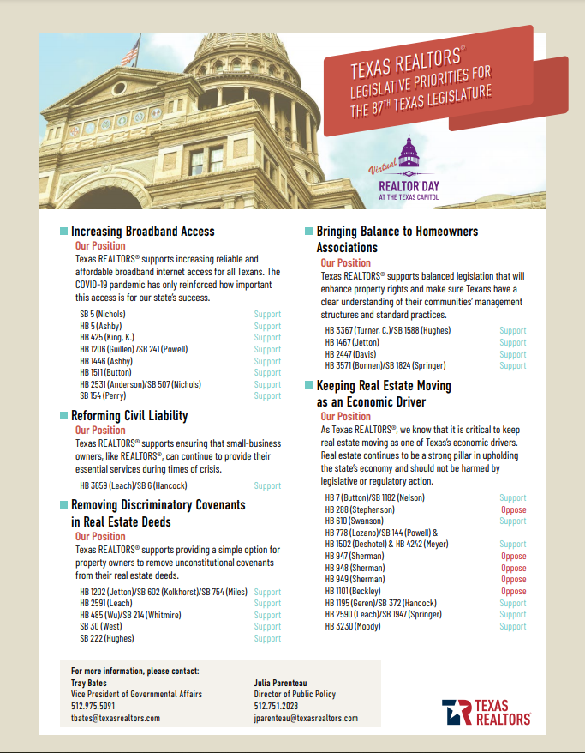
Texas REALTORS® Legislative Priorities
The 2021 session saw shifting priorities due to COVID-19 response and then the February utility outages.
REALTOR® Day Legislative Priorities
Increasing Broadband Access (House Bill 5 sent to governor)
Reforming Civil Liability (Senate Bill 6 sent to governor)
Removing Discriminatory Covenants in Real Estate Deeds (Senate Bill 30 sent to governor)
Bringing Balance to Homeowners Associations (Senate Bill 1588 sent to governor)
Keeping Real Estate Moving as an Economic Driver
(The Legislature supported our positions on the value of protecting Texas real estate! Bills to mandate sales price disclosure, tax real estate services, and prohibit the use of remote online notary and e-filing for deeds did not advance.)

Slide 14
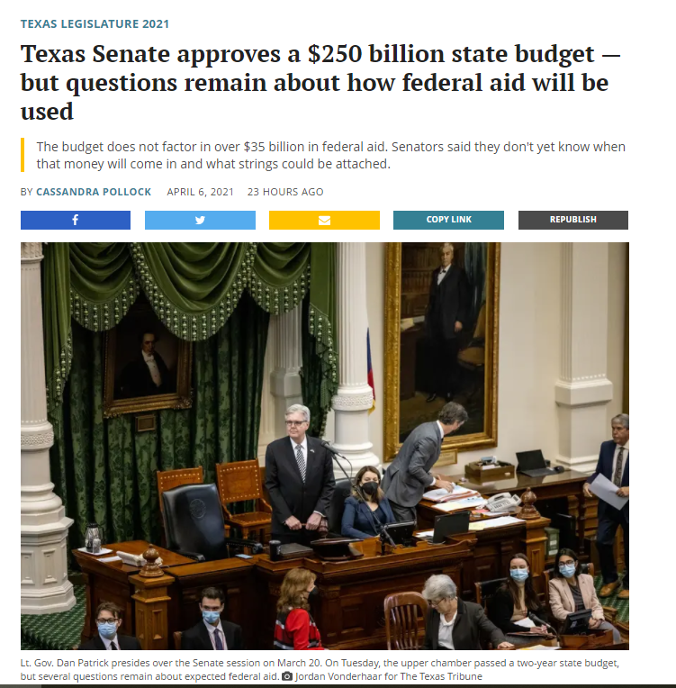
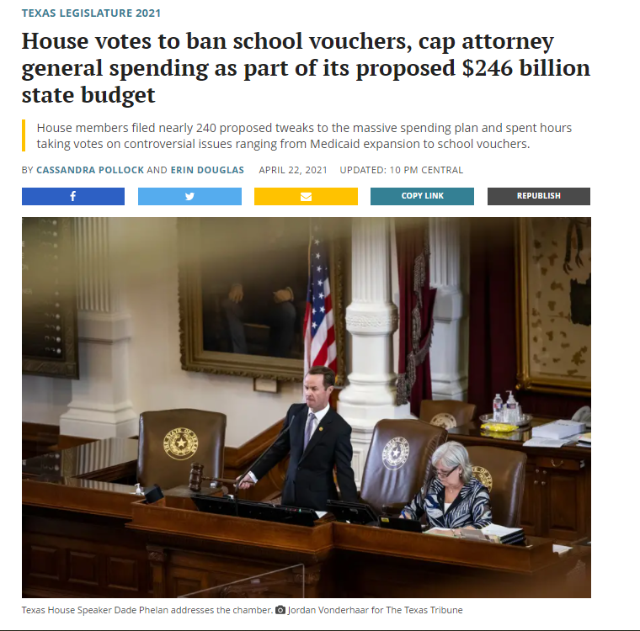
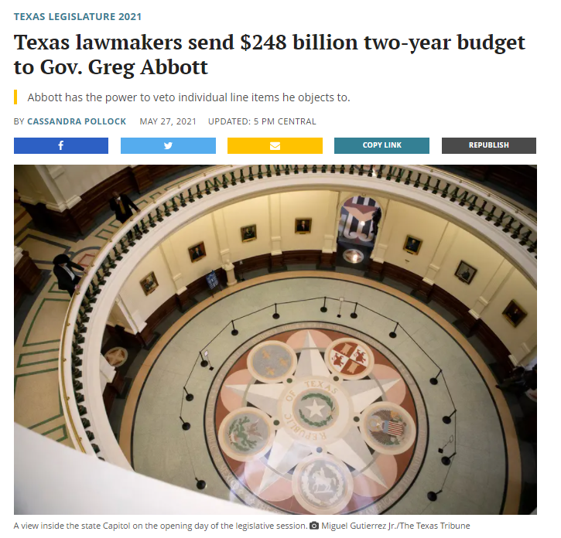
The One Bill They Must Pass: The Budget
The Texas Legislature is constitutionally required to pass the state’s two-year budget.
Senate Bill 1 is the state budget for 2022-2023.
When the session started, legislators expected to make deep cuts; however, financial forecasts have improved in recent months.
As of June 1, the budget awaits Gov. Abbott's approval.
Note: Gov. Abbott has until June 20 to either sign or veto passed bills … or they automatically become law.

Slide 15
Everything starts and ends locally
The Four Rivers Assoc. covers five counties and is impacted by every municipality within those counties.
Public Policy: Member driven process to determine a policy idea’s impact on the real estate industry and our stance. Real estate is one of the most regulated industries. Strong public policy ensures consumers can buy, sell, and lease real property without undue burden from the government.
Issues Mobilization: Special fund to help local associations with local policy issues. REALTOR® engagement through Issues Mobilization has been proven to flip public, and elected official, perception on issues, resulting in victories which had seemed impossible. SMTX 4 All
Political Affairs: Core part of GA goals and strategy. Four main goals
1. Keep Texas REALTORS® informed and engaged
2. Build and strengthen relationships with elected officials and candidates
3. Elect REALTOR® Champions at all levels
4. Ensure everyone knows REALTORS® are engaged and paying attention

Slide 16
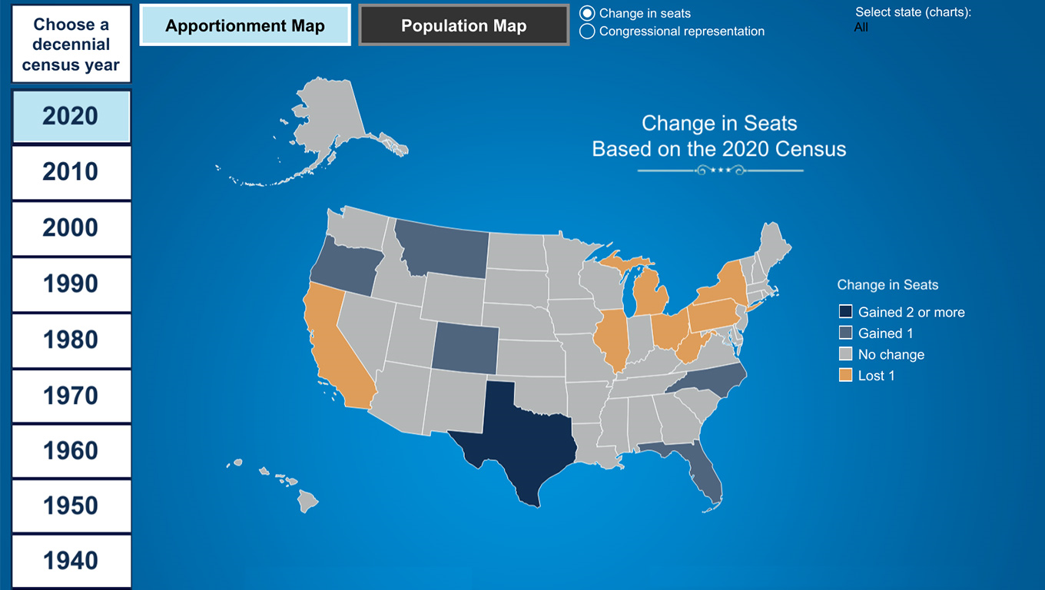
Redistricting: Special Session(s)?
Every 10 years, the Texas Legislature redraws boundaries for state legislative and U.S. Congressional districts.
The Census Bureau expects to deliver info legislators need to redraw the district lines by Sept. 30, 2021.
That is six months later than the March date originally planned … and only 71 days before the filing deadline for the 2022 elections.
The regular session ended May 31, so the governor is all but certain to call them back for a special session this fall to address redistricting.
Source: Census.gov
On April 26, the U.S. Census Bureau announced that Texas has gained two Congressional seats—the only state to gain more than one.

Slide 17
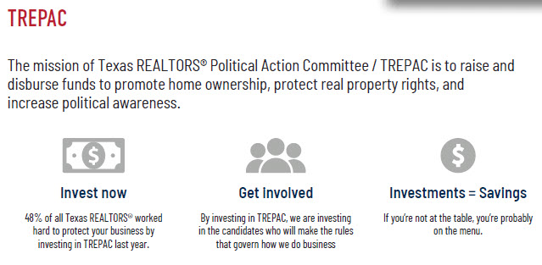

Slide 18
If real estate is your profession, politics is your business. And no one protects the real estate industry and your bottom line like TREPAC/Texas Association of REALTORS® Political Action Committee.
TREPAC backs local, state, and national candidates and elected officials who have a proven track record of protecting private-property rights, preserving the dream of homeownership, and supporting the vitality of the real estate industry.

Slide 19
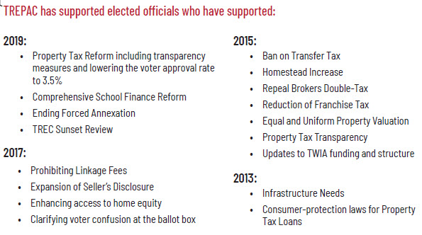

Slide 20
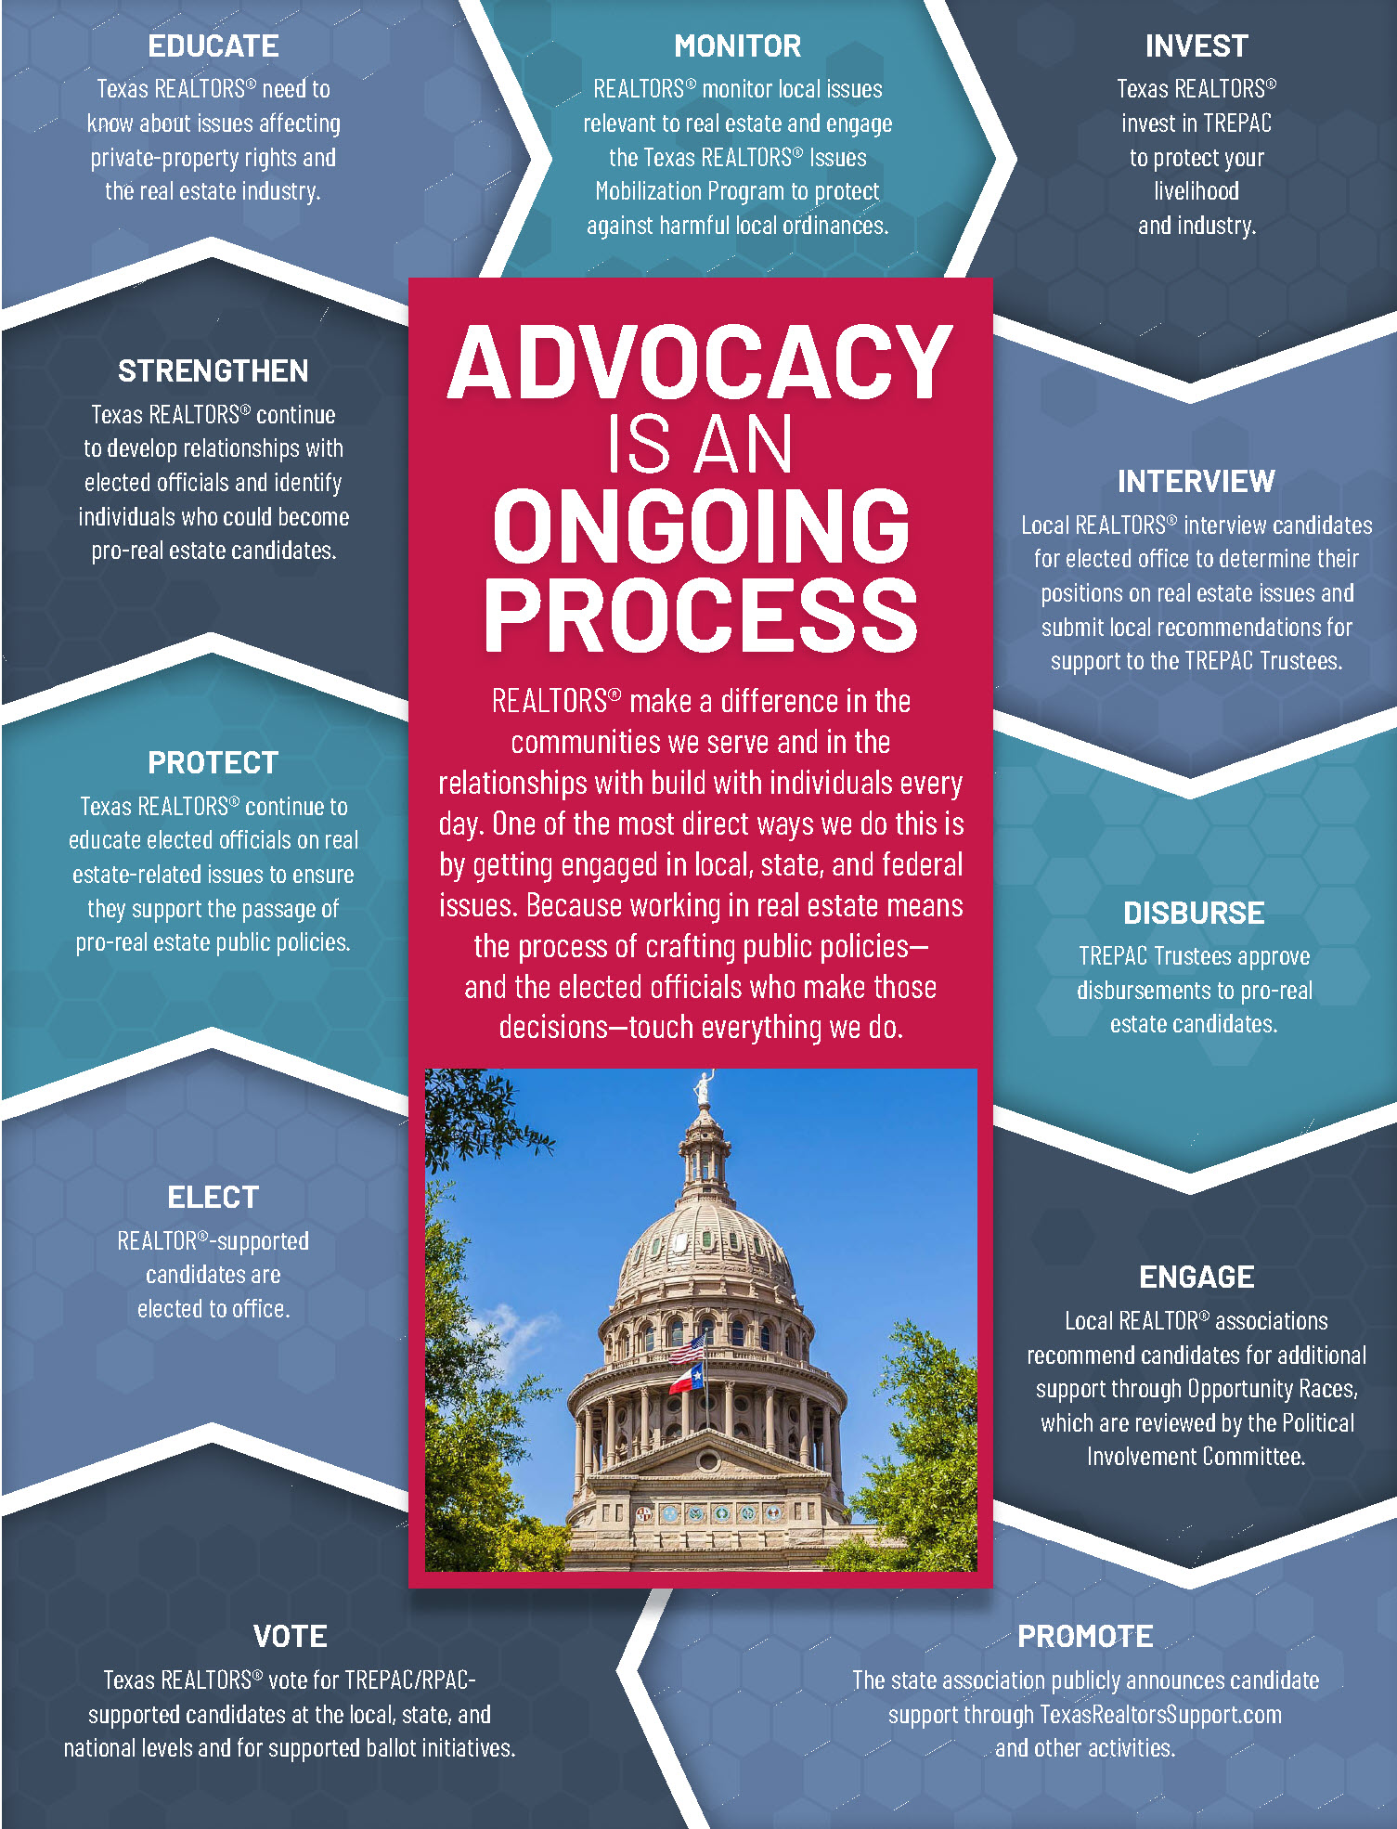


Slide 21
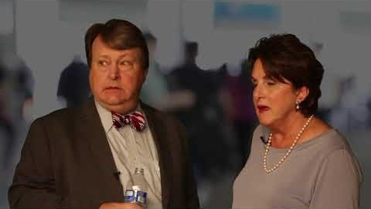
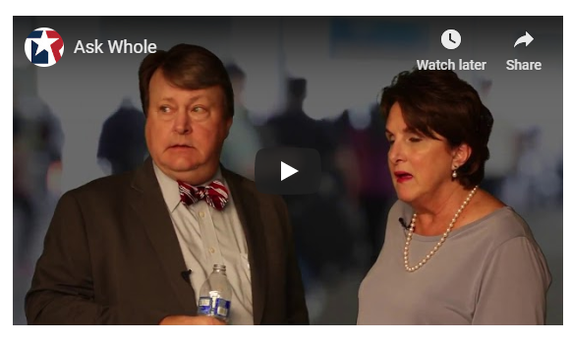

Slide 22

Stay informed
Text “txrealtors” 30644
TexasRealEstate.com/Liaison
TexasRealEstate.com/Issues
Receive periodic updates on issues
important to you and your profession from the experts!

Slide 23
GA Oversight Chair
Melissa Walls
melissa@cornerpostrealestate.com
Casey Lee – Government Affairs Director
casey@fourriversrealtors.com
512-738-7053
TREPAC Chair
Brenda Damron
brenda@thedamrongroup.com
Hays County
San Marcos:
Cody Lantelme
cody@carsonproperties.net
Kyle/Buda:
Peggy Jones
peggyjones@austinsa.com
Guadalupe County
Seguin
Ken Kiel
kkiel@cbharper.com
TREPAC Trustee
Debbie Homeier
debbie@vallonerealestate.net
Political Involvement Comittee
Warren Hoskinson
hoskinsonrealestate@yahoo.com
Gonzales County
?
Comal County
New Braunfels/Canyon Lake
Esther Boarnet
eboarnet@gmail.com
Central Texas Field Rep
Nate Catey
ncatey@texasrealtors.com
737-262-6386
Caldwell County
?

Slide 24
What is a Board of REALTORS® ?
3-tiered organization, each governed by a member elected Board of Directors:
  NAR (founded in 1908)
  TAR (chartered in1920)
  Pre-merger existence (Chartered in the 1960’s) Local Association formed January 1, 2014

Slide 25


Break time
10 Minutes

Slide 26

Antitrust

Slide 27

Fair Housing

Slide 28

REALTORS® recognize the significance of the Fair Housing Act and reconfirm their commitment to upholding Fair Housing Law as well as their commitment to offering Equal Professional Service to all in their search for real property.

Slide 29


Slide 30
NAR Code of Ethics Training Requirement.
Failure to complete training during any cycle will lead to suspension of membership for the January and February immediately following the cycle deadline, with termination of membership starting March 1 after the cycle deadline.
Current Cycle
January 1, 2019 to December 31, 2021
Future Cycles
January 1, 2022 to December 31, 2024
January 1, 2025 to December 31, 2027

Slide 31
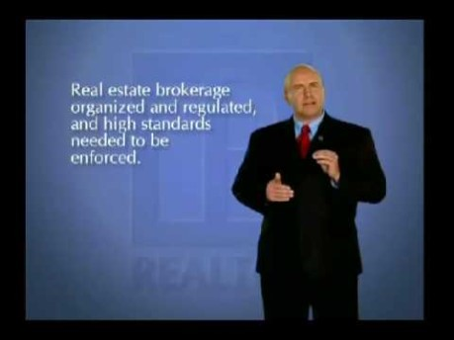
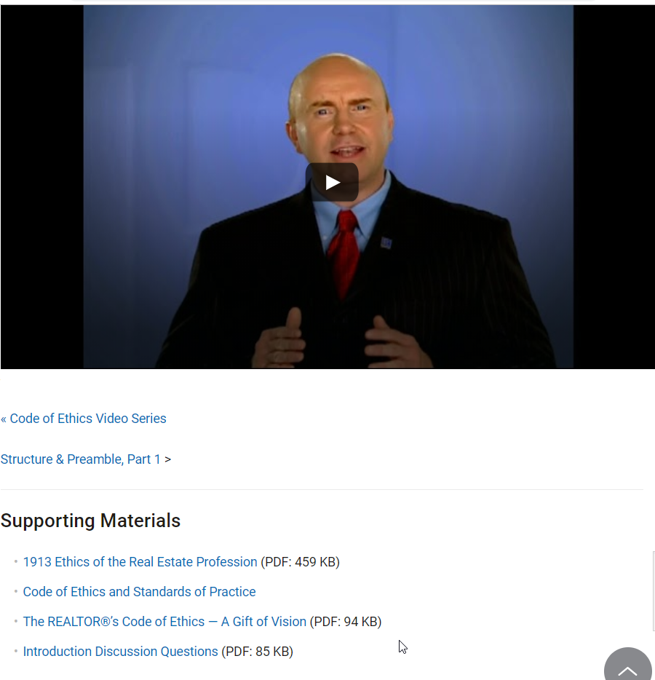

Slide 32
Contact the Broker
Contact the person's broker to inform him or her what happened. It could lead to a quick resolution.
Use the Ombudsman Program
A volunteer from the Texas REALTORS® Professional Standards Committee will listen to your concerns, explain possible resolutions, and answer questions.
File an Ethics Complaint
If contacting the broker and talking to an ombudsman don't resolve the problem, you can file a formal complaint.
File an Anonymous Complaint
For certain types of Code of Ethics violations, you can submit an anonymous complaint.
Arbitration
This process is used when you think you're owed money based on an agreement.

Slide 33
The Code of Ethics is your pathway to professionalism. Make sure you understand what separates you, as a REALTOR®, from other real estate professionals, and get your office talking about and living by the Code.

Slide 34
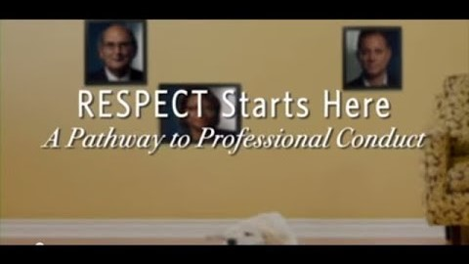

Slide 35

Central Texas Multiple Listing Service

Slide 36
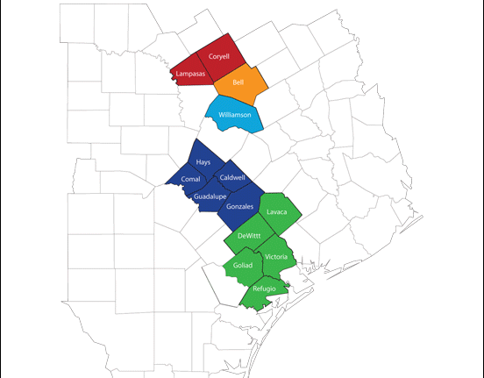
Coverage Area:
-Four Rivers
-Victoria
-Williamson County
-Temple Belton
-Ft Hood
Notes:
Central Texas MLS consists of 5 shareholders.
Four Rivers, Victoria, Williamson County, Temple Belton, and Fort Hood
Together, we currently have 4800+ members and growing

Slide 37
Top Compliance Issues:
Branded or Copied Photos
Addresses not mapped accurately
Wrong Status – Listing says expired when it has sold
Incorrect Information in Remarks – No Gate Codes or contact info
Incorrect Acreage – Split Parcels
Notes:
Branded Photos – You cannot use photos that have logos or contact information in them. You MUST use original pictures and not copied form another agent or MLS.
Address Not Mapped- With many new subdivisions many properties are not found when entered into the MLS. Verify your listing is displayed accurately on the map. If not click “Get Lat/Long Manually” and manually place the map pin where the home or property is located.
Wrong Status – This happens when the listing is entered into multiple MLS and not updated in each. The property is Sold, agent is happy and neglects to update it in the MLS and so it expires.
Incorrect Remarks – Do not put gate codes. This is a security risk for the owners or tenants. Also never put any agent contact information into the remarks
Incorrect Acreage – Happens when owner wants to sell parcels of the total lot. Email Compliance@ctxmls.com and it will be waived.

Slide 38
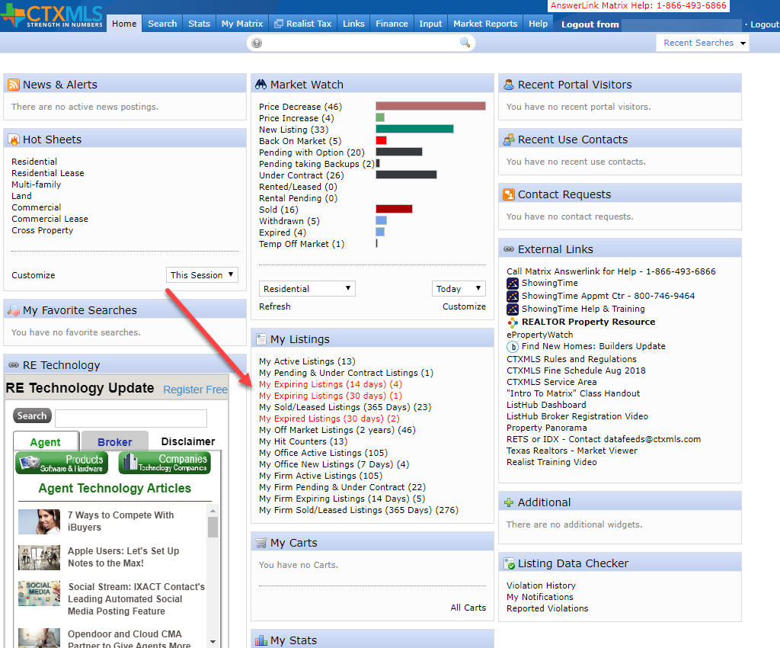
Incorrect Status:
Matrix shows you before they expire

Slide 39

Report IT
Click the Yellow Caution icon to send a manual Report IT on a listing.
Leave a detailed explanation of the suspected compliance issue and LDC Specialist shall investigate and render a decision if it warrants any further action.

Slide 40
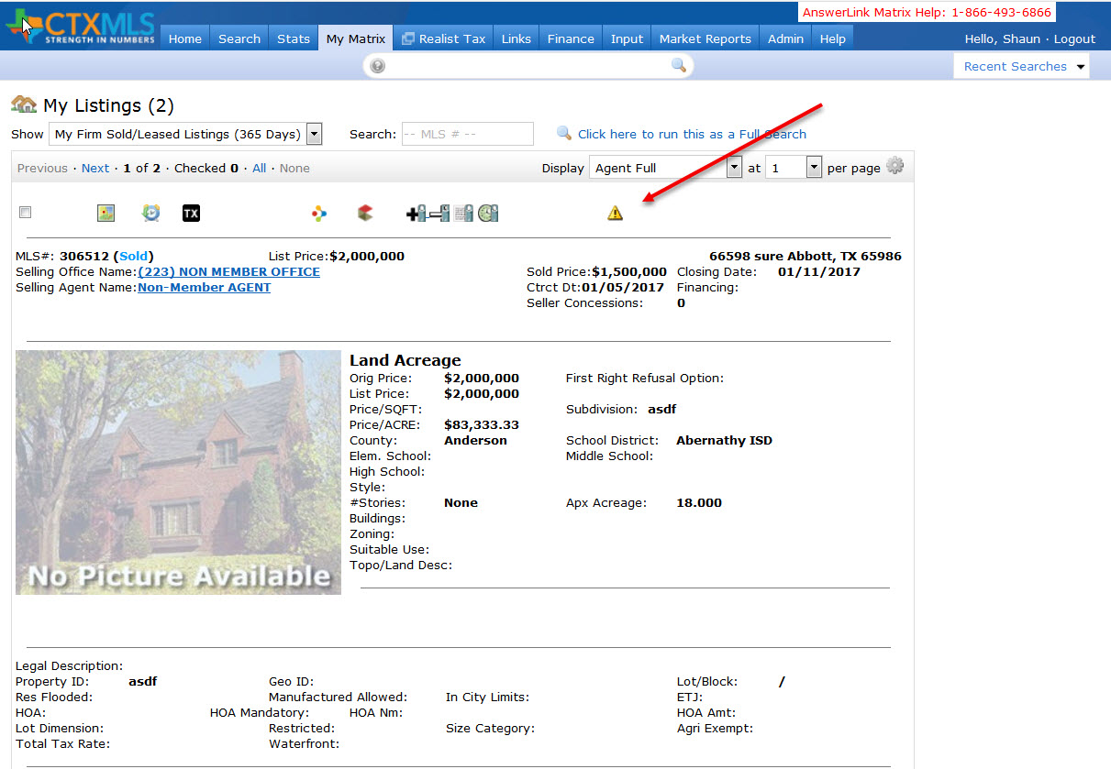
Report IT cont.

Slide 41
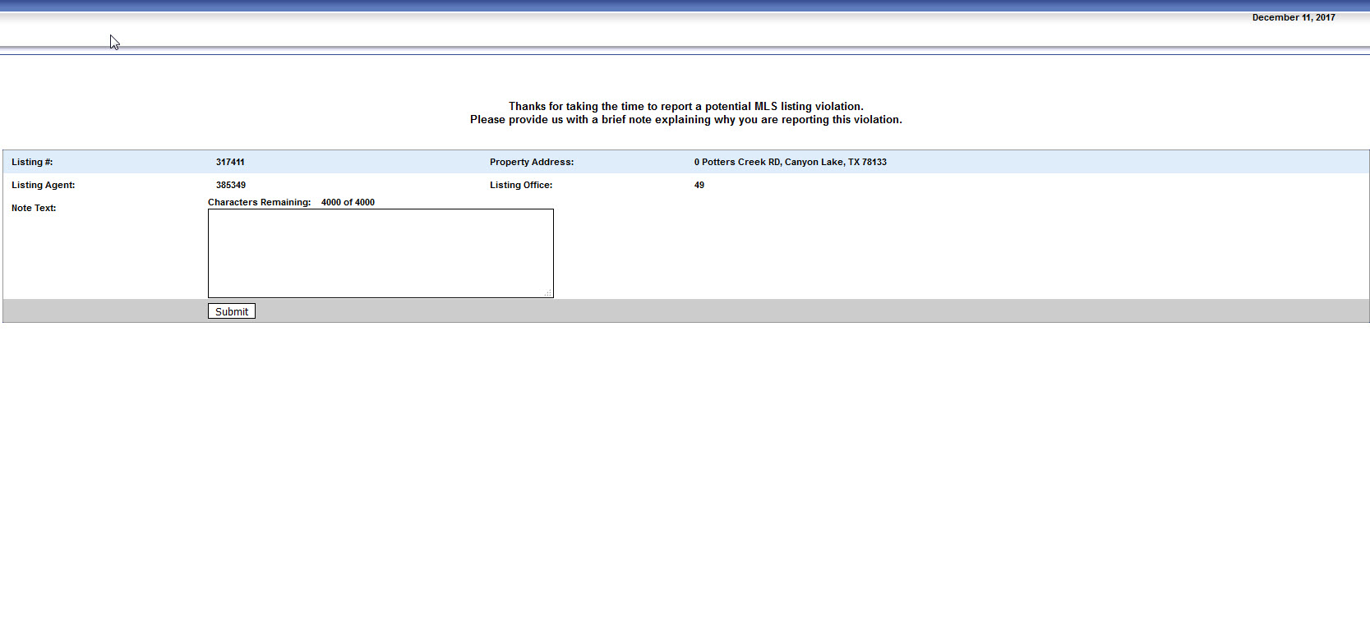
Report IT cont.
Notes:
Enter a short description of the compliance issue
All Report It’s are sent anonymously

Slide 42
Compliance Workflow
  Minor Offence:
    1st Warning – If you correct the listing no further action.
    2nd Warning – After 72 Hours a 2nd warning is sent to correct the listing.
    $100 Fine – 72 Hours after the 2nd warning it’s an automatic fine if not corrected.

Slide 43

Compliance Workflow cont.
Serious Offence:
  No warnings
  Automatic $100 Fine
  Allowing a listing to expire without changing the status to Sold
  Branded Photos
  Duplicating listings within the same property type

Slide 44
Compliance Workflow cont.
Egregious Offense:
  No Warning
  Automatic $1000 fine
  Sharing Password or Login
  Failure to provide Listing Agreement within 48 of request
  Failure to correct any of the mentioned compliance issues

Slide 45
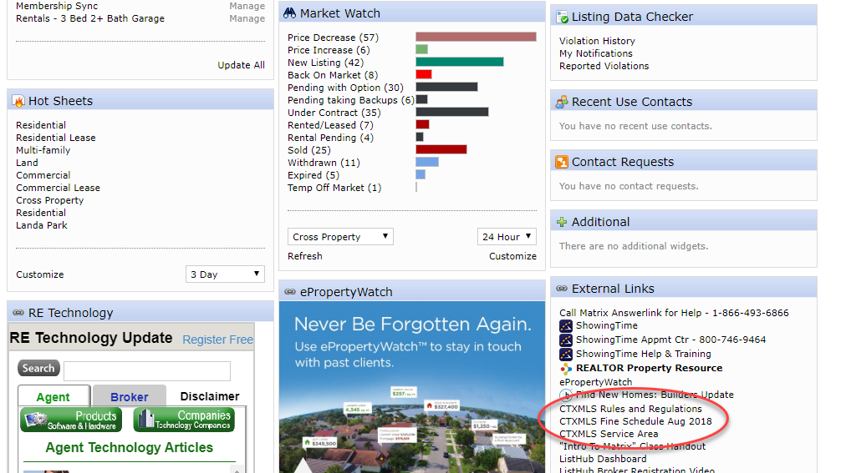
Notes:
Listings Rules, Fine Schedule, and coverage area can me found on the home page under External Links

Slide 46
Lunch
30 Minutes

Slide 47
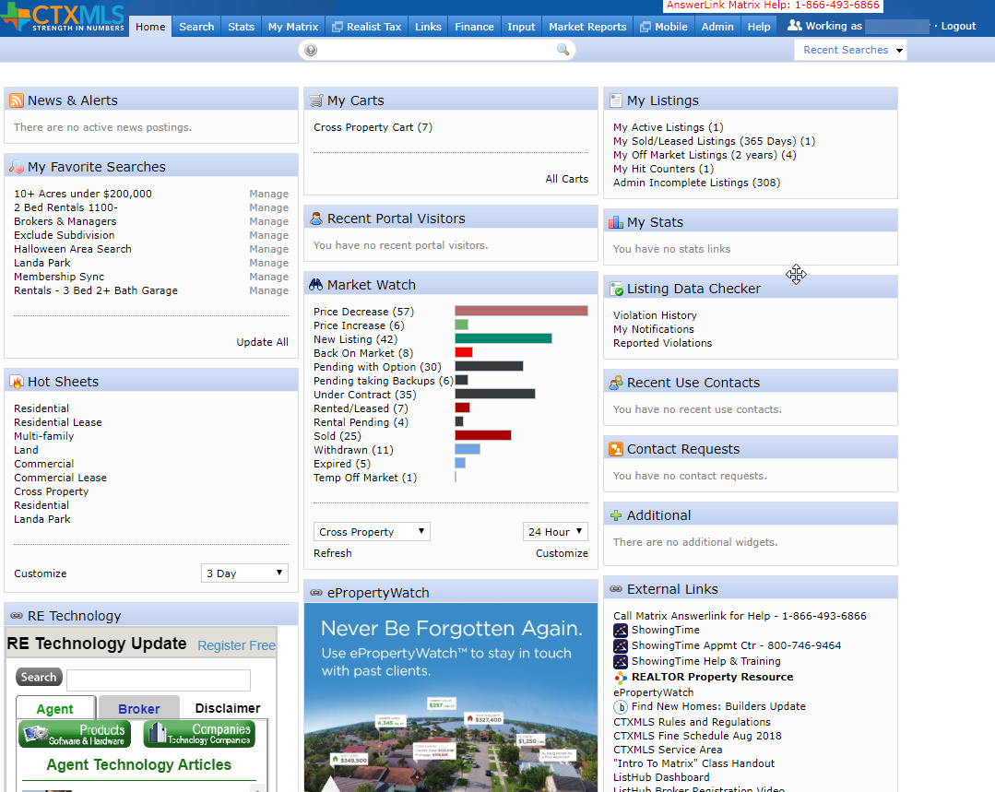

Matrix

Slide 48
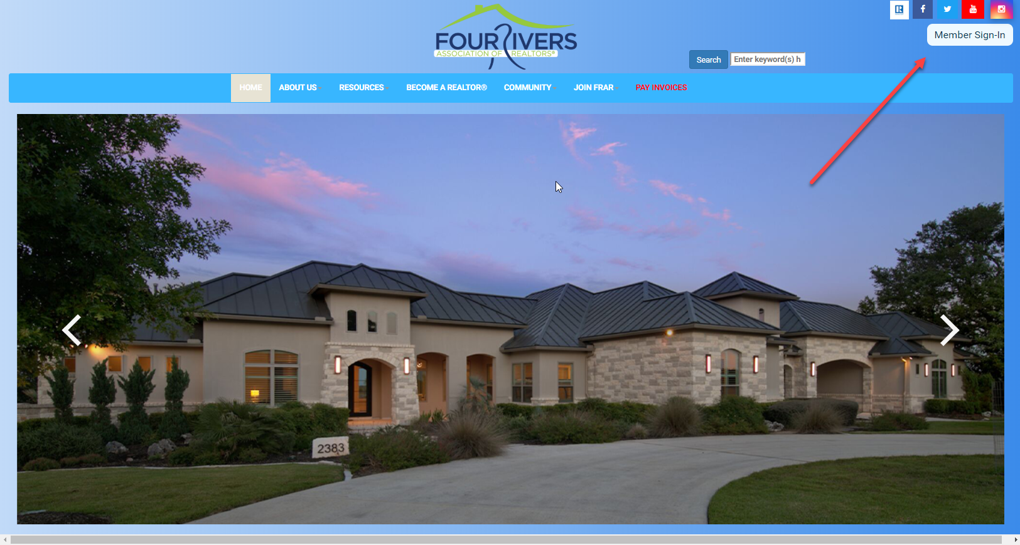
Matrix Cont.
Access via Fourriversrealtors.com from your Member Dashboard

Slide 49
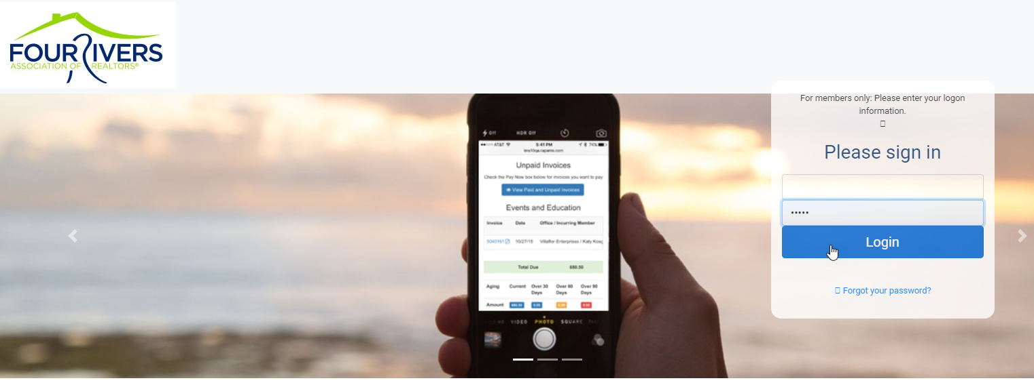

Slide 50

Click CTXMLS button on your member dashboard to access Matrix

Slide 51
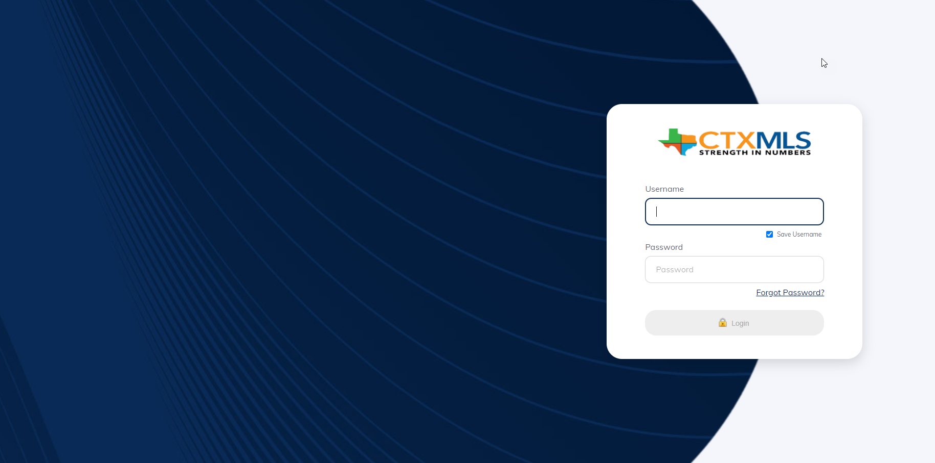
Click CTXMLS button on your member dashboard to access Matrix

Slide 52
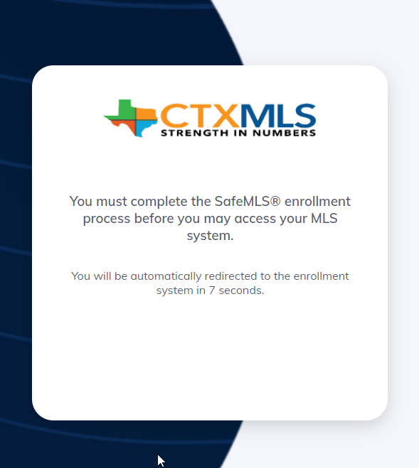
Click CTXMLS button on your member dashboard to access Matrix

Slide 53
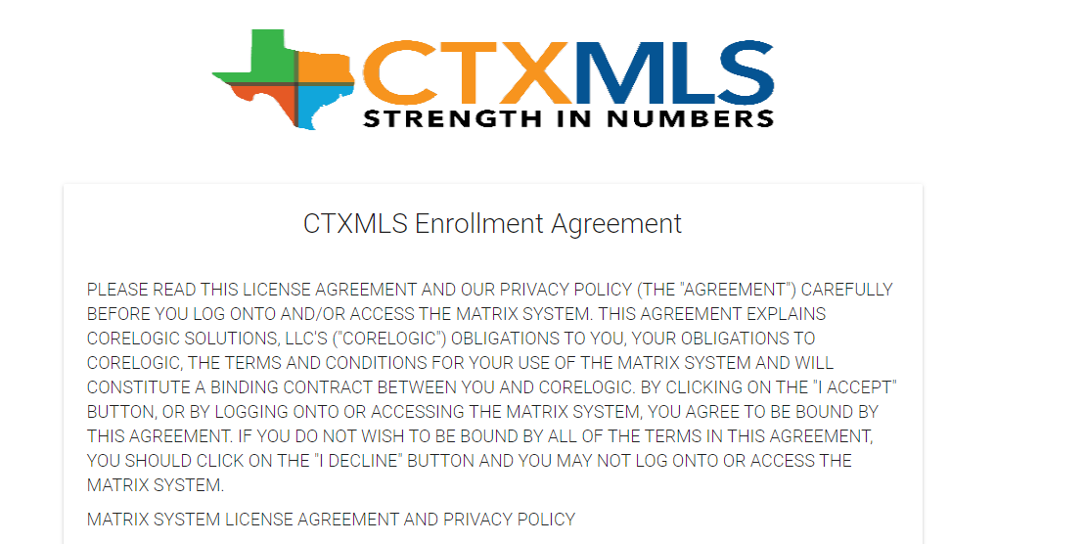
Click CTXMLS button on your member dashboard to access Matrix

Slide 54
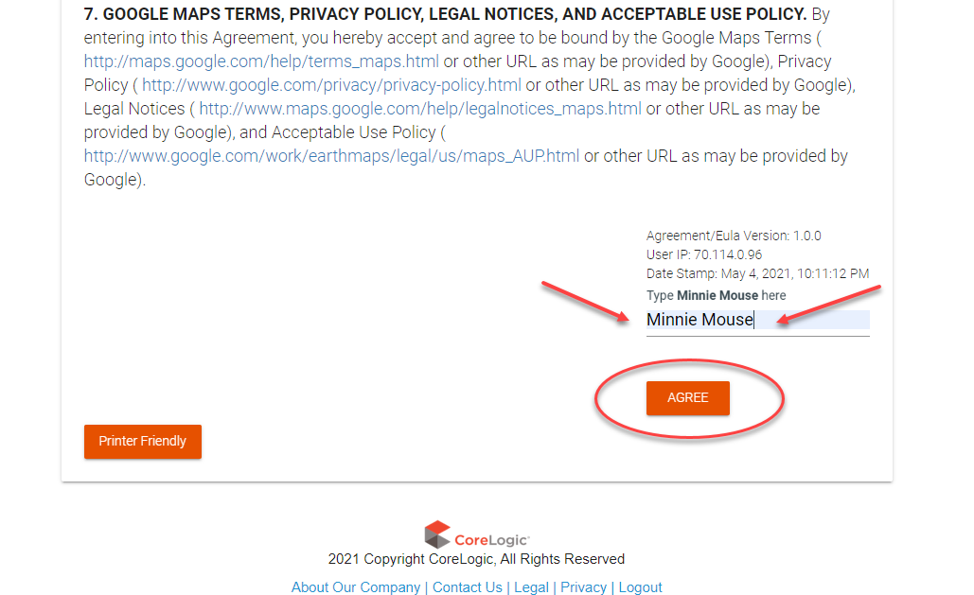
Click CTXMLS button on your member dashboard to access Matrix

Slide 55
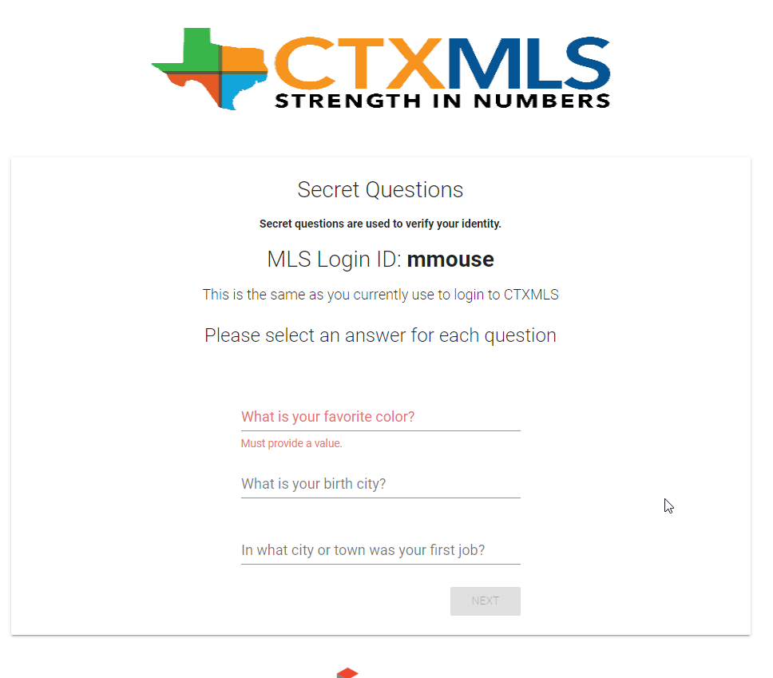
Click CTXMLS button on your member dashboard to access Matrix

Slide 56
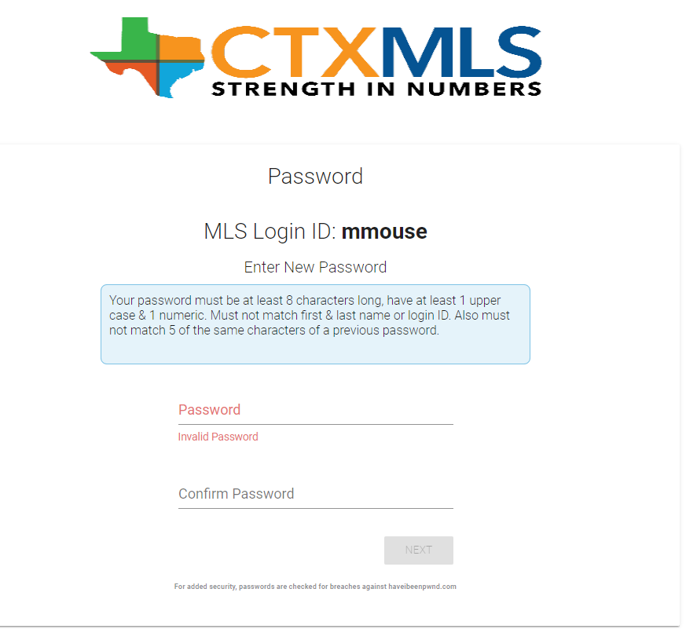
Click CTXMLS button on your member dashboard to access Matrix

Slide 57
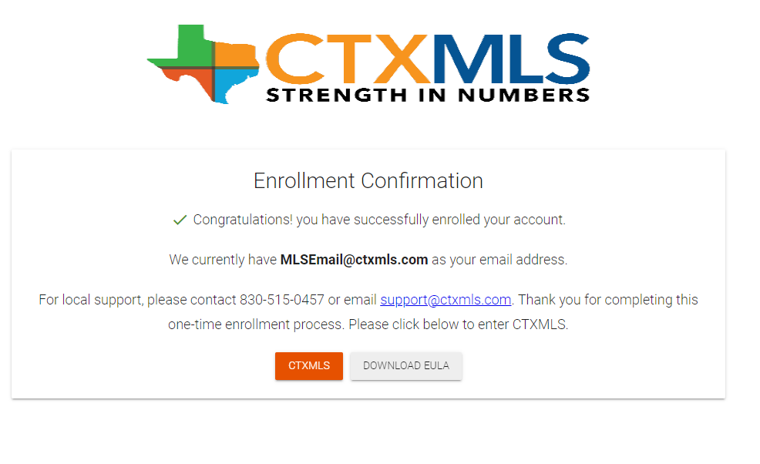
Click CTXMLS button on your member dashboard to access Matrix

Slide 58
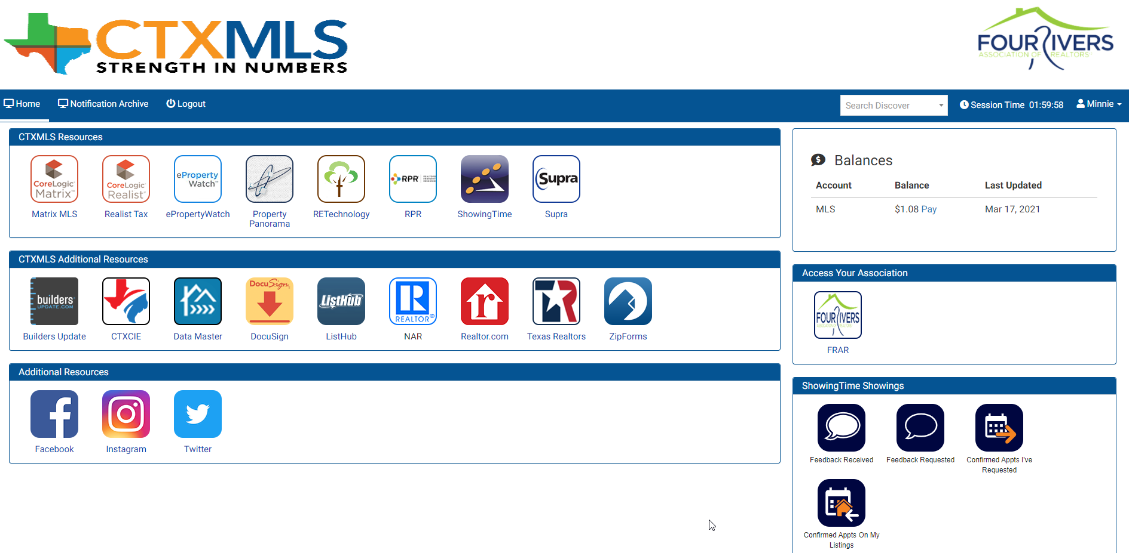
Click CTXMLS button on your member dashboard to access Matrix

Slide 59
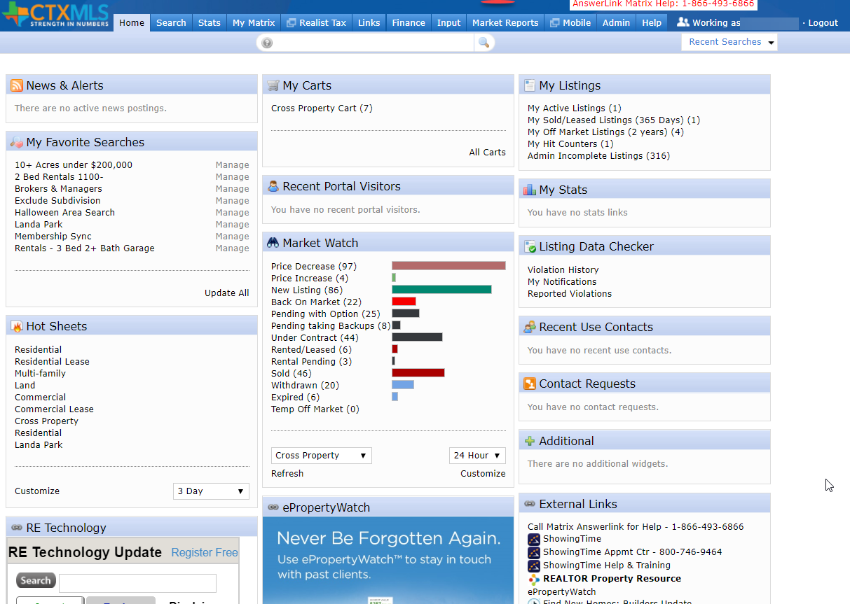
Matrix Home Page

Slide 60
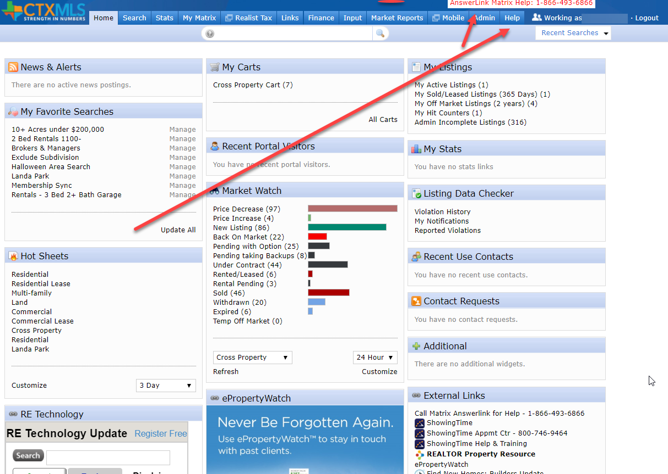
Help found under Help Tab or Answerlink
Notes:
Help can be found under the Help Tab or Four Rivers Staff or by calling Answerlink. NOTE: Answerlink is best as last resort or after hours.

Slide 61
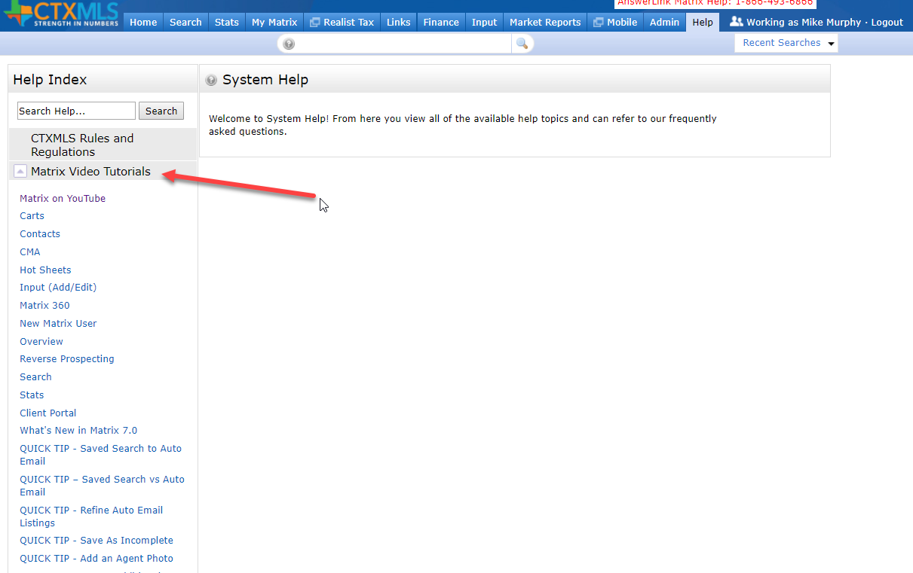
Video Tutorials found under Help Tab

Slide 62
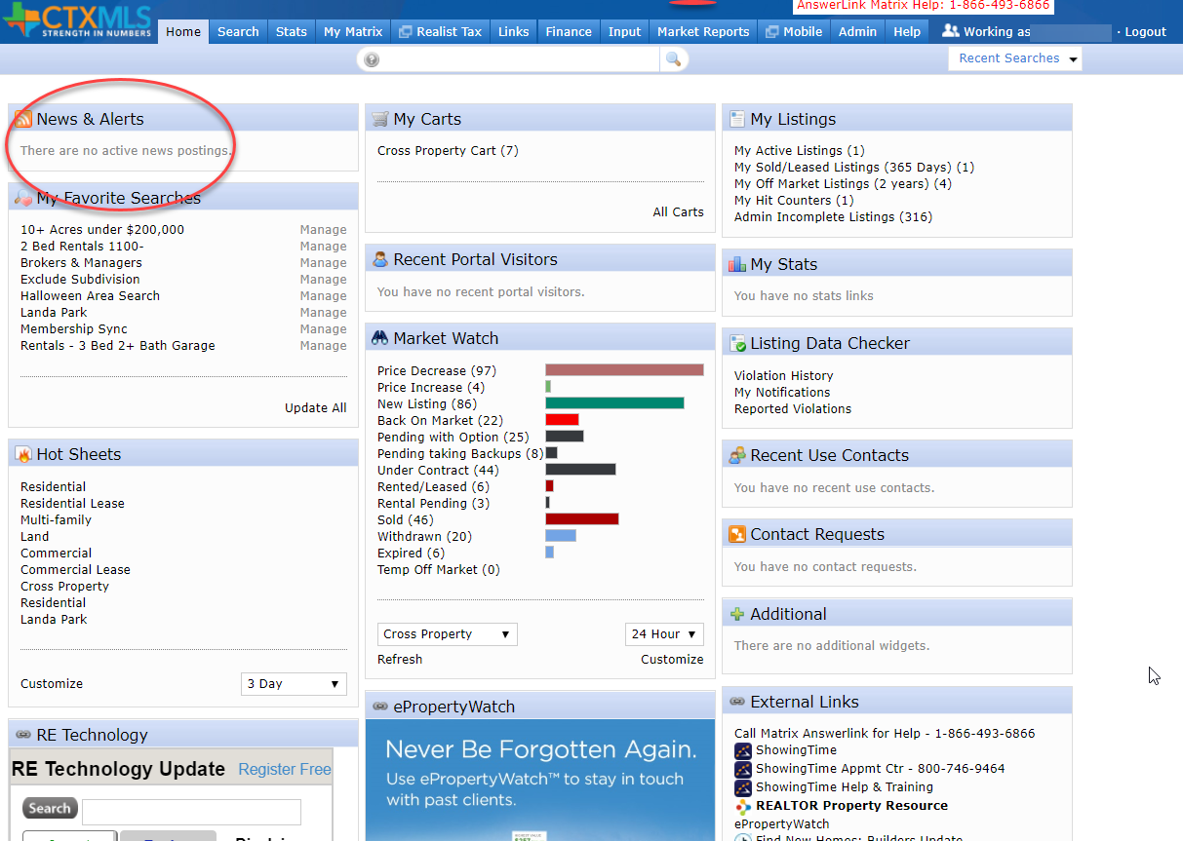

News & Alerts

Slide 63

Learning Center
On Members Home Page

Slide 64
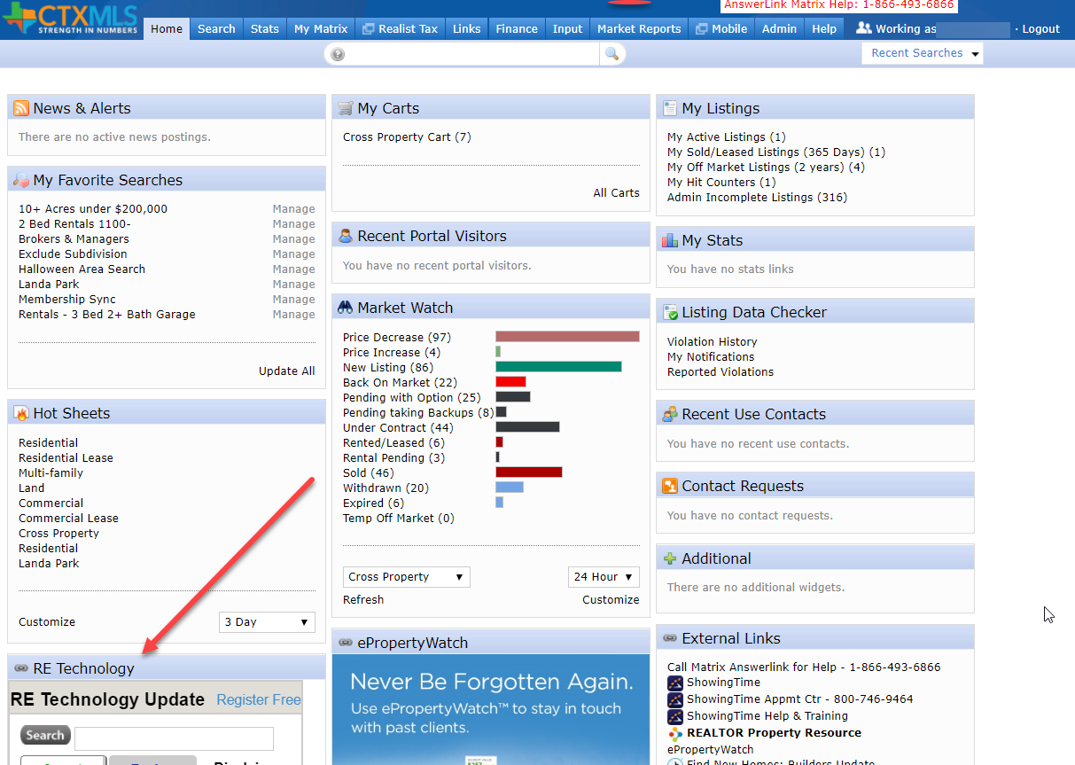
RE Technology
Industry News & Updates

Slide 65

RE Technology cont.

Slide 66


E Property Watch

Slide 67
E Property Watch cont.
This is a web and email service that brands your contact info and sends market and neighborhood updates to your clients
Electronic version of branded notepads and calendars
Keeps clients informed on home sales in their neighborhood

Slide 68
Did you know You can Farm using Public Records Search in Matrix?
No need to search in a separate Realist platform
Farm Neighborhoods directly in Matrix
Print Mailing labels

Slide 69
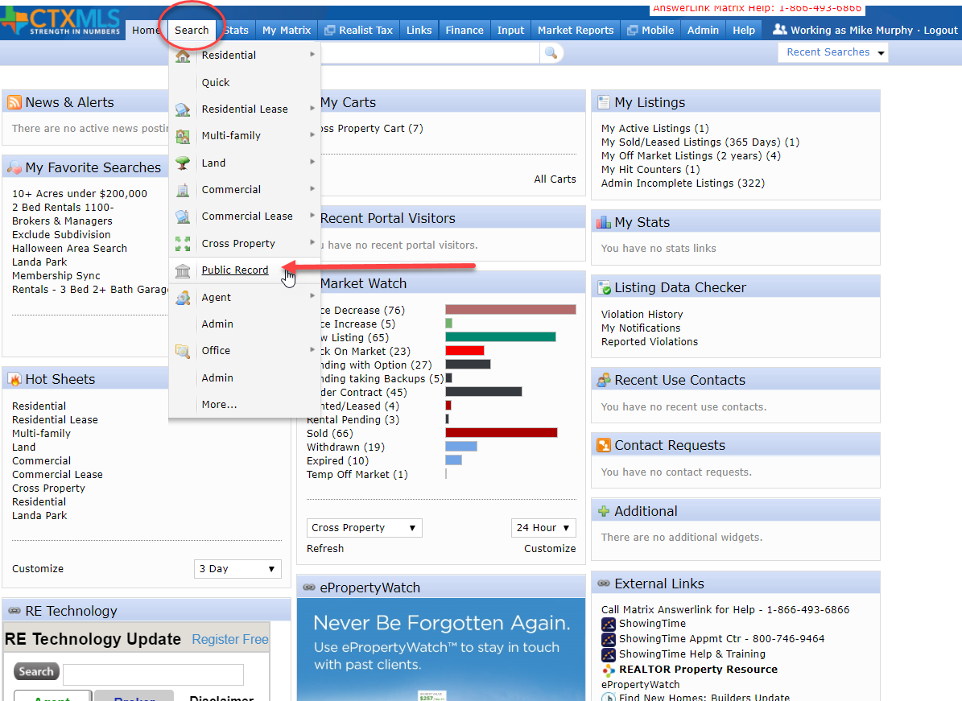
Public Records Search in Matrix cont.
Notes:
Click Search > Public Record

Slide 70
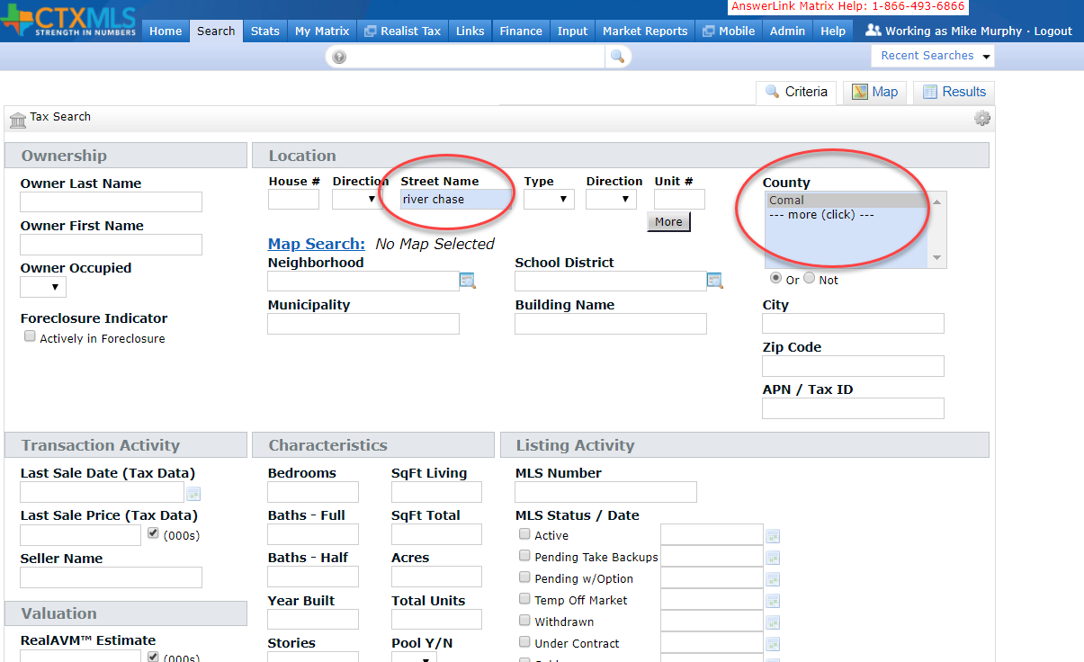
Public Records Search in Matrix cont.
Notes:
Street Name – River Chase
County – Comal
Click Results

Slide 71
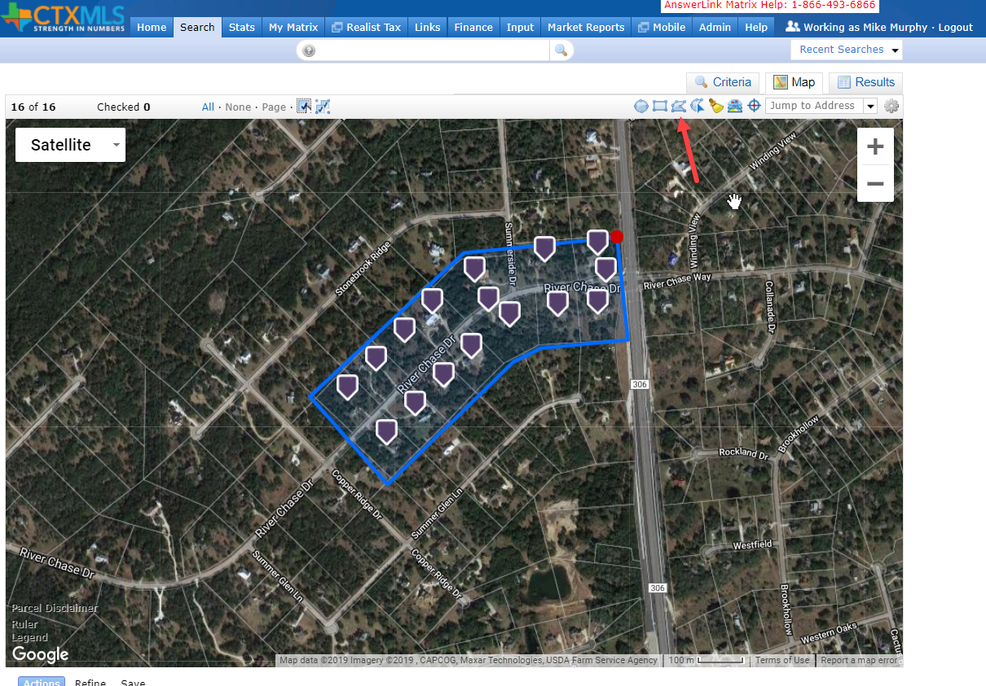
Public Records Search in Matrix cont.
Notes:
On the results, click Polygon icon to draw a polygon
Trace Neighborhood
Be sure to click on start point to close the polygon
Click Results

Slide 72
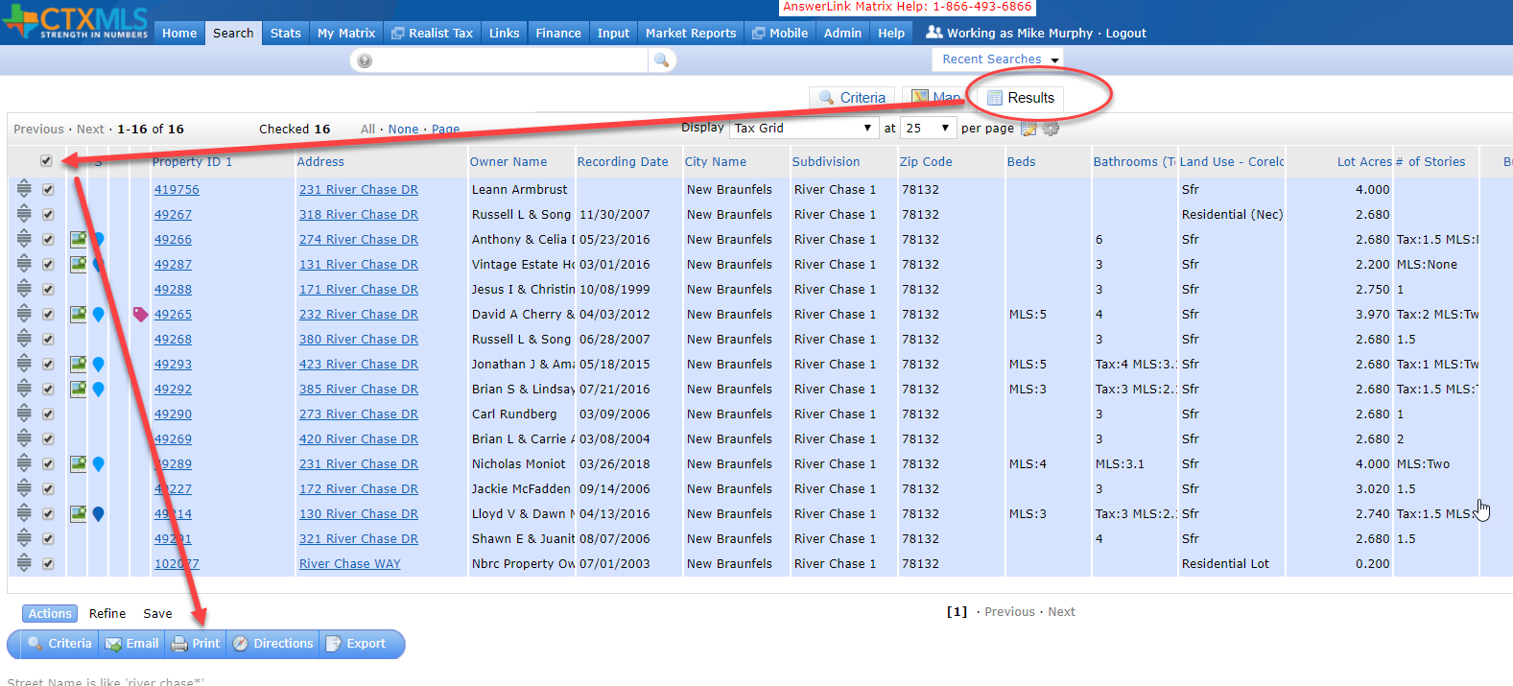
Public Records Search in Matrix cont.
Notes:
Click Results tab
Select the check box above results to select all results
Clcik the Print button on the bottom

Slide 73
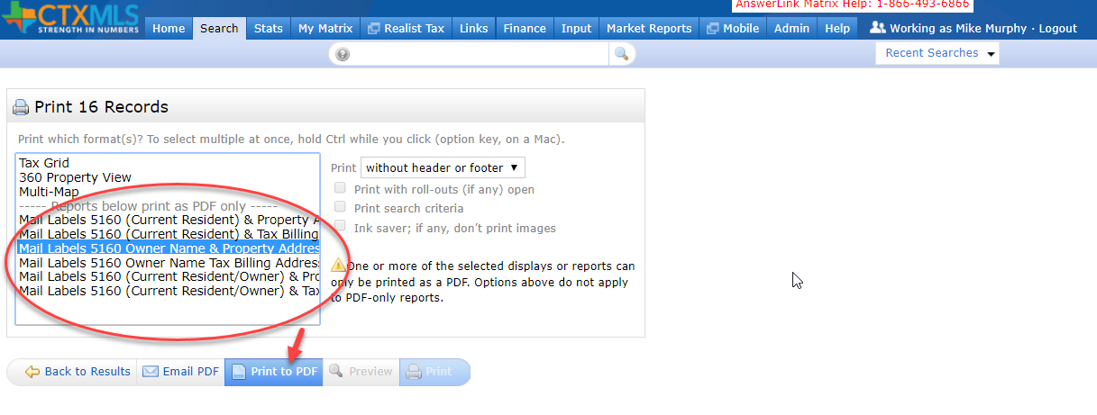
Public Records Search in Matrix cont.
Notes:
Select one of the Mail Label options
Click Print to PDF
Then print your mailing labels

Slide 74
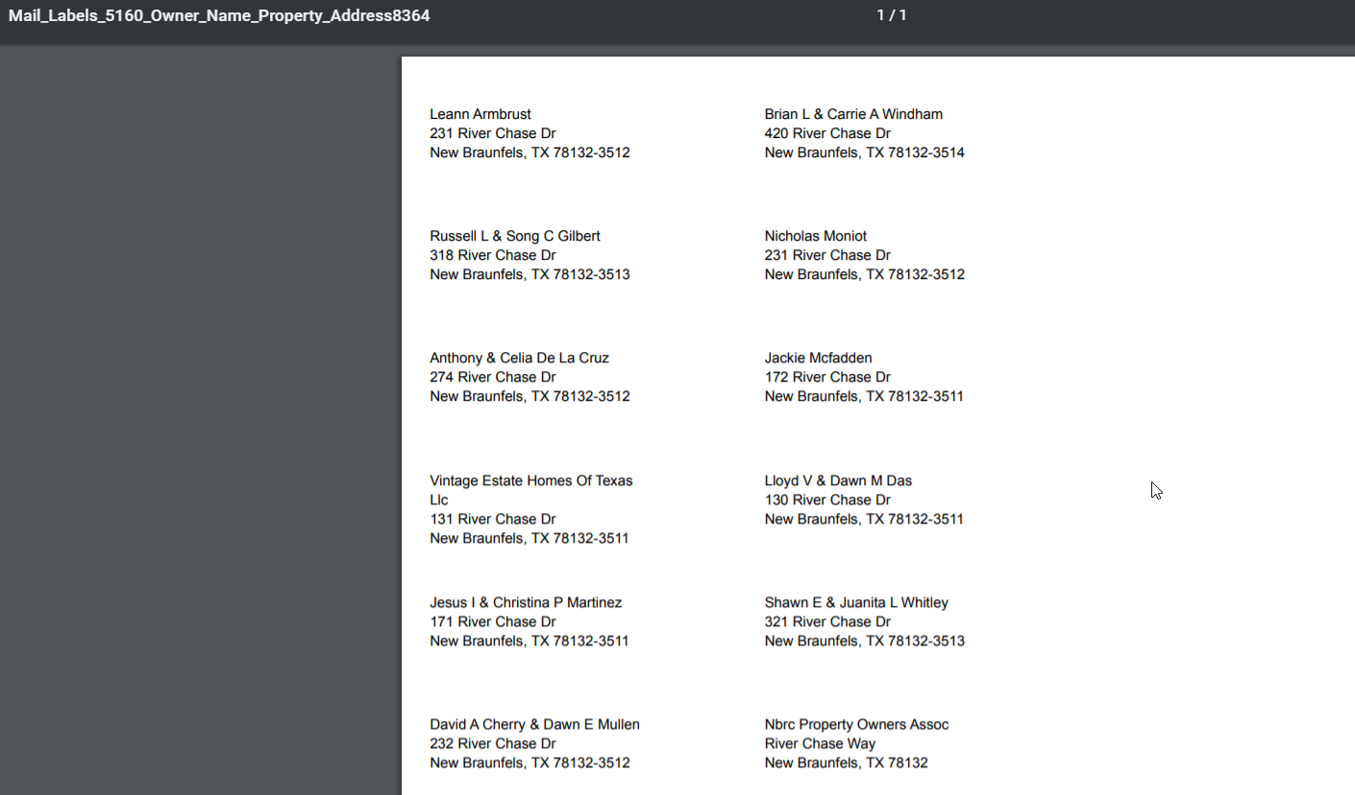
Public Records Search in Matrix cont.

Slide 75
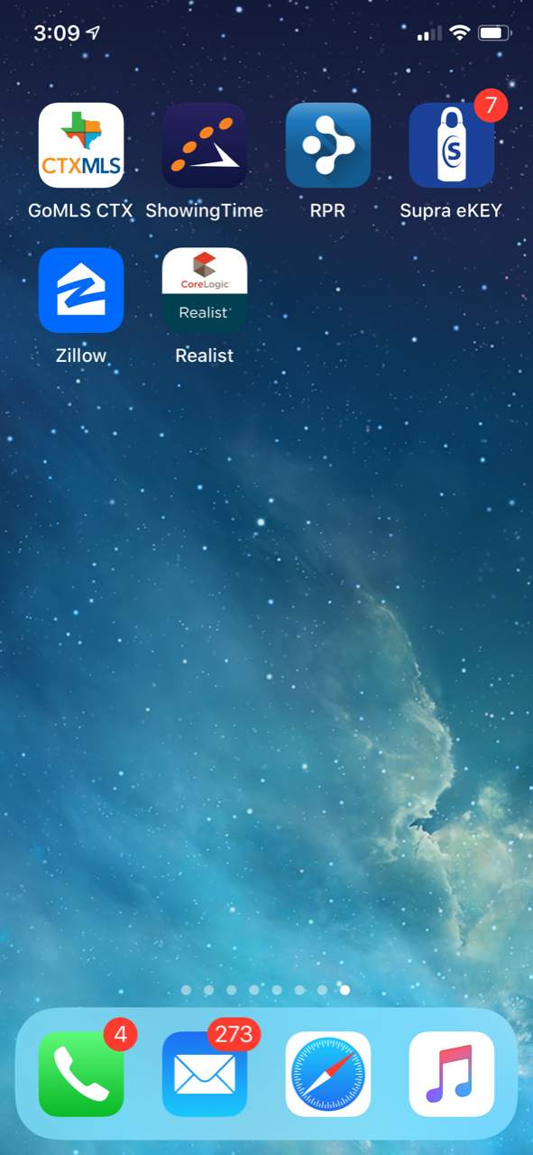
Mobile Apps

Slide 76
Free Mobile Apps
CTXMLS – GoMLS (Matrix Mobile)
ShowingTime
RPR – NAR National searches
Supra – Lockbox
Zillow

Slide 77


App Store search ctxmls
GoMLS: CTxMLS
Matrix Listings
Matrix Contacts
Branded with your info
Can be shared with clients
Agent sees active, sold, All
Clients only see Active List

Slide 78


ShowingTime
Schedule Showings
Receive notifications
Text or Email
Chat direct with List Agent
Running behind
Delay Appmts 15 minutes

Slide 79


RPR (REALTORS® Property Resource )
Nation Search All MLS’
Nice Reports
Nice Display
Easy to use
Agent Only App
Free with NAR Membership

Slide 80


Slide 81

Supra
Bluetooth to open lockbox
Chat
Flashlight
ALERT – Will call contact emergency alert.
FRAR CoOp with CTXMLS
San Antonio and Austin

Slide 82
Zillow
Easy Search
Household name clients use this
Nice UI
Adding Search by Brand or appliance, etc
Search Viking stove
Adding 360 video

Slide 83


Zillow Cont.

Slide 84
Intro to Matrix
Selena Medina

Slide 85
Break time
5 Minutes

Slide 86

FRAR Committee Descriptions:

Slide 87
Governmental Affairs: Passionate about politics? We are the Purple Party (The Real Estate Party) Members stay actively involved and monitor/take action on issues going on in our local areas and work in sub committees.
Scholarship: Support education and give back to the community by planning and hosting scholarship fundraisers, choose local student recipients for the program, and impact the lives of deserving families and students.
Professional Development: Coordinates/plans membership luncheons and important events (Market Forecast and REALTOR® Rally) to bring relevant content and knowledge to membership.
TREPAC: Awareness and PAC fundraising for the Texas Real Estate Political Action Committee) to support local and state REALTOR® Champions and communicate TREPAC success stories to Members and Property Owners.
FRAR MLS: Works to inform and education MLS Subscribers about how to use Matrix and CTXMLS Rules
& Regulations.
Professional Standards: Focus on education and training of professionalism, The Code of Ethics, and Standards of Practice with an emphasis on Broker Engagement.
NextGen: Built on aiding new member, 5 Years and Younger to the Real Estate Profession, through Lunch’n Learns, CE Classes, Panel discussions and community outreach projects. All REALTOR® Members welcome!

Slide 88
Three ways to make REALTOR® Trademark
REALTOR® should ALWAYS be CAPITALIZED, and trademark used when possible.
*Exception on some social media (Facebook Events and some publications)
Open parenthesis, letter R, closed parenthesis. (R)
ALT 0174
Special Characters in phone/mobile device

Slide 89

Why NAR Protects the REALTOR® Trademark

Slide 90


Slide 91


Slide 92


Slide 93


Slide 94
What is most important to remember as a NEW REALTOR®?
1. REALTOR® means = Member of NAR
2. REALTOR® only has 2 syllables (REAL-TOR)
3. REALTOR® should always be capitalized and followed by the trademark symbol when possible.
4. REALTOR® logo has design standards that should be followed when communicating to the public.
5. There should always be a comma between your name and the term REALTOR®, and that information should be followed by your brokerage information for a complete contact.

Slide 95

REALTOR® SAFTEY

Slide 96

Marketing & Communications

Slide 97

Communicate with frar
StaY up to date with what is going on
in your association, And in your
real estate profession!

Slide 98

FRAR Weekly Newsletter
Monday morning memo

Slide 99

FRAR Facebook: @facebook.com/fourriversaor

Slide 100

FRAR Twitter: twitter.com/fourriversaor

Slide 101

FRAR Instagram:
Instagram.com/fourriversaor

Slide 102

FRAR Texting Program
Toll free #:
1-844-336-3727
*Save to contacts
Text “FRAR" to:
1-844-336-3727 to Opt-In/Message
Important Alerts/Reminders
2-Way Connection

Slide 103
local member benefits
Member Loyalty Cards (Get Punched)
-Quarterly $100.00 drawing
-Annual Dues Drawing
Education Opportunities-
-18 Hrs. of Free Classes Annually
-Up to a 25% Discount on paid classes/Board Store Items
FRAR REALTOR® Kid Scholarship
Exclusive Supra eKey Reciprocity
2 Office Locations
$10 Luncheons/FREE Events
Leadership and Community Outreach

Slide 104

FRAR Website www.fourriversrealtors.com

Slide 105
I AM A REALTOR®
I Pledge Myself To strive to be honorable and to abide by the Golden Rule; To strive to serve well my community, and through it, my country; To abide by the REALTORS'® Code of Ethics and to strive to conform my conduct to its aspirational ideals; To act honestly in all real estate dealings; To protect the individual right of real estate ownership and to widen the opportunity to enjoy it; To seek better to represent my clients by building my knowledge and competence

Slide 106


Slide 107

Thank you for joining us today!
You will receive an email with a brief survey to give
us feedback on this class and all the information
and links to this presentation.
Picture Time!

